Slide 1
TIF: Guided Roundtable
"Discussing TIF Challenges & Solutions"
Sophie Adams
Matt Lorenzen
Chuck Arnold
Timothy Bishop
City of Albany
City of Wilsonville
City of Redmond
City of LaGrande

Slide 2
BASIC TIF MODEL

Slide 3
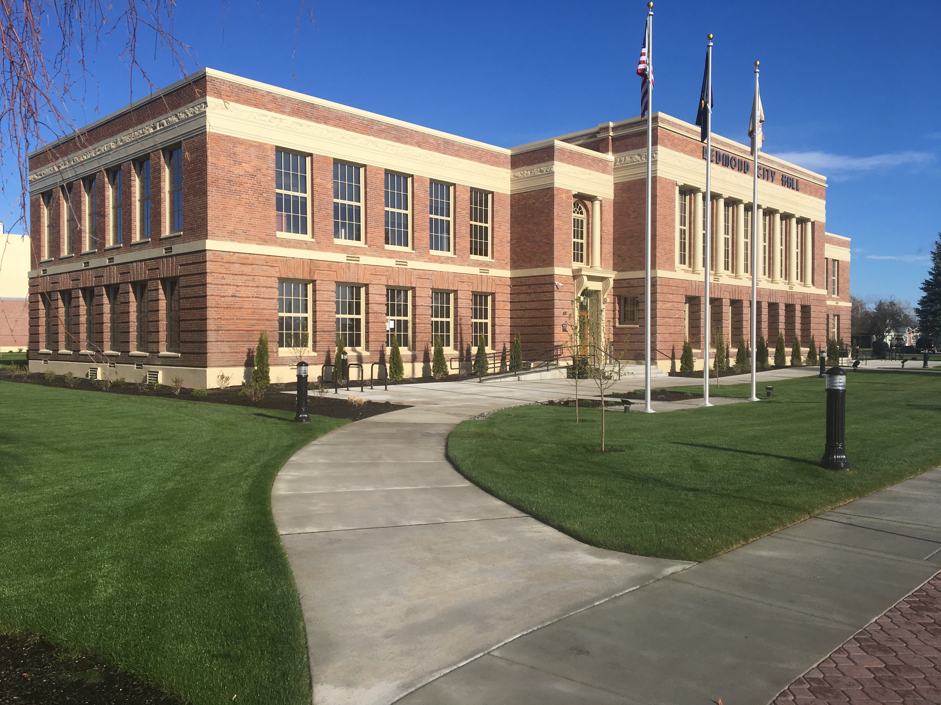
Topic 1 – Redmond Opportunity Case Study

Slide 4
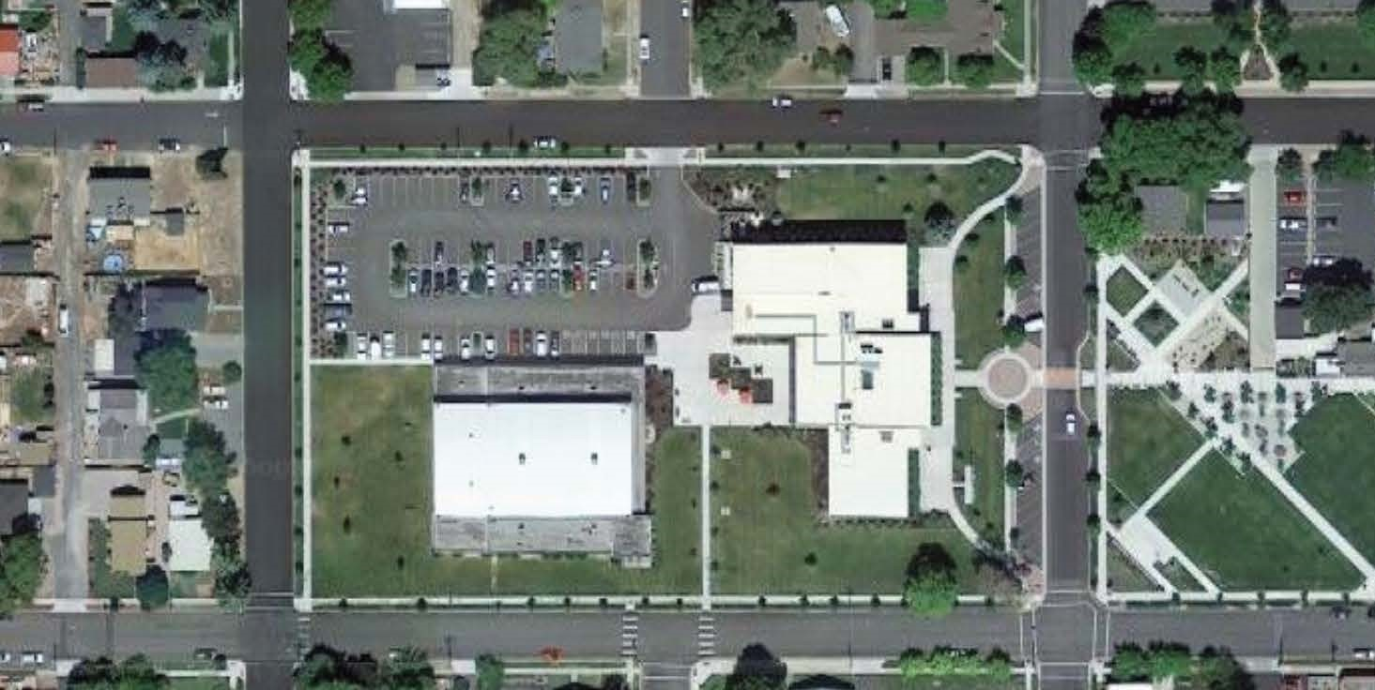
Topic 1 – Redmond Opportunity Case Study

Slide 5
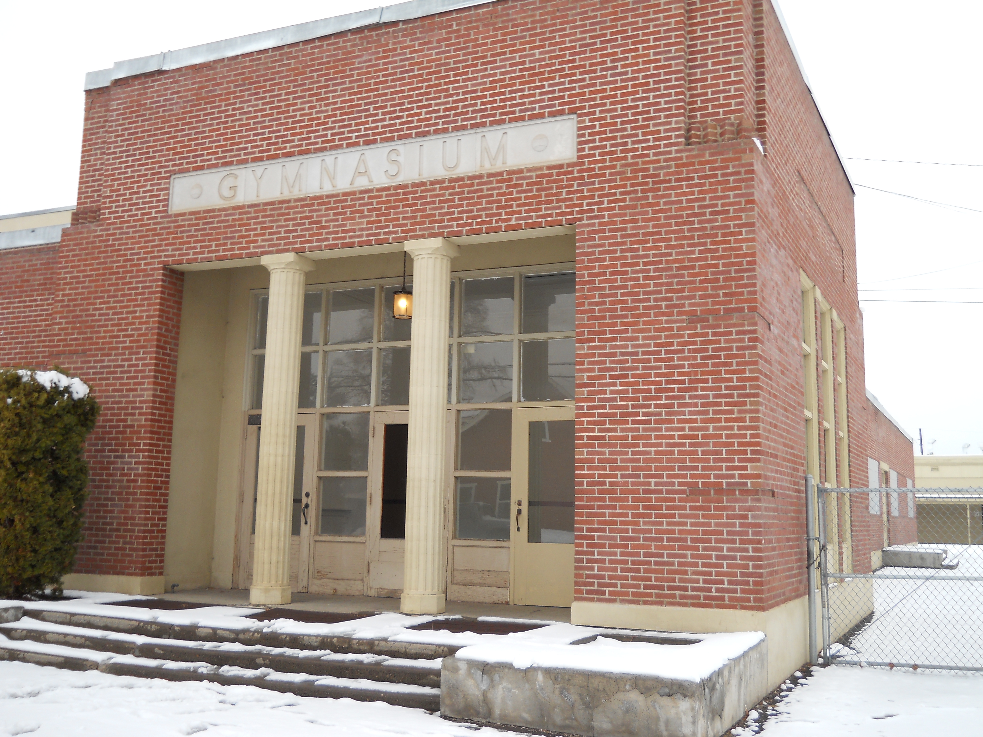
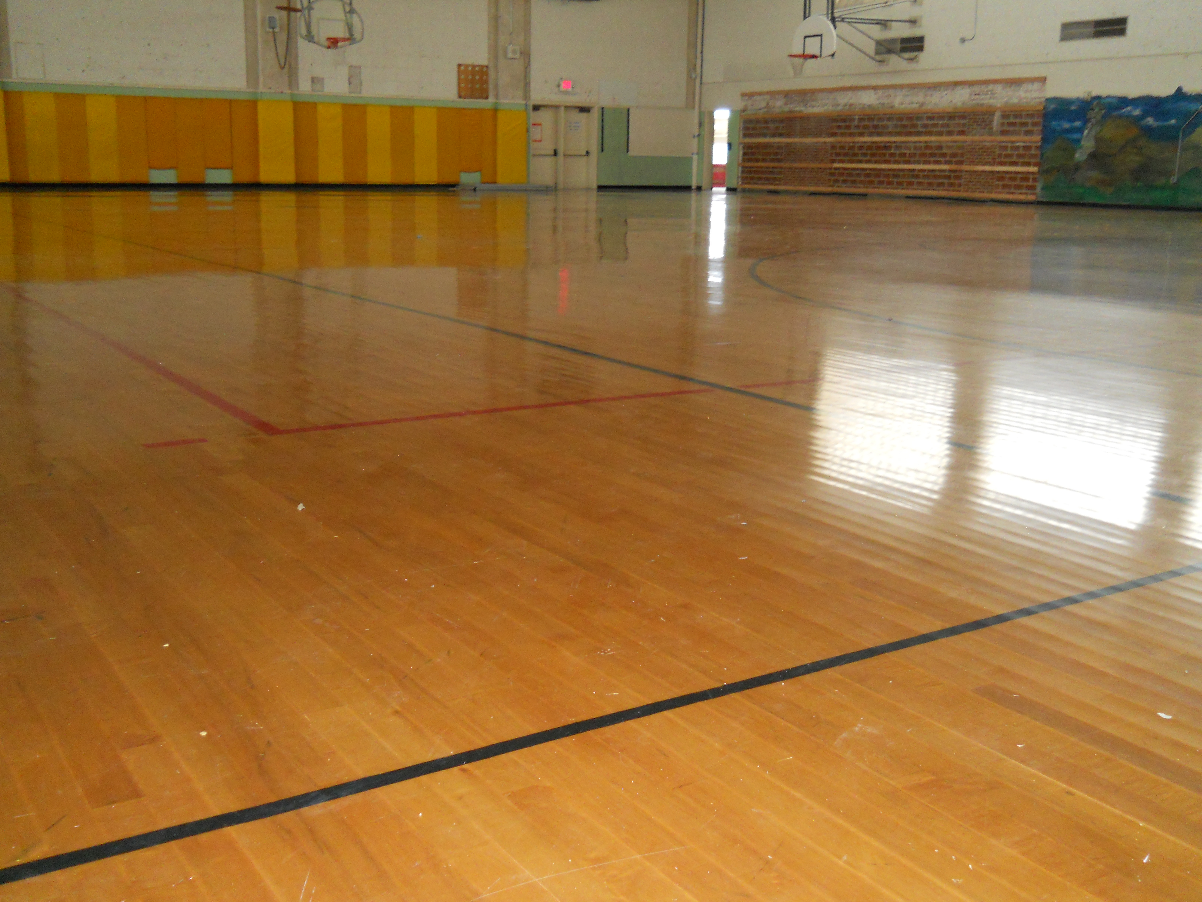
Topic 1 – Redmond Opportunity Case Study

Slide 6
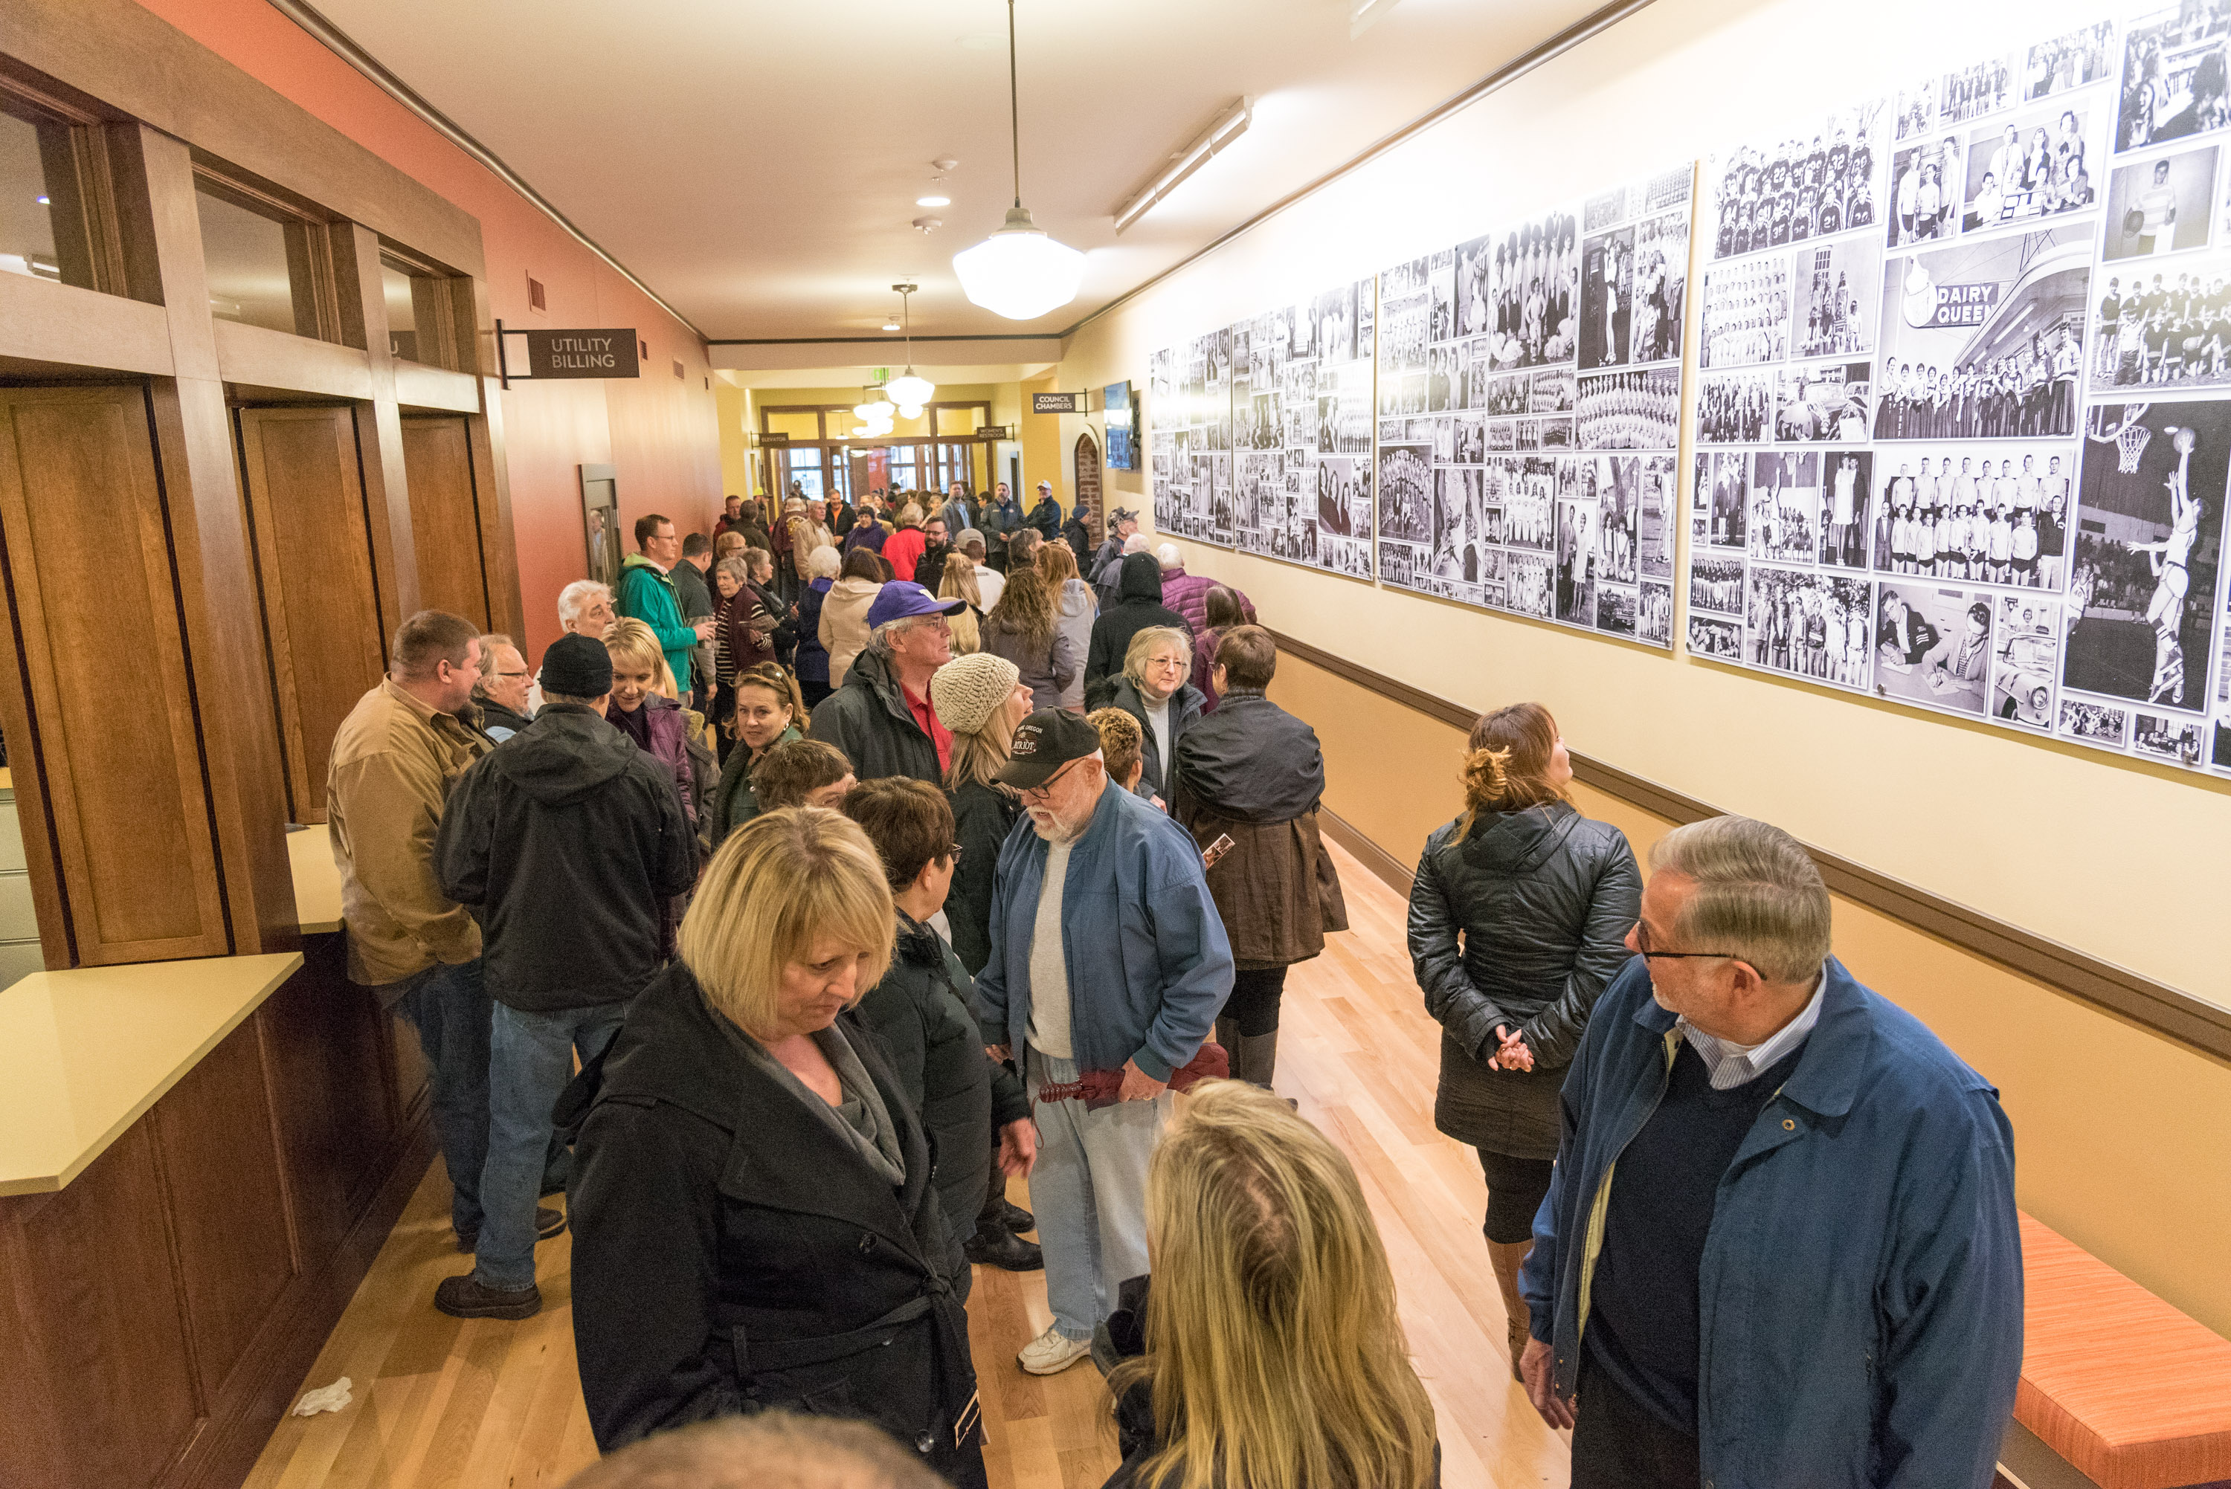
Topic 2 – How to Engage Overlapping Taxing Districts

Slide 7
Topic 3 – Room's Choice

Slide 8
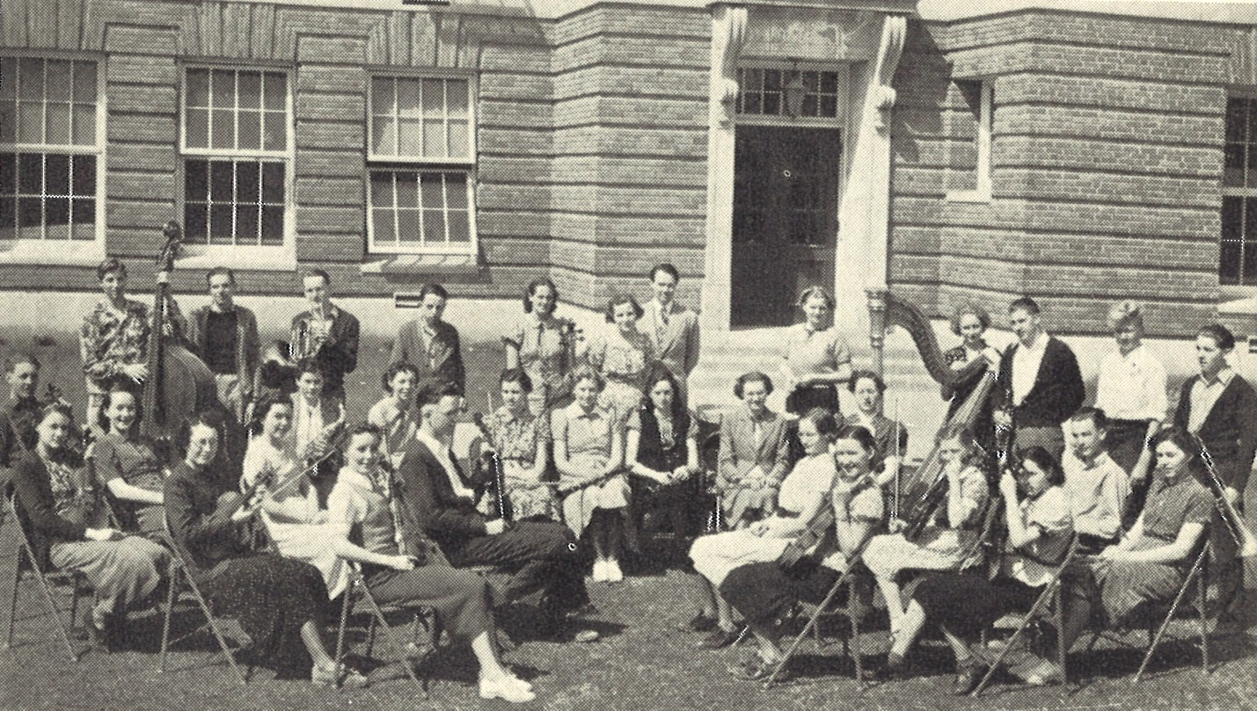
Topic 4 – Tips for Starting a TIF District

Slide 9
GET INVOLVED
TIF SUBCOMMITTEE
Tour Sites
Convene TIF Practitioners
Keep Best Practices Guide Current
Track Legislation
Operate As A Resource for Agencies

Slide 10
Thank You!
SPONSORS

