Slide 1
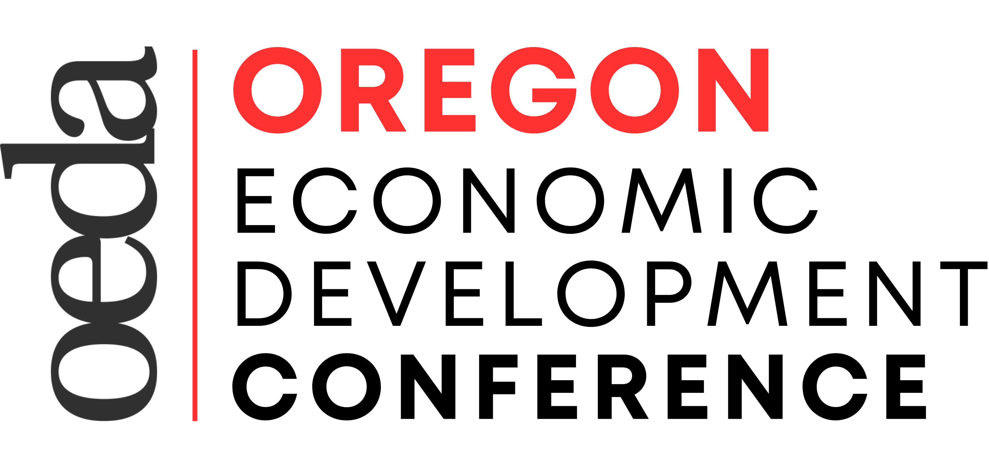
BREAKOUT B
“Outdoor Recreation Economy and Workforce Development in Oregon”

Slide 2
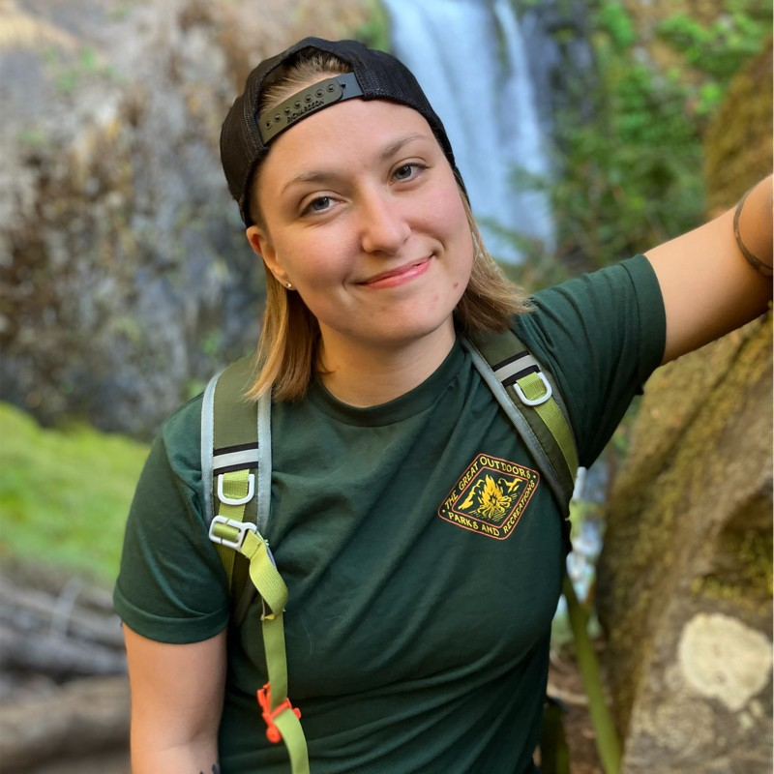
SPEAKERS
Kate Porsche
Nikki Cook
Interim Director
OSU CORE
Program Coordinator
OSU CORE

Slide 3
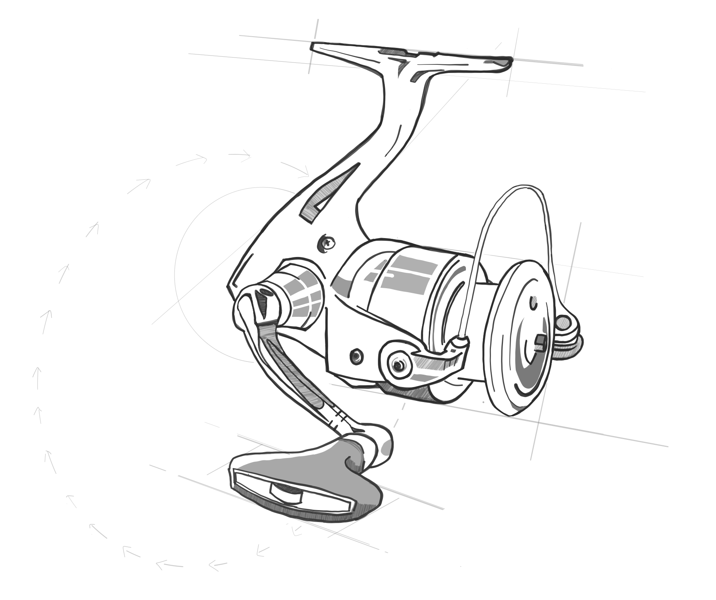
Kate Porsche, Interim Director
Center for the Outdoor Recreation Economy
kate.porsche@oregonstate.edu
Nikki Cook, Program Coordinator
Center for the Outdoor Recreation Economy
Nikki.cook@oregonstate.edu
Notes:
Hello, I’m Kate Porsche, and honored to serve as interim director for OSU’s Center for the Outdoor recreation Economy.
Nikki Introduction

Slide 4
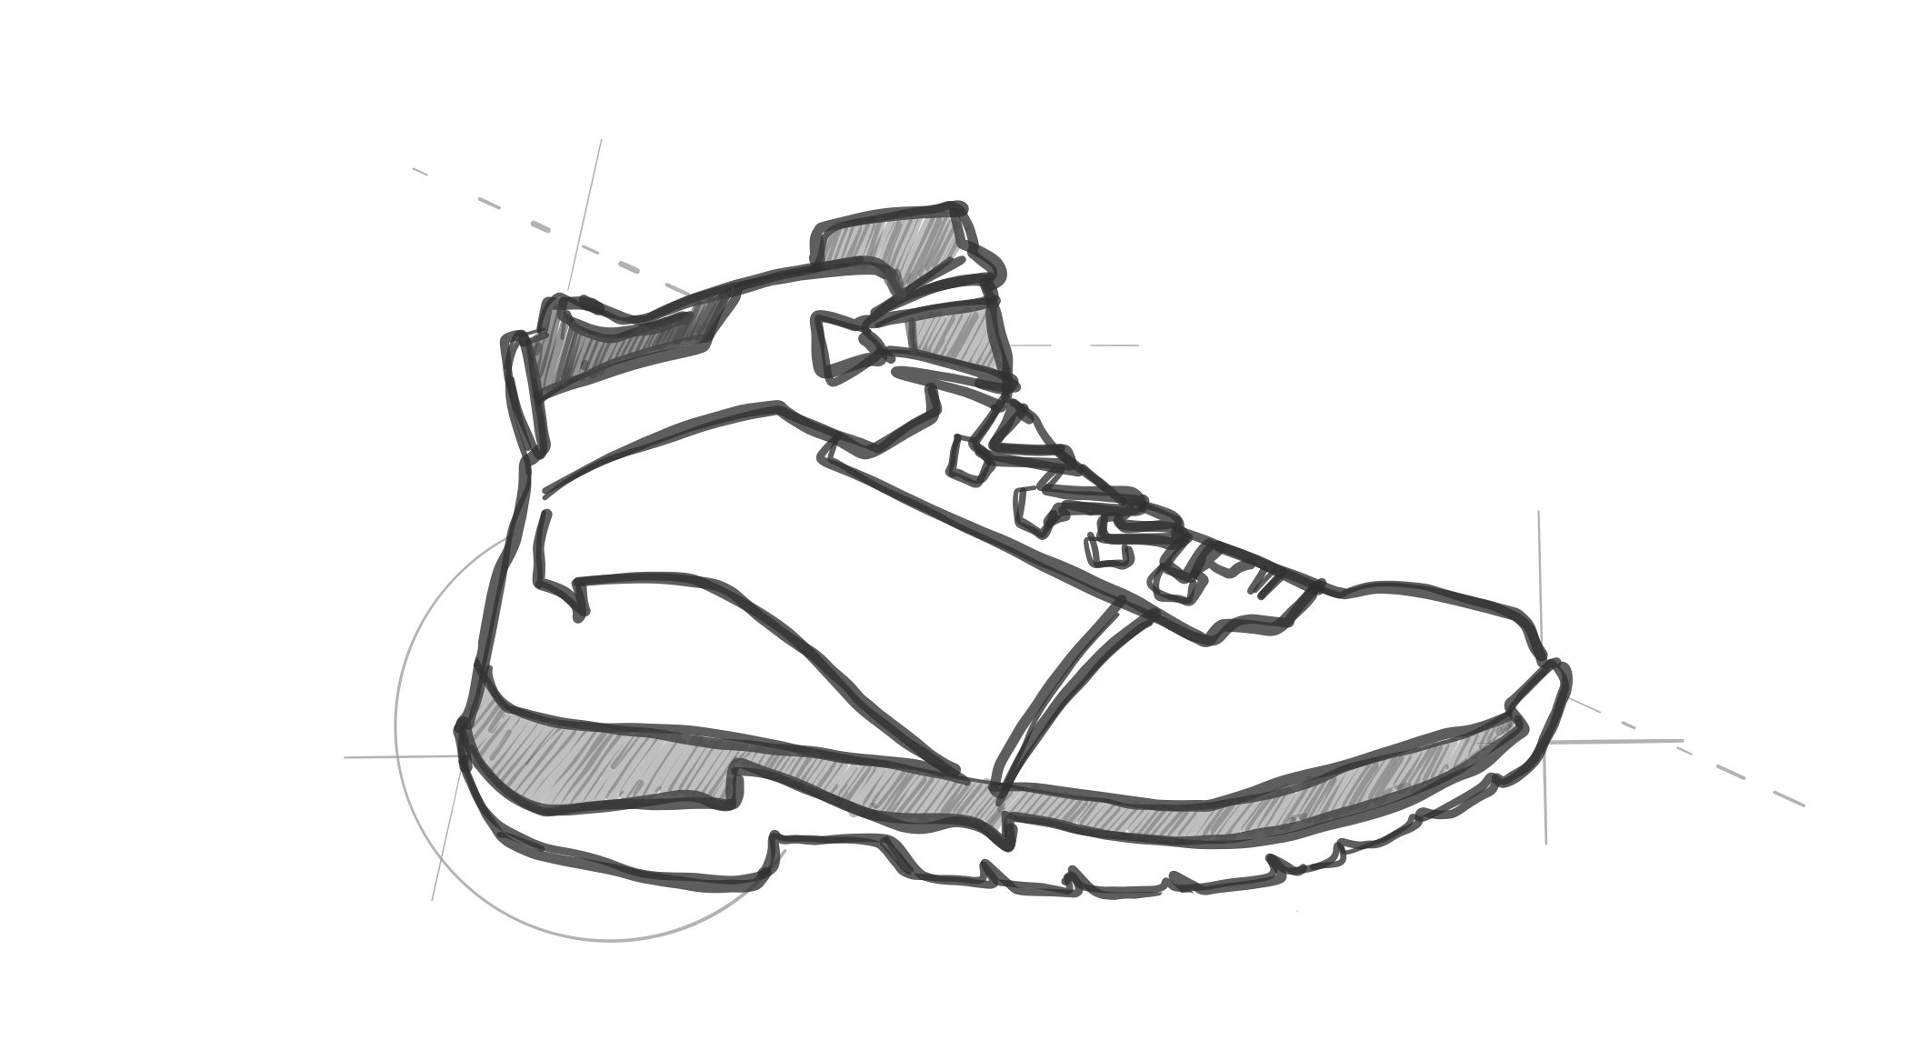
Learning Outcomes
Share how we define the Outdoor Rec Economy
Highlight researched workforce needs
Discuss higher education’s role in workforce development solutions
Explore work being done in specific sectors
Notes:
KATE

Slide 5
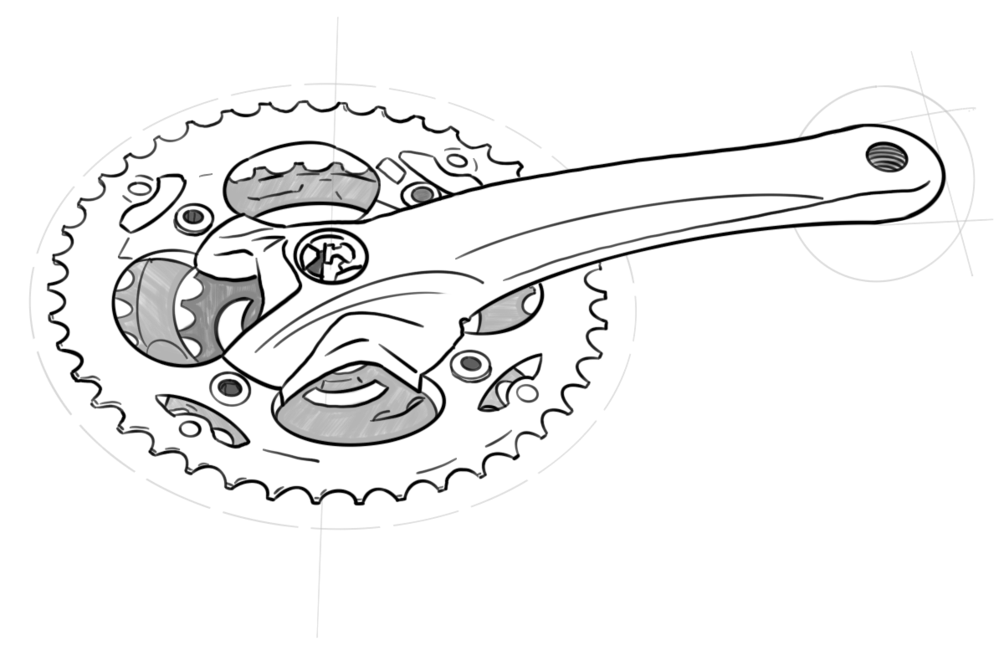
WHAT IS THE OUTDOOR RECREATION ECONOMY?
Notes:
KATE
When people think about rec economy, they often think about the front-line folks they interact with – people at REI, a fishing guide, or park ranger, but there’s so much more to the rec economy.

Slide 6
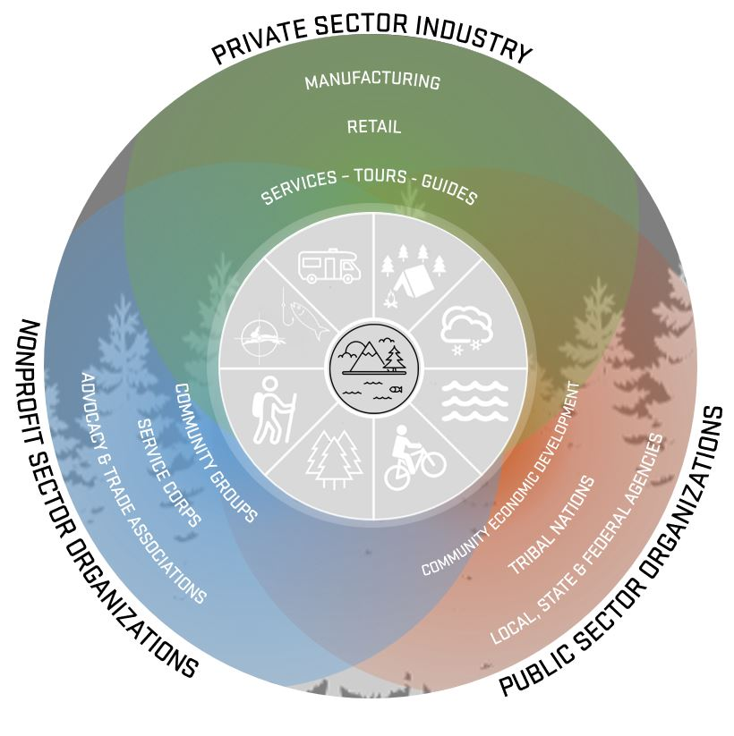
WHAT IS THE OUTDOOR RECREATION ECONOMY?
Notes:
KATE
Different organizations and breath of representation
Manufacturers like Ruff Wear or Hydroflask in Bend, Keen or even Leatherman.
Public Sector:
Community and ED organizations
Tribal nations
Local, state and federal agencies
Non-profits:
Community and service groups/advocacy and trade organizations
Oregon Trails Alliance
Or our partnership with ORR – the nations leading coalition of outdoor rec trade associations

Slide 7
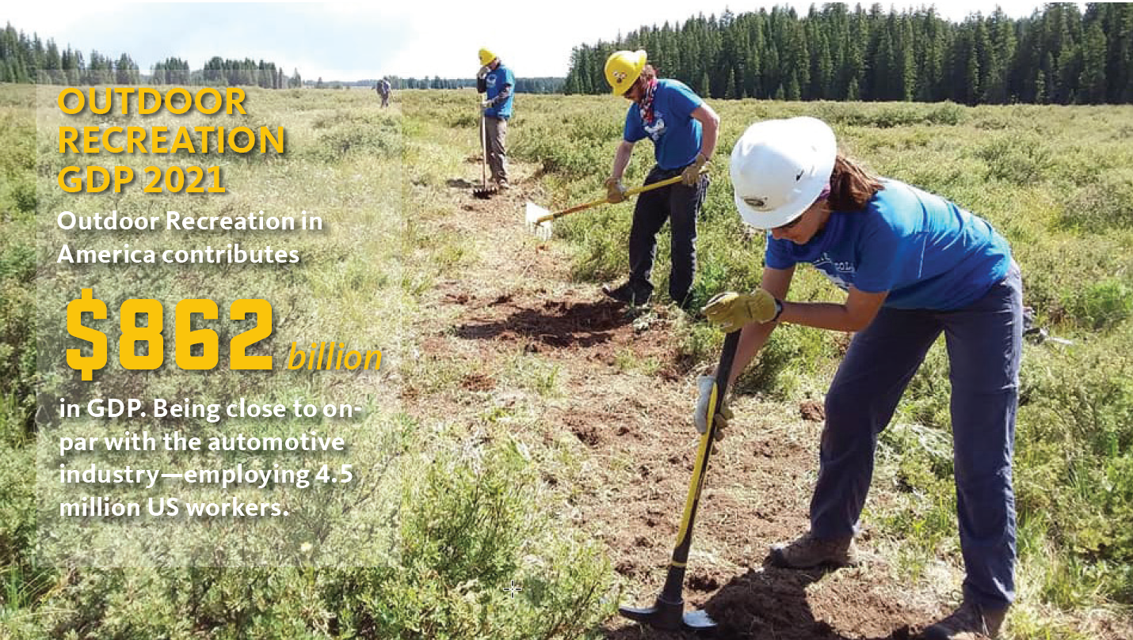
OUTDOOR RECREATION ECONOMY IMPACT

Slide 8
The Center for the Outdoor Recreation Economy provides workforce development solutions that support the outdoor recreation economy in reaching its full potential.
OSU
NEXT GENERATION OF THE OUTDOOR WORKFORCE
5.2 MILLION JOBS
IN AN INDUSTRY
COMPRISING 2.1% GDP
Pathways to New and Better Jobs
SUPPLY
DEMAND
WHAT IS THE OUTDOOR RECREATION ECONOMY?
Notes:
Taking you back to your ECON101 class and talk about supply and demand
5.2 million jobs in an industry comprising 2.1% of the GDP
nearly double that of the Pharmaceutical Industry and
close to on-par with the automotive industry.
We’re talking about an economy that employs 4.5Million US workers
Let’s put that another way CLICK:
ONE kid in every classroom in America will be working in the outdoor economy
– and yet we don’t have clear educational pathways to help them get these jobs or a clear focus on workforce development. CLICK and CLICK
CORE is here to be a part of the solution in Oregon and across the nation.
Worth mentioning that more and more
People are looking for meaningful jobs; and for many, they find meaning in the outdoors
ORE can provide that meaningful work, authentic connections to the outdoors, and help local economies at the same time.

Slide 9
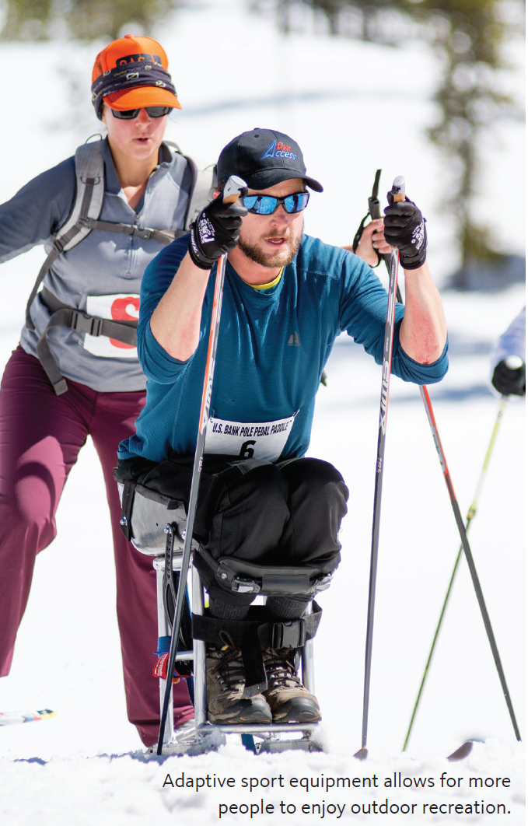
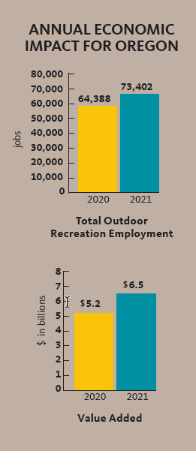
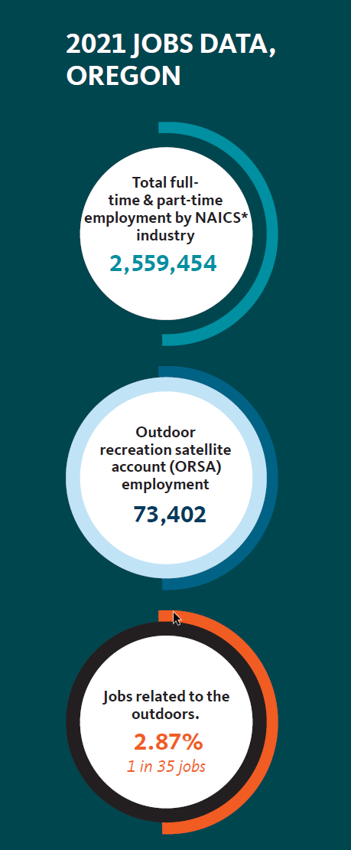
IMPACT in OREGON

Slide 10
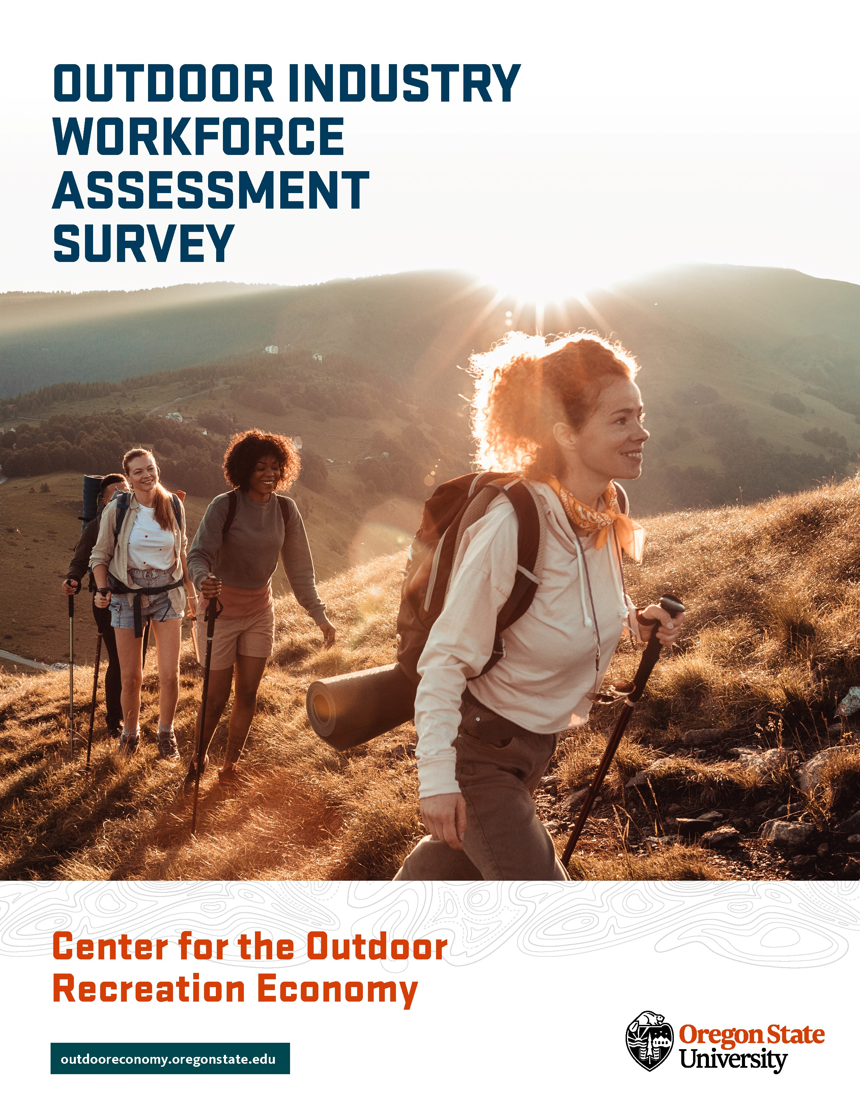
WORKFORCE STUDY
SCOPE
Talent Attraction
Retention Initiatives
Diversity, Equity, and Inclusion Outcomes
Notes:
NIKKI
Two primary topics of interest: Talent attraction and retention initiatives and DEI outcomes
Highlight workforce hiring and retention trends
Help inform educational and up-skilling initiatives that aim to make job opportunities in the outdoor industry more accessible and equitable
Provide a snapshot of where the industry stands in their efforts to improve diversity, equity, and inclusion outcomes
Surface best practices for inspiration and adoption by other companies

Slide 11
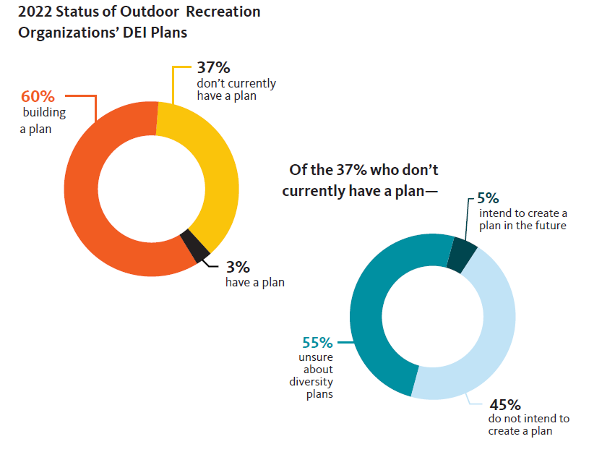
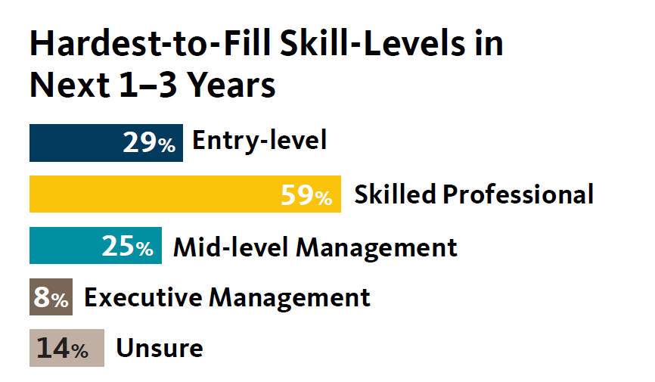
WORKFORCE STUDY
Key Takeaways
New Hires
Work/Lift Balance
Qualified Applicants
Increasing DEI Efforts
Organizational vs Industry Opportunities
Notes:
NIKKI
New Hires: The industry expects to hire for a high volume of entry and skilled professional positions.
Organization Opportunity:
- Add and elevate talent from unique backgrounds, perspectives, or nontraditional career paths to reflect the changing face and interests of the outdoor participant.
- Train, upskill, and elevate current talent into higher-level roles.
Industry Opportunity:
- Coordinate messaging with job boards, trade events, and workforce organizations about exactly what these jobs are, associated pay and benefits, and potential career paths.
Work/Life Balance: Outdoor companies are prioritizing flexible work arrangements and work-life balance as attraction and retention strategies ahead of employee benefits and financial rewards.
Organization Opportunity:
- Recognize that remote work and hybrid work arrangements will become the norm - Understand that flexible work arrangements and work-life balance as perks have limits and should not be used as wholesale substitutes for competitive wages and benefits packages.
Industry Opportunity:
- Share best practices supported by metrics for employee attraction and retention.
Qualified Applicants: The largest barriers to recruiting hard-to-fill jobs are finding qualified applicants, and lack of affordable housing options proximal to the job location.
Organization Opportunity:
- Consider collaborating with educational institutions to develop tailored programming to close these
qualification gaps and create direct onramps from classroom to career.
- Get clear on which skills are absolutely necessary versus those that are nice to have or can be trained.
Industry Opportunity:
- Take a creative, multi-pronged approach to address affordable housing and cost-of-living issues in outdoor
recreation hubs, including:
- Company-owned or subsidized employee housing
- Support of affordable housing policy initiatives, and/or
- Shifting to a remote or hybrid workforce, among others.
Increasing DEI: Companies who have a diversity plan in place are utilizing a wide variety of methods and tactics to achieve their goals. However, companies that do not currently have a diversity, equity, and inclusion plan in place largely do not plan to implement one or do not know where to start.
Organization Opportunity:
- Utilize and learn from key sources (e.g. In Solidarity Project, Outdoor CEO Diversity Pledge, Camber
Outdoors) where DEI best practices and lessons learned are shared at the organization level.
Industry Opportunity:
- Understand the rationale behind organizations that are reluctant or resistant to advance DEI and provide clear education resources (particularly utilizing existing guides, thought leaders, and toolkits) to help companies who are unsure of how to start, find their first step.

Slide 12
WHERE DOES CORE FIT IN?
Notes:
Kate
OSU’s Center for the Outdoor Recreation Economy came out of OSU’s Impact Studio and launched in 2019
* A new way of thinking about education, which of course you all at Ecampus have been on the cutting edge of. Could OSU be at the forefront in creating education and workforce solutions specific to the Outdoor Recreation Industry?
CORE is a partnership of OSU’s Division of Extension and Engagement, the College of Forestry, OSU-Cascades, and the Office of the Provost.

Slide 13
C
O
CONTINUING EDUCATION
& TRAINING
OSU DEGREES & CREDENTIALS
Non-credit (technical and non-technical) training developed in coordination with industry to meet workforce needs.
An new focus on for-credit and micro-credit pathways, taking advantage of alternative credentialing innovation at Ecampus.
R
E
RESEARCH &
THOUGHT LEADERSHIP
ECONOMIC DEVELOPMENT
Leadership in research related to the continuing health, vitality, and accessibility of the ORE.
In areas transitioning from resource-based economies and seeking ways to maintain strong, vibrant communities.
WHERE DOES CORE FIT IN?
Notes:
4 Pillars
(which our teammate Danny realized fit into this handy acronym!)
All of this work we do in lock-step with Industry partners so that our research, or education is relevant and meets industry need
Continuing Education and Training – Non-credit (technical and non-technical) training developed in coordination with industry to meet workforce needs.
DEGREES & CREDENTIALS - An new focus on for-credit and micro-credit pathways, taking advantage of alternative credentialing innovation at Ecampus
3) RESEARCH & THOUGHT LEADERSHIP - Leadership in research related to the continuing health, vitality, and accessibility of the ORE.
4) ECONOMIC DEVELOPMENT - In areas broadening from resource-based economies and seeking ways to maintain strong, vibrant communities.
Surrounding all of this work, is what I call an overarching lens through which we do our work. That is a focus on creating a more diverse, equitable, and inclusive space in the ORE
—being purposeful the creation of economic opportunities for folks who have been previously underrepresented in this space

Slide 14
FORE101: Foundations of the Outdoor Recreation Economy
Ski Lift Maintenance Technician (LMT) Level 1 Training
Ski Lift Operations Training
PROGRAMS
Intro to FORE101
How a Ski Lift Works module
Outdoor Recreation Roundtable (ORR) Rural Economic Development Toolkit
FREE COURSES & TOOLKITS
PILOTING IN SU/FA 2023
Elevate: Access, Belonging, & Success Training for the Outdoor Industry
CURRENT & UPCOMING PROJECTS
Notes:
we’ve developed programs including
FORE 101
Ski Lift Maintenance Technician training
Free courses and toolkits
Intro to FORE 101
How a ski lift works Module
ORR Rural ED Toolkit
And programs we will be piloting in 2023
* Ski lift operations training
* DEI – Frontline retail workers, in partnership with ORR

Slide 15
Outdoor Industry Workforce & DEI Assessment (VF, OIA, ORR)
Case Study: DEI Strategies for Small Businesses (Cairn, DEI Lab)
Inclusive Customer Service Competency Framework (AARP)
LWCF Project Opportunity Survey & Findings (ORR)
COMPLETED RESEARCH PROJECTS
Ski industry workforce assessment (PNSAA)
State agency workforce assessment (OPRD)
SCORP (COF, OPRD)
Workforce Profiles and Pathways (ORR)
+ More
RESEARCH PROJECTS IN DEVELOPMENT
CURRENT & UPCOMING PROJECTS
Notes:
research partner for the industry - informs the industry and us as to the types of education opportunities
A couple of examples:
AARP - collaboration with AARP and College of Public Health & Human Sciences,
CORE identified research and training opportunities to make the outdoors more accessible and inclusive of the 50+ community.
One of the outcomes of the project included a proposed set of competencies necessary for all customer service employees
in the industry.
These competencies will also be used as standards to develop the curriculum and learning outcomes for future trainings.
SCORP – statewide comprehensive outdoor recreation plan Oregon’s SCORP provides a strategic vision for local, regional, state, and federal agencies, together with tribal governments, and private and non-profit partners, to effectively and adequately provide outdoor recreation and conservation to meet the needs of Oregon state residents
Like our other work, you can see how this research is being done hand-in-glove with the outdoor industry

Slide 16
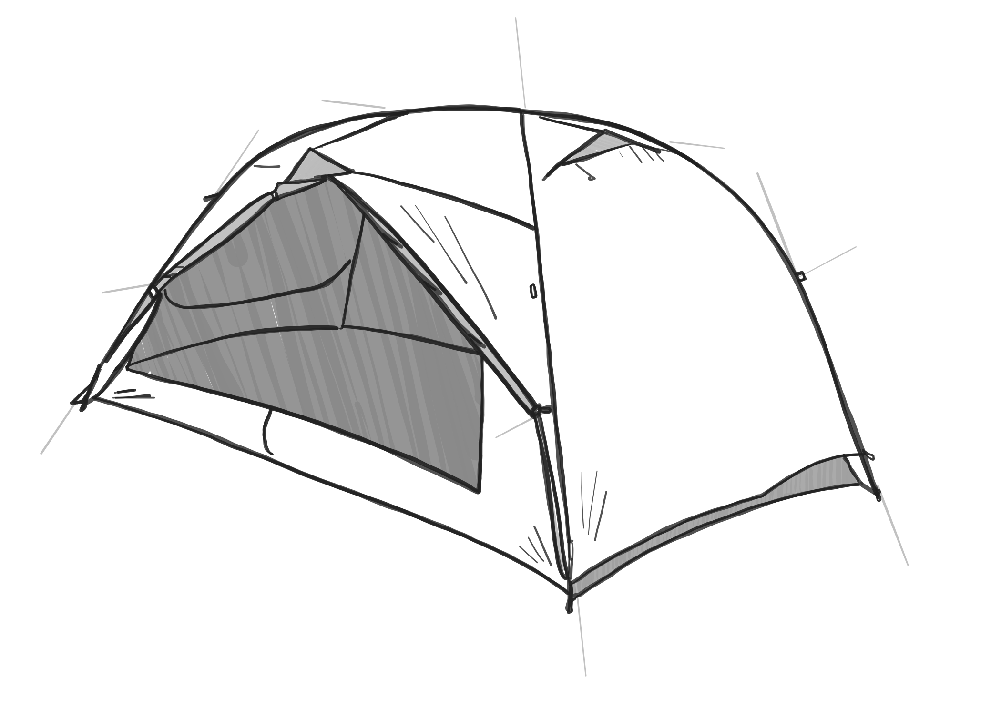
OUTDOOR ECONOMY NATIONAL CONSORTIUM

Slide 17
Lack of clear understanding about what “the outdoor recreation industry” really is
An “exclusivity epidemic” in the outdoor industry
Need for community economic development
Lack of national-level coordination between academia and industry
ISSUES TO ADDRESS
OUTDOOR ECONOMY NATIONAL CONSORTIUM
Notes:
One part of CORE’s thought leadership work
We have acted as a convenor and coordinator at a national level.
There exist some challenges as this industry emerges and begins to coalesce
Lack of clear and universal understanding about what “the outdoor recreation industry” really is.
An “exclusivity epidemic” in the outdoor industry – the outdoor industry is hyper-networked, creating an exclusive culture where it’s all about who you know and experience within the outdoor industry and conformance to the outdoor industry culture/way of life is required to get a job in the industry. This has led to an industry that lacks diversity of people and thought and leads to the belief by minority populations that they are not welcome in the industry or in the outdoors.
Ways people recreate, rules, etc., developed in 20th century, the folks making the rules and engaging tend to be white
Health benefits, outdoors is like free medicine to those who have access to it
Barriers to participation:
Workforce has its hand on the levers– creating equitable pathways will help to drive inclusivity in the outdoors in the future
A strong need for community economic development to address transitioning natural resource economies in America’s rural towns.
We continue to see migration to quality-of-life communities in US (communities with recreation baked in)
Access to the outdoors as part of the equation for the viability of these communities
Lack of national-level coordination between academia and industry to ensure academic programs are responsive to the needs of the industry. Consistent educational opportunities

Slide 18
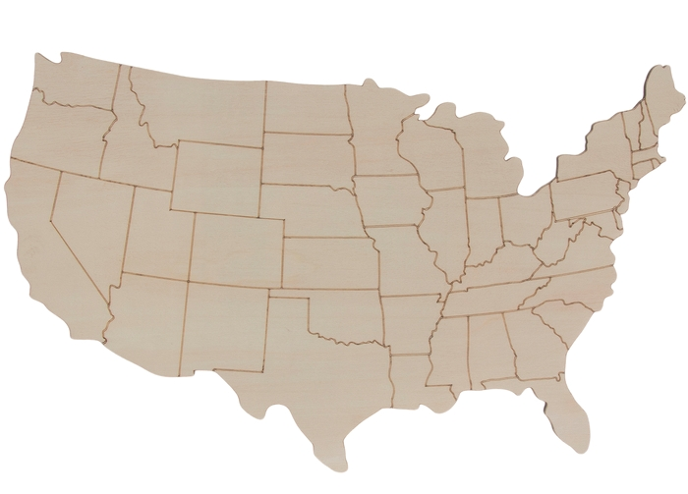
Share information and resources
Set standards
for jobs
Assist member schools in using the standards
Connect directly with the industry
Conduct collaborative research
OUTDOOR ECONOMY NATIONAL CONSORTIUM
Notes:
Benefits of a consortium: (fade in on click)
Share information and resources
Set standards for jobs
Connect directly with the industry
Creates educational and workforce development, which is a key part of building a more diverse and inclusive outdoor industry.
Conduct collaborative research
Funding: A national consortium representing a broad group of colleges and universities is in a better position to receive federal and private funding.
Senate has told us that if we want funding for this work, we need to do it at a national level – hence the consortium
Are we competitors with these folks, sure, but this industry is working together,
With 2 of my favorite expressions: a rising tide raises all boats, and the notion of rowing together to achieve greatness.
Thrilled that OSU is helping to coordinate and convene these conversations with our partners.

Slide 19
RURAL DEVELOPMENT TOOLKIT

Slide 20
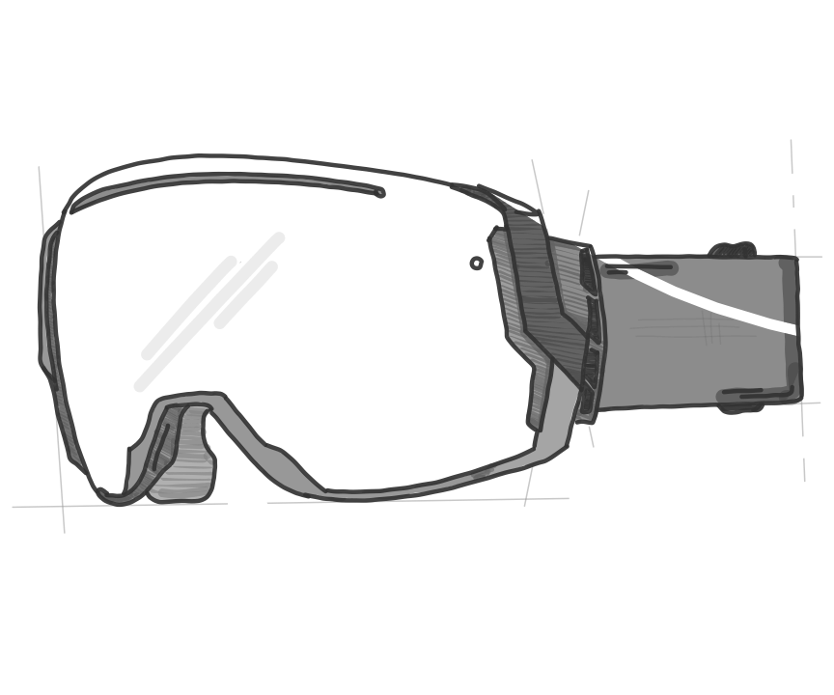
CORE’s WORK with THE SKI & SNOW SPORTS INDUSTRY
Notes:
Nikki
Start with industry needs assessment: The importance of showing up and listening
Working with regional associations
Identified a huge workforce gap with Lift Maintenance Technicians
Course preview: https://vimeo.com/702915974
Through working on the LMT program we have been able to identify emerging workforce needs in the Ski Industry
Things in our sandbox
The Silver Tsunami: An aging wealth of generational knowledge
Risk & Safety protections from litigation
Gender inequities and industry-wide embedded sexism
Extreme lack of diversity resulting in decreased access and representation
External factors impacting business and the workforce
Impacts of climate change
Housing and seasonality nature of the industry
How to collaborate
Uplift voices through program development process
Representation matters
Content is one thing, but adoption is another
Create space for thought leadership that is trauma-informed

Slide 21
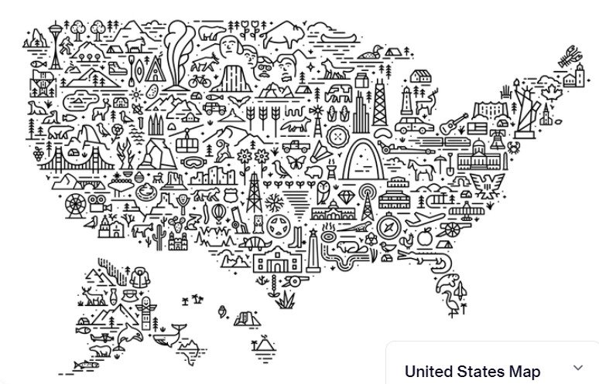
Industry Engagement
Workforce Development
Rural economic development
Outdoor Rec Consortium
Research
Community Engagement
CENTER FOR THE OUTDOOR RECREATION ECONOMY
Notes:
Final slide
CORE is focused on all of these areas: industry engagement
And overarching: working to create a diverse and inclusive outdoor industry.

Slide 22
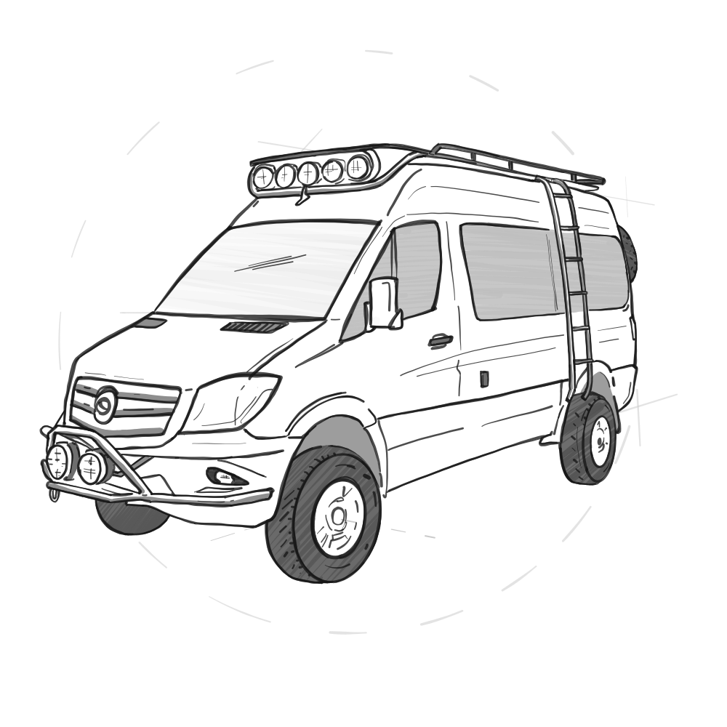
OPEN FOR QUESTIONS
KATE PORSCHE
Interim Director
NIKKI COOK
Programs Coordinator

