Slide 1
BREAKOUT B
“Innovative solutions to connecting previously incarcerated and previously houseless to programs and employment
in Oregon Communities”

Slide 2
SPEAKERS
Holly Holtan-Archer
Nancy Pance
HVRP Job Developer
Goodwill Industries
Co-Founder
Opportunity Oregon

Slide 3
Everyone deserves a chance after paying their debt to society, and hiring ex-offenders strengthens companies, communities, families and the economy.

Slide 4
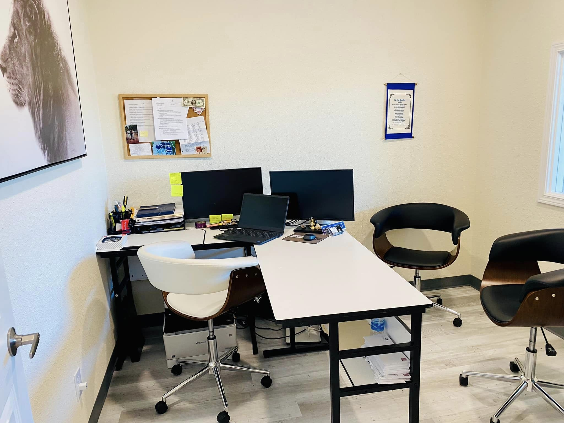
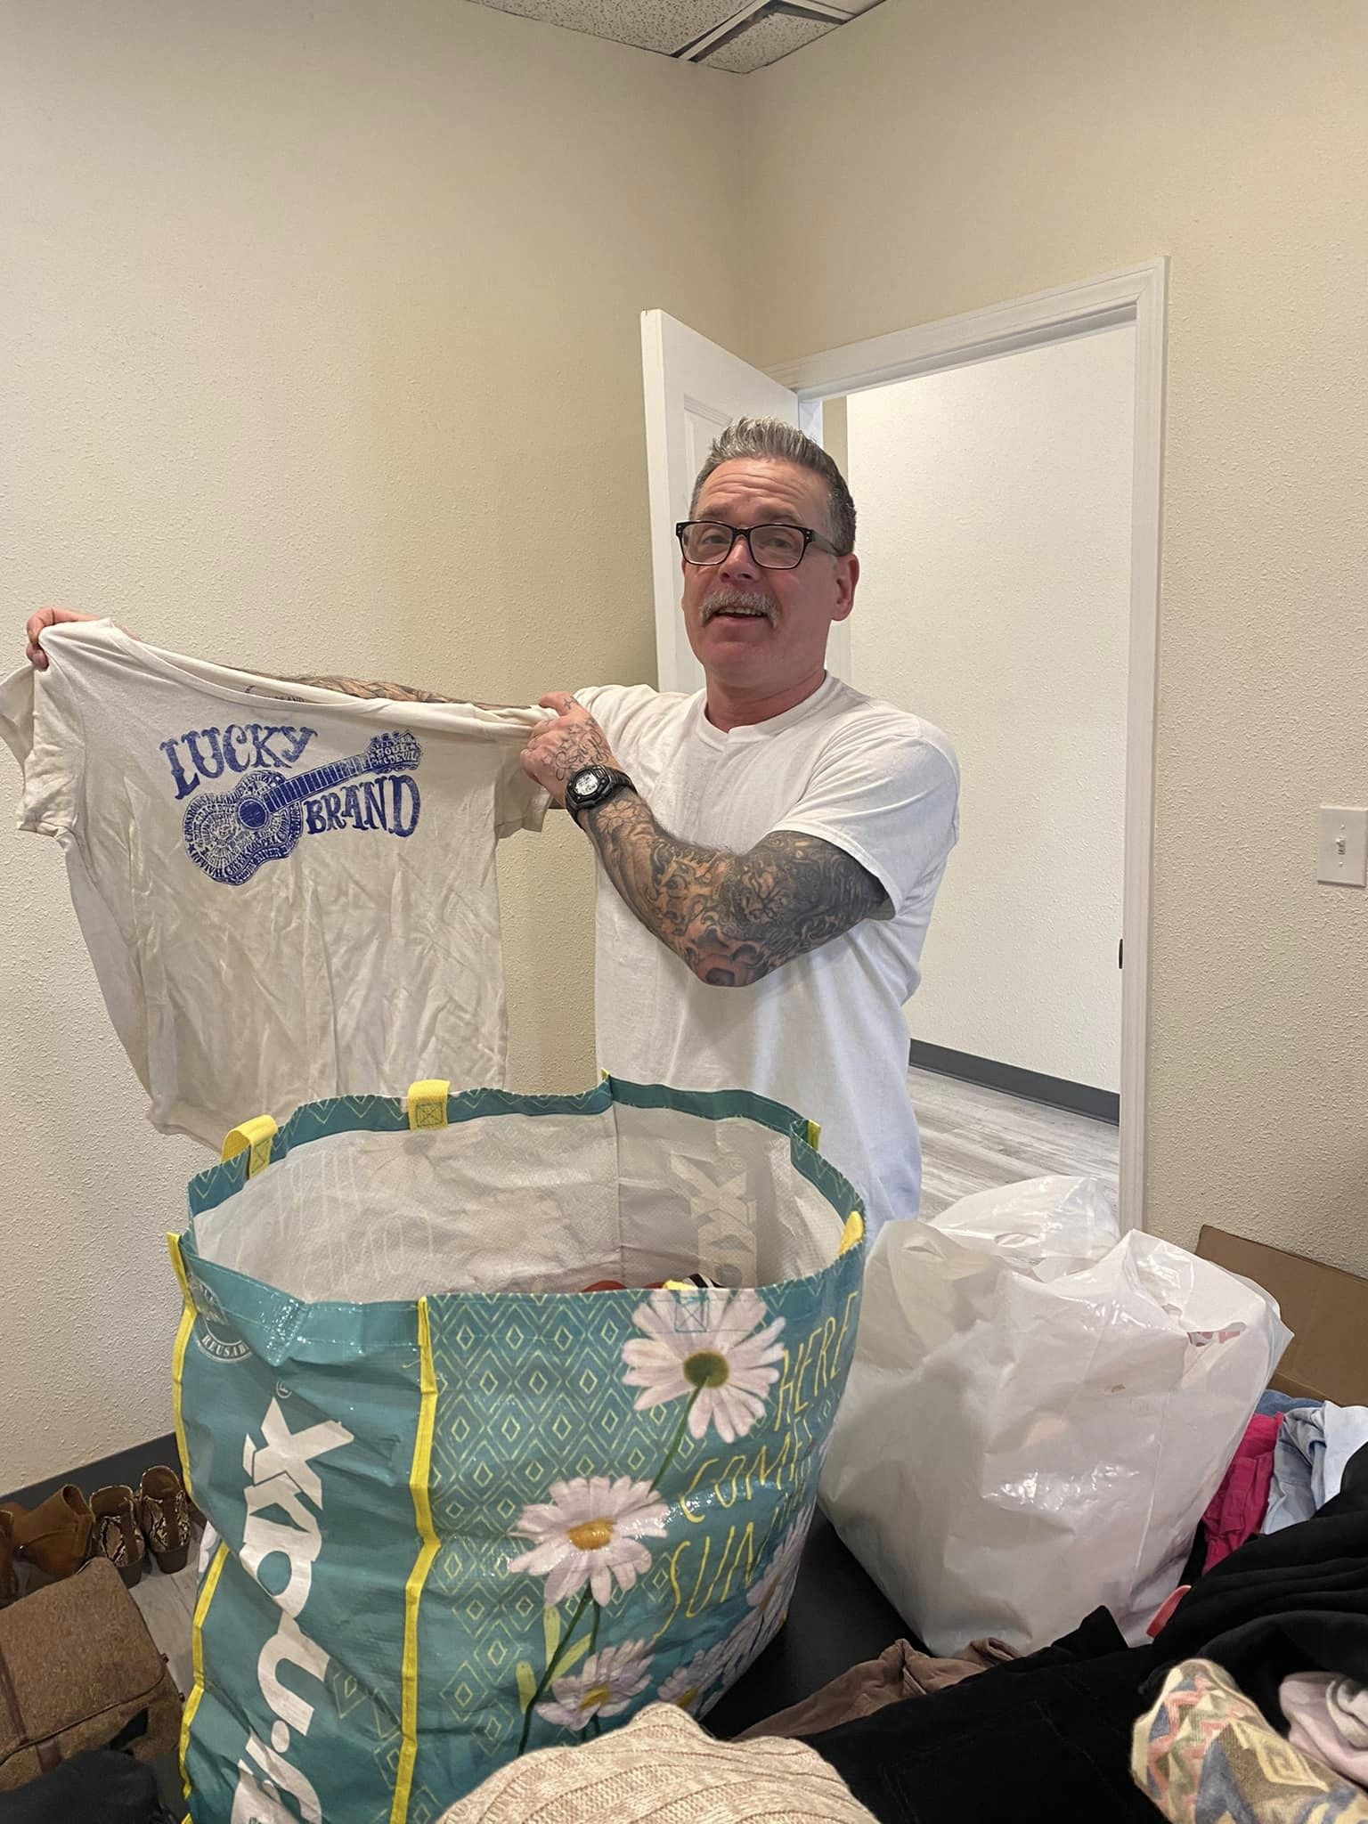
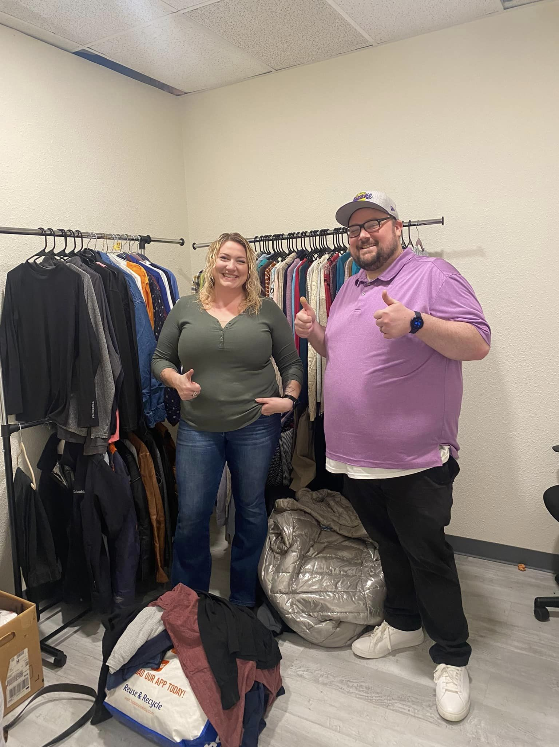
Based in Lane County, services are available statewide either remotely or in-person.

Slide 5
We began by bringing workshops/classes into Coffee Creek Correctional & Oregon State Penitentiary.

Slide 6
We formed partnerships

Slide 7
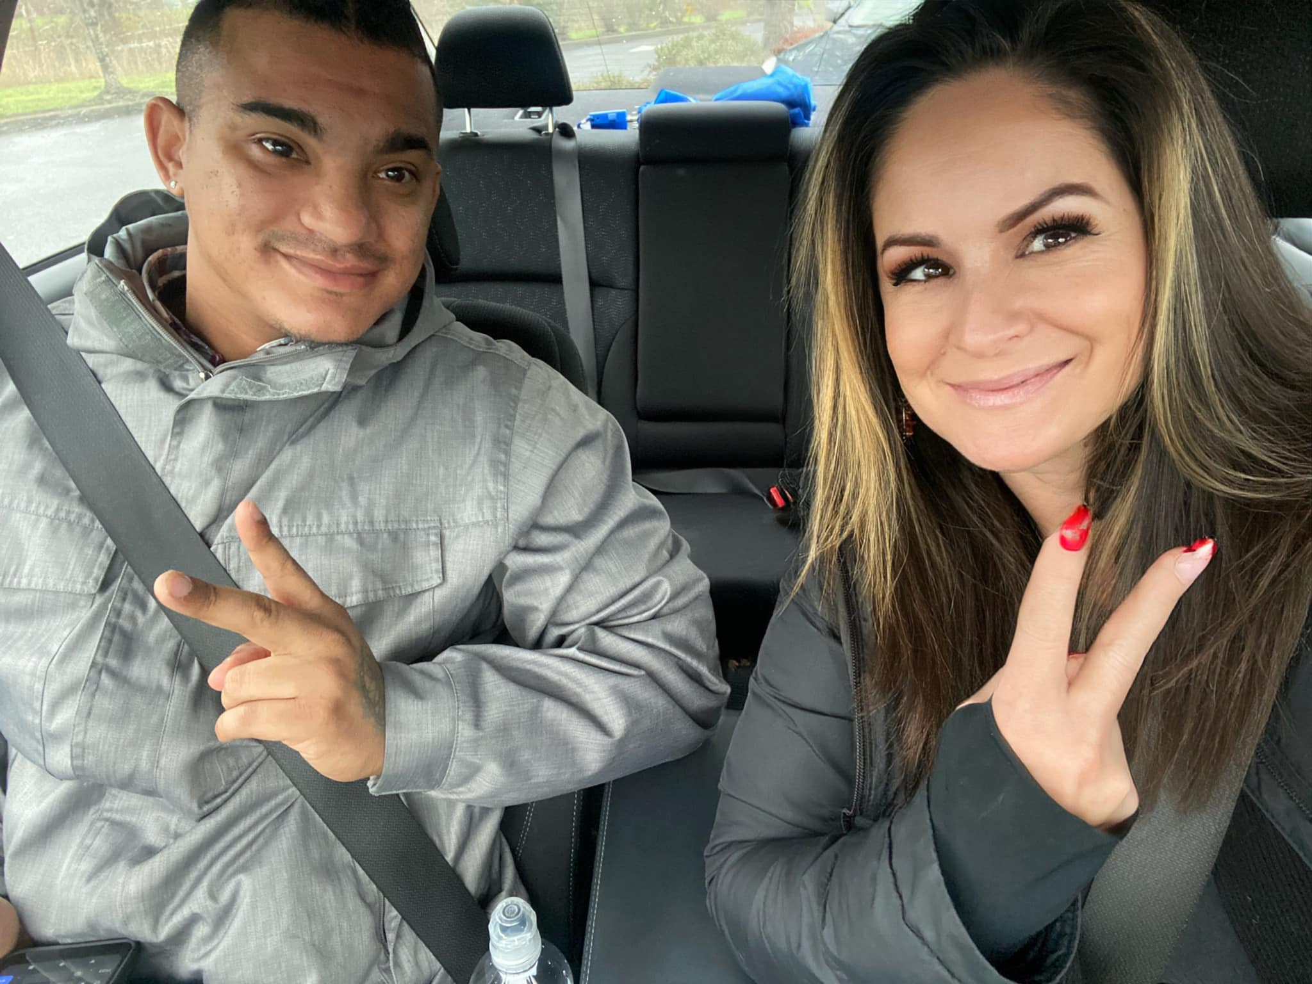
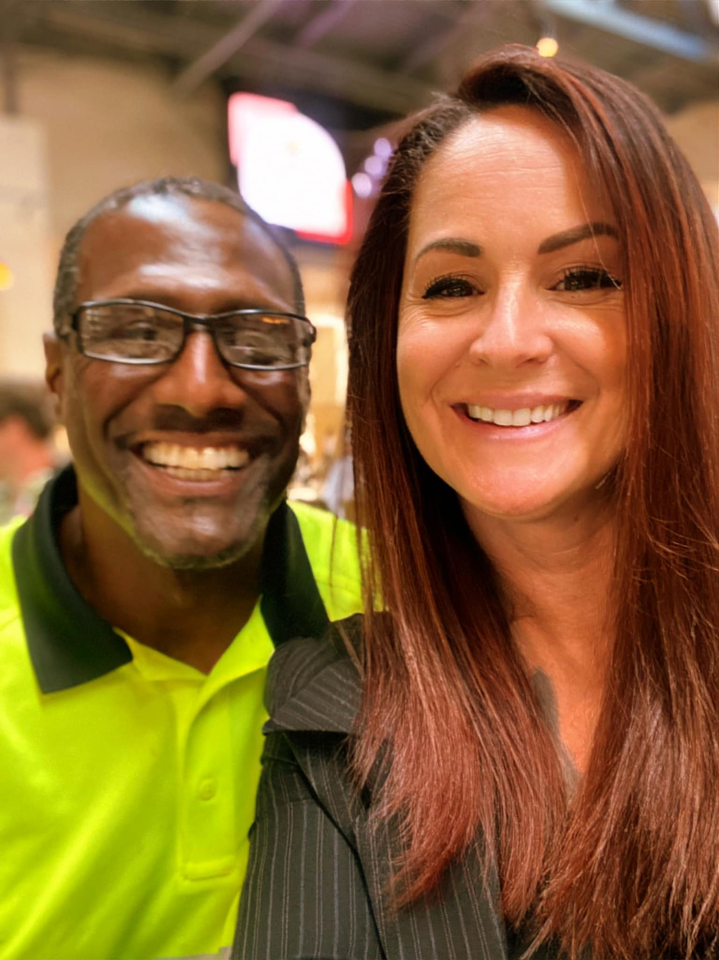
We have so many success stories, here’s a few….

Slide 8
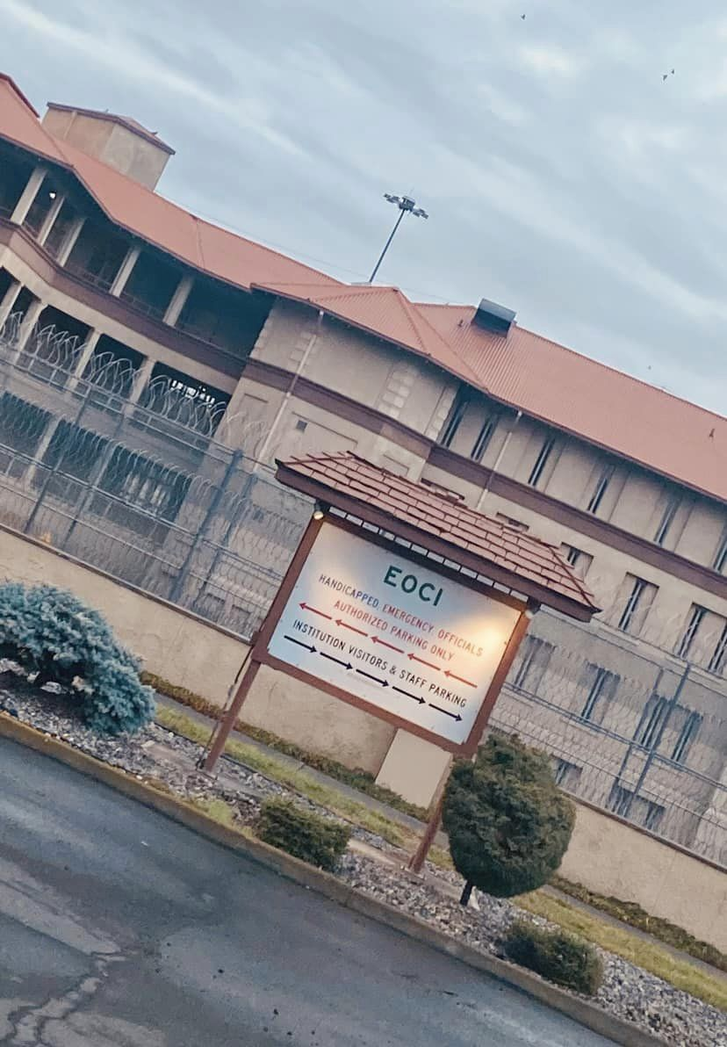
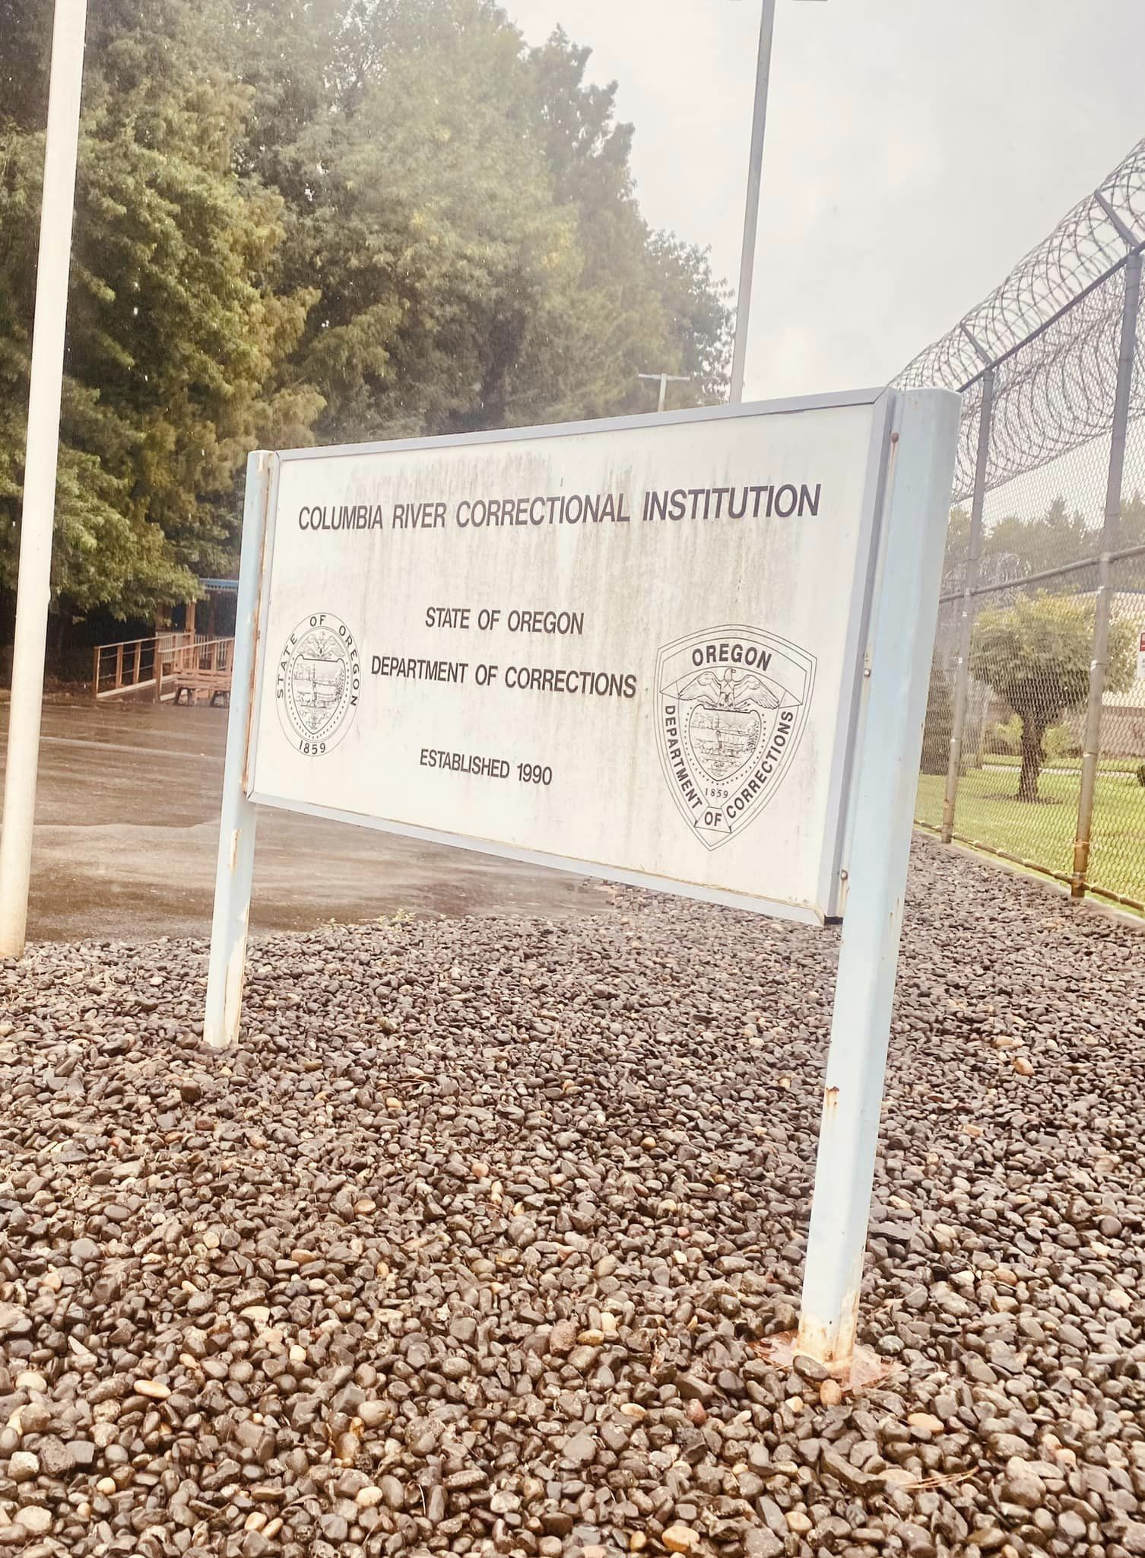
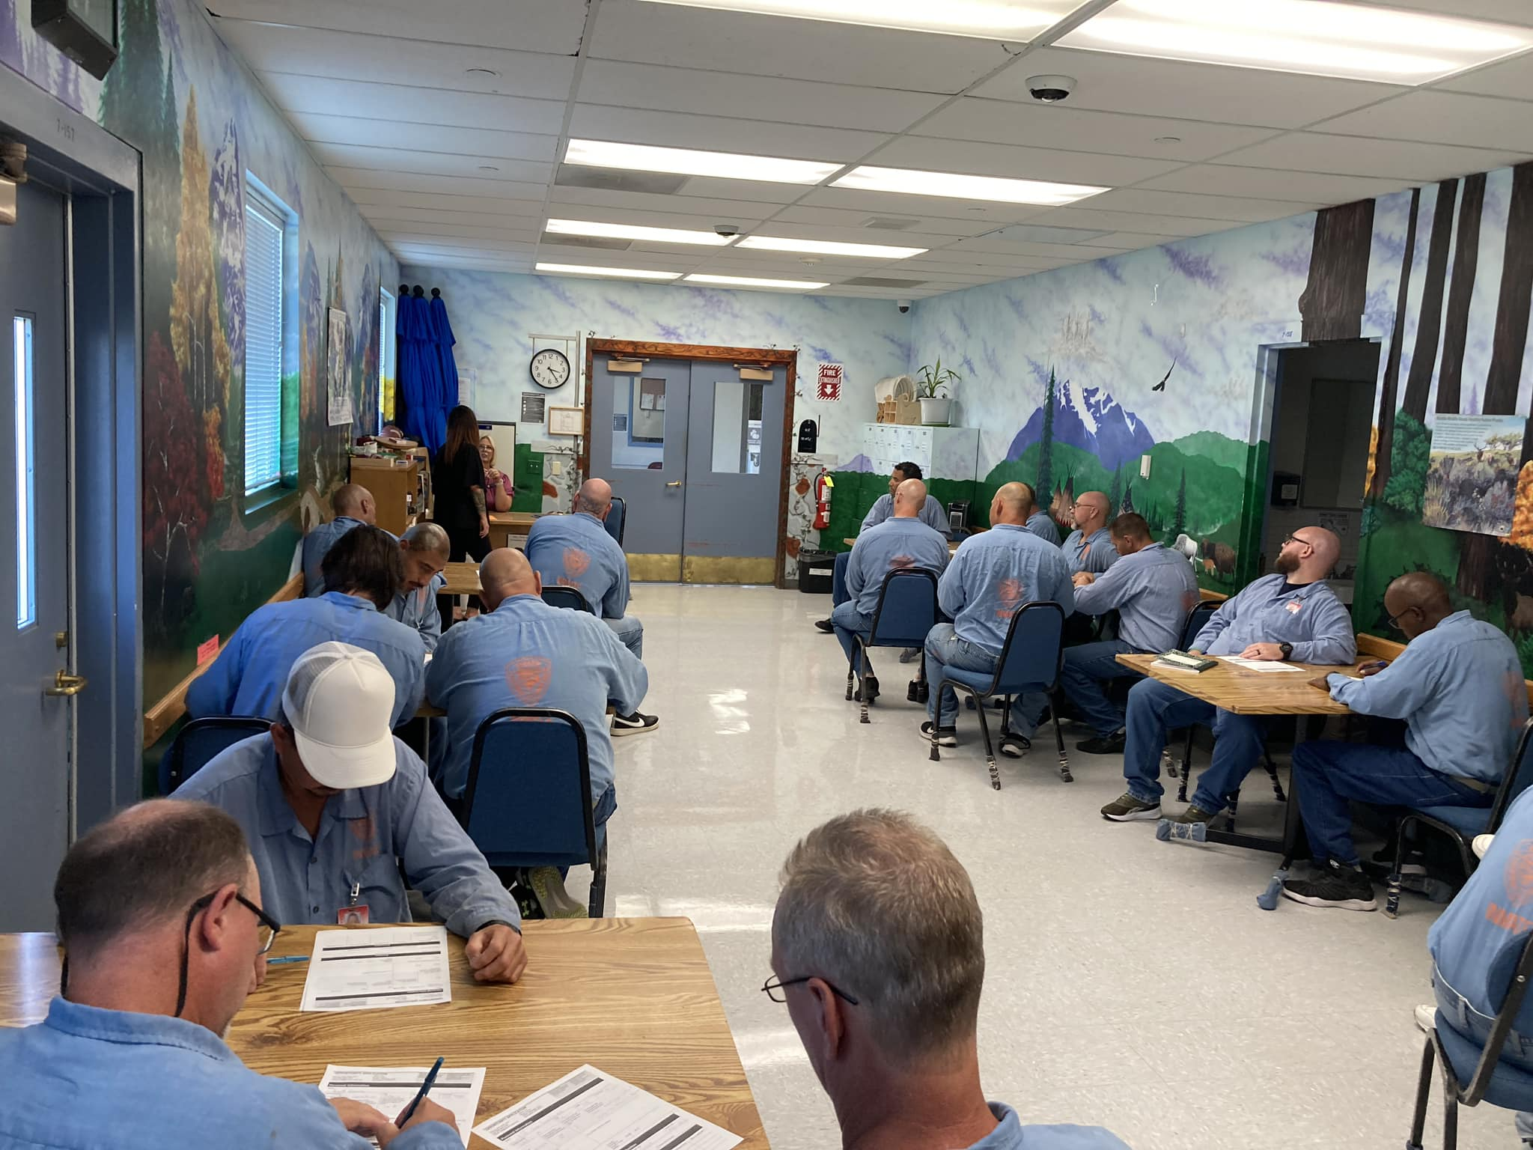
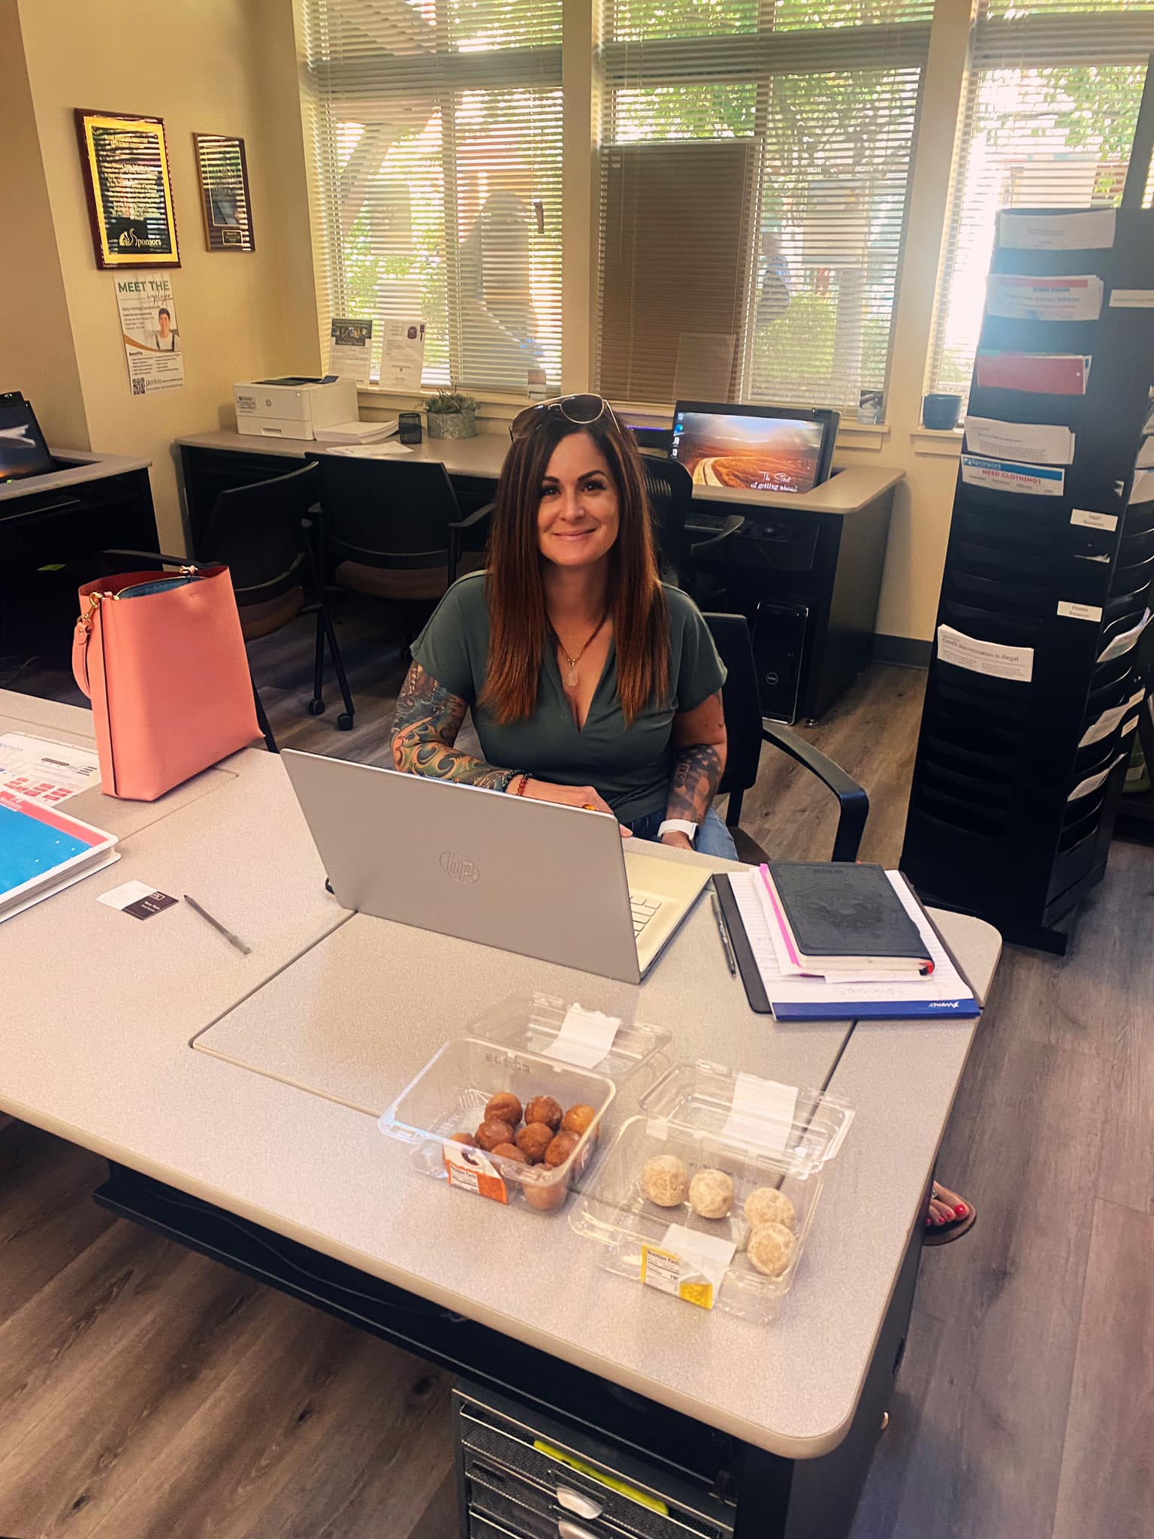
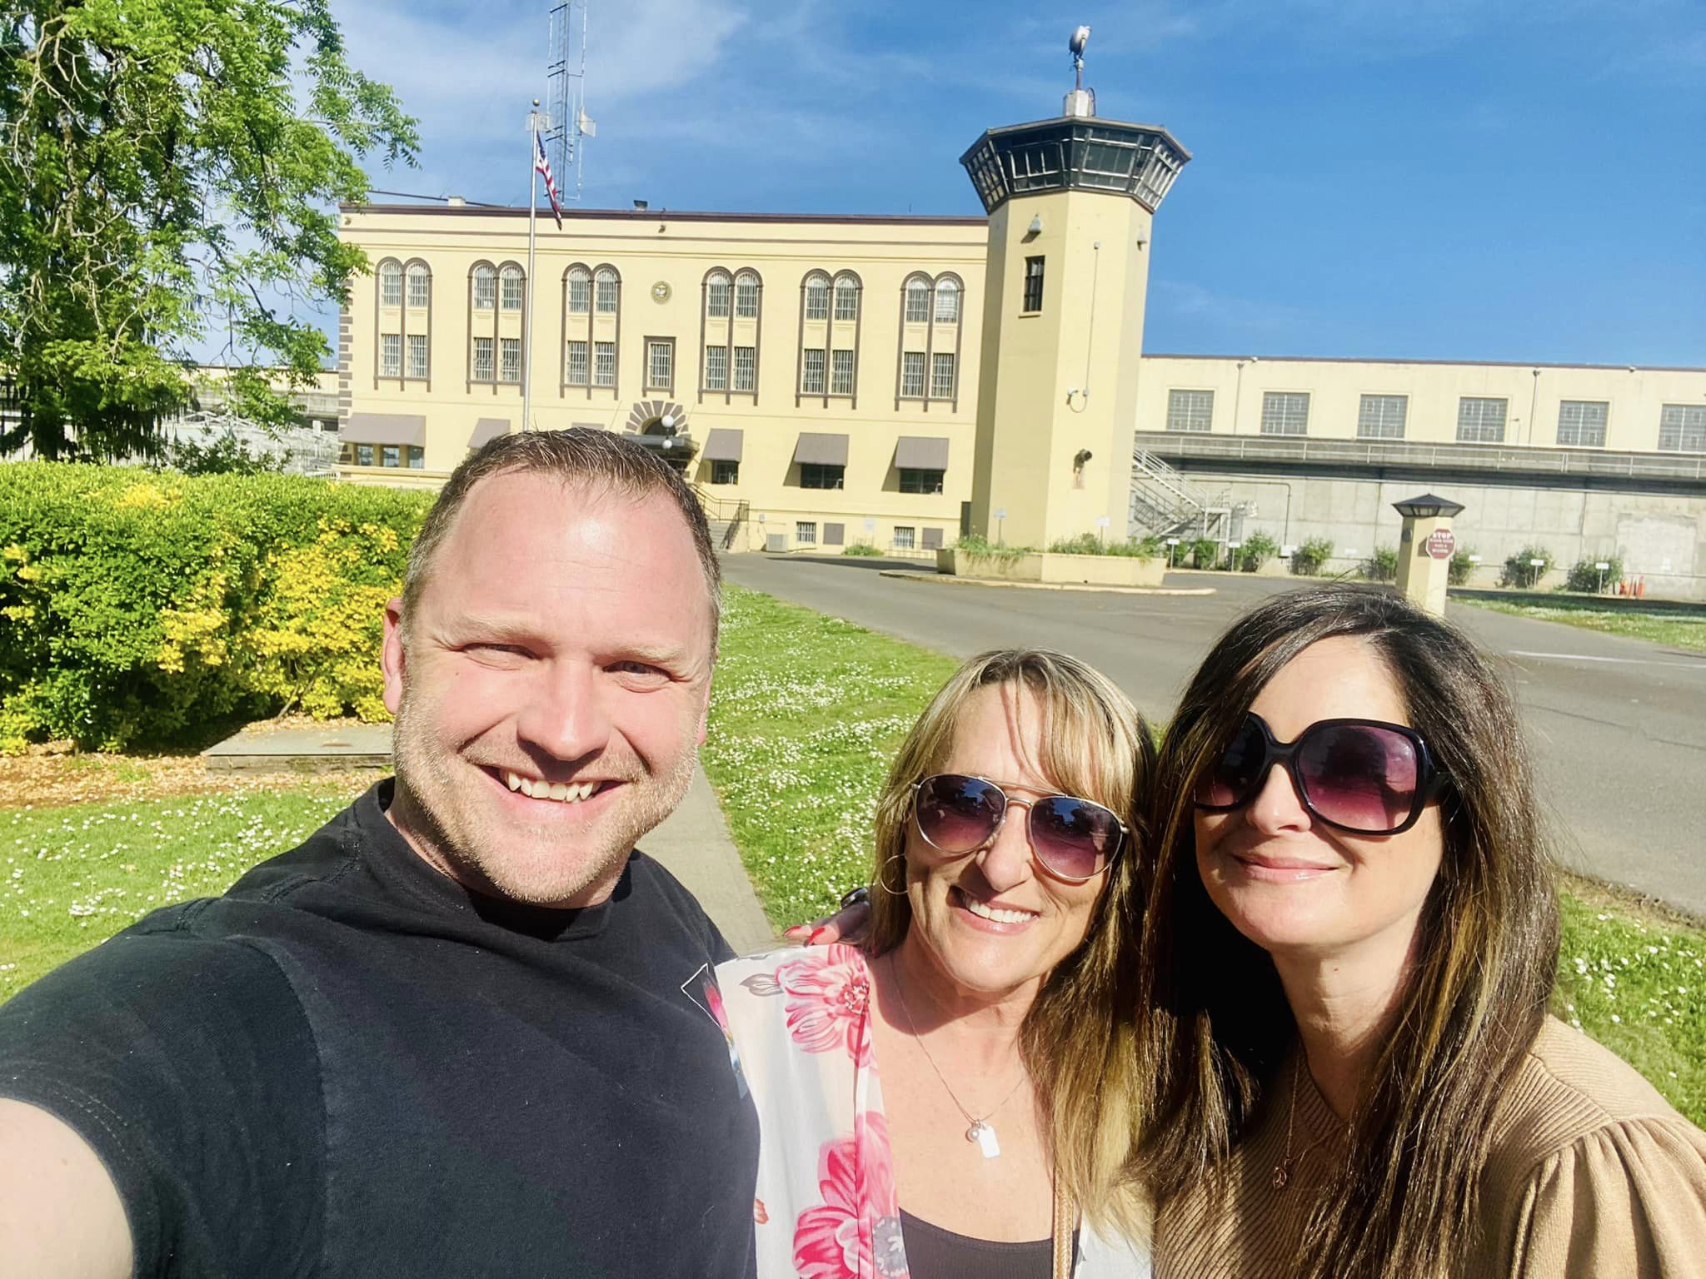
Seminars & workshops inside

Slide 9
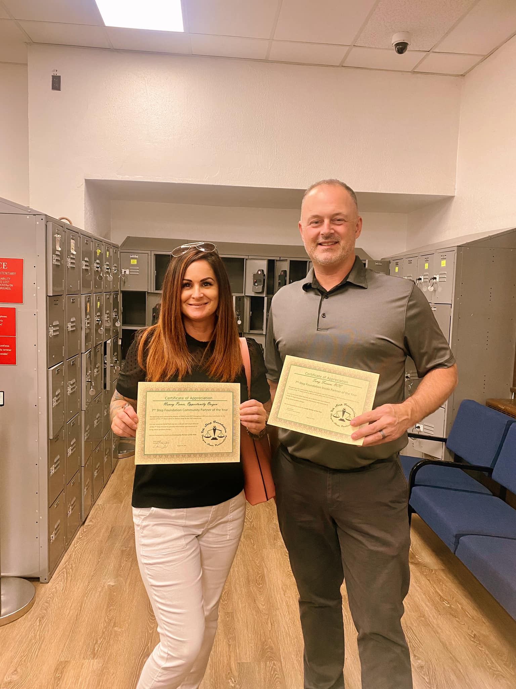
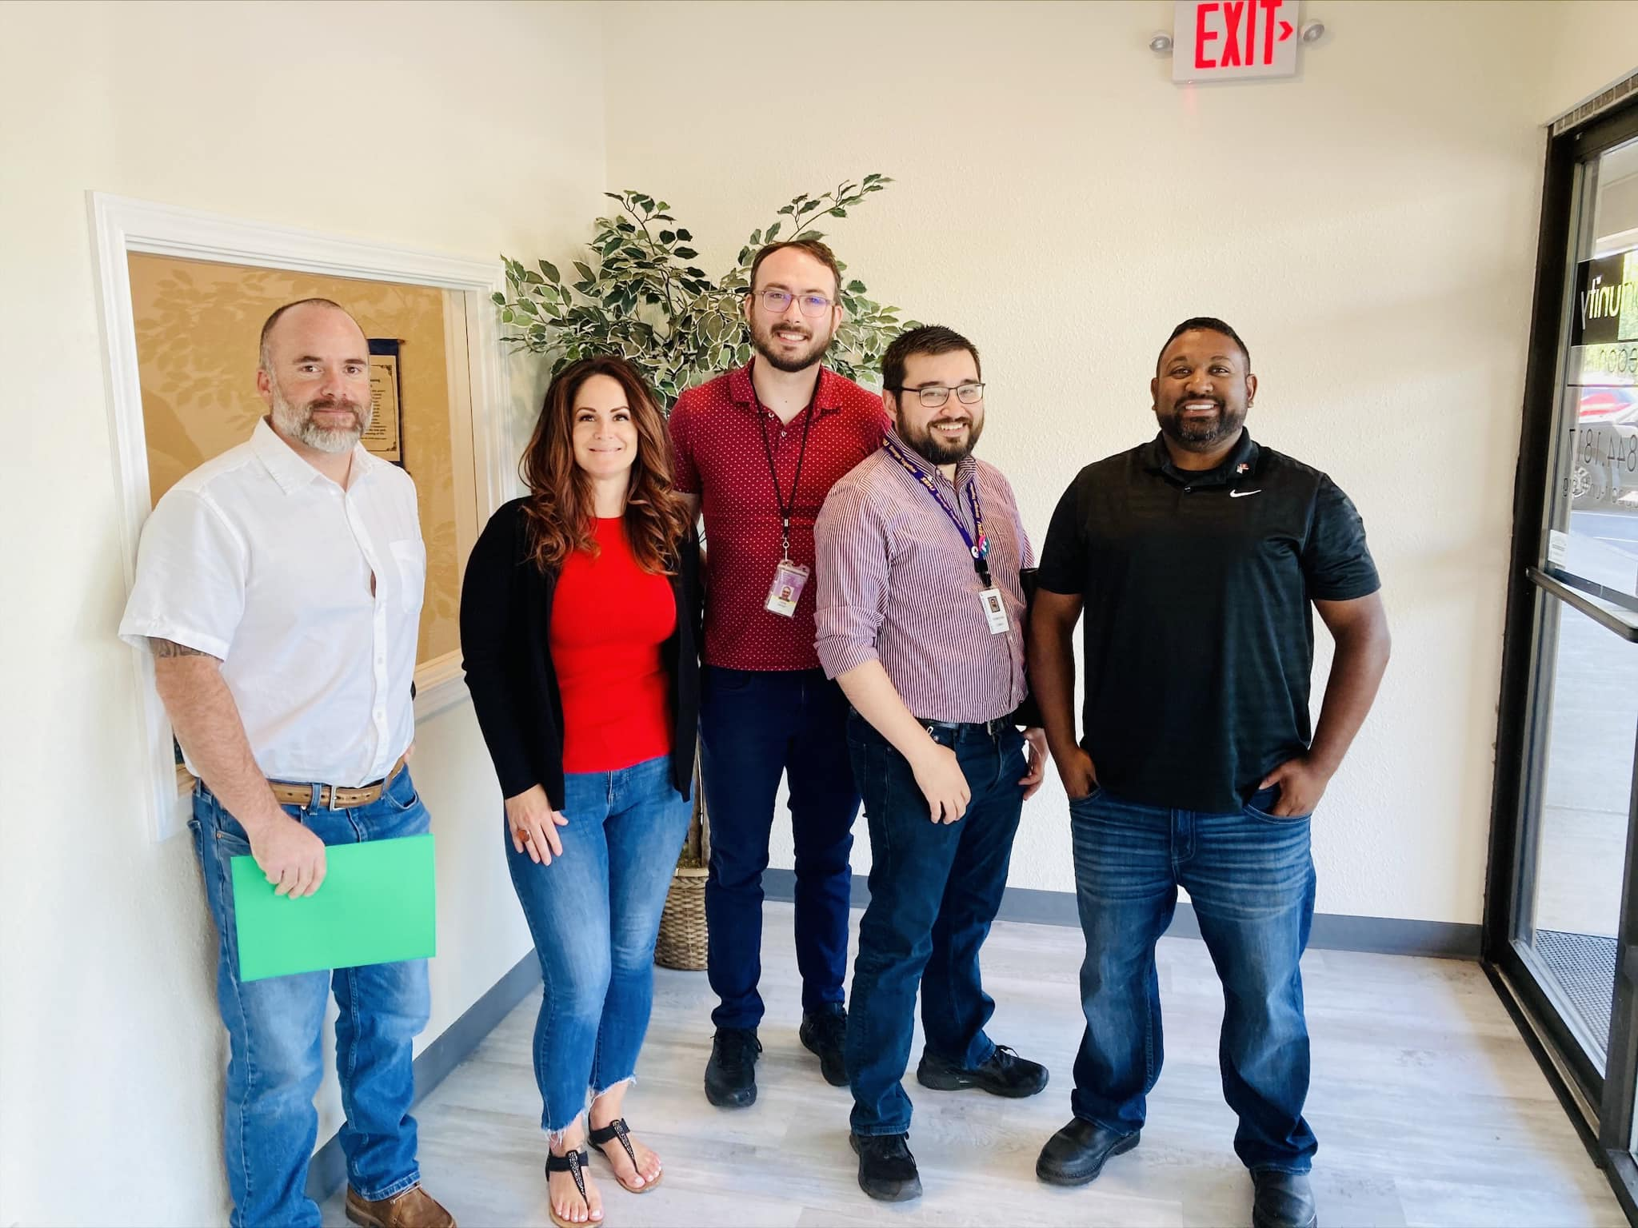
Partnerships and community collaboration have led to more effectiveness in our services.
Career Fair
OCE
WorkSource

Slide 10
Employer Benefits
We’ve included just a few of the countless benefits from hiring our recruits.
Higher retention rates
More loyalty and gratitude
Tax kickbacks for employers (up to $9600 per employee!)
No cost $5,000 federal bonding program.
We coordinate with 11 state prisons and have a constant flow of employees throughout Oregon.

Slide 11
Recruit Benefits
Interview clothing
Resume & cover letter preparation
Mentorship and continued support
Job placement or employment resources provided until employment is gained.
Much, much more….
All services provided are at no cost to the employees.

Slide 12
Hiring this untapped pool of talent boosts the economy, creates safer communities and helps reduce recidivism.
Questions?

Slide 13
Veteran Connections Homeless Veterans Reintegration Program
Goodwill Industries of Lane, South Coast Counties & Alaska

Slide 14
Program Highlights
Funded by the US Department of Labor VETS
Serves veterans who are homeless or at risk of becoming homeless
Veterans must have been discharged from service under other than dishonorable circumstances
Veterans must have at least one day of federal active duty service
Veterans must be willing to actively seek employment

Slide 15
HVRP Process
Participant
Enroll in HVRP
Stabilization and referrals
Training and supportive services
Job search and employment

Slide 16
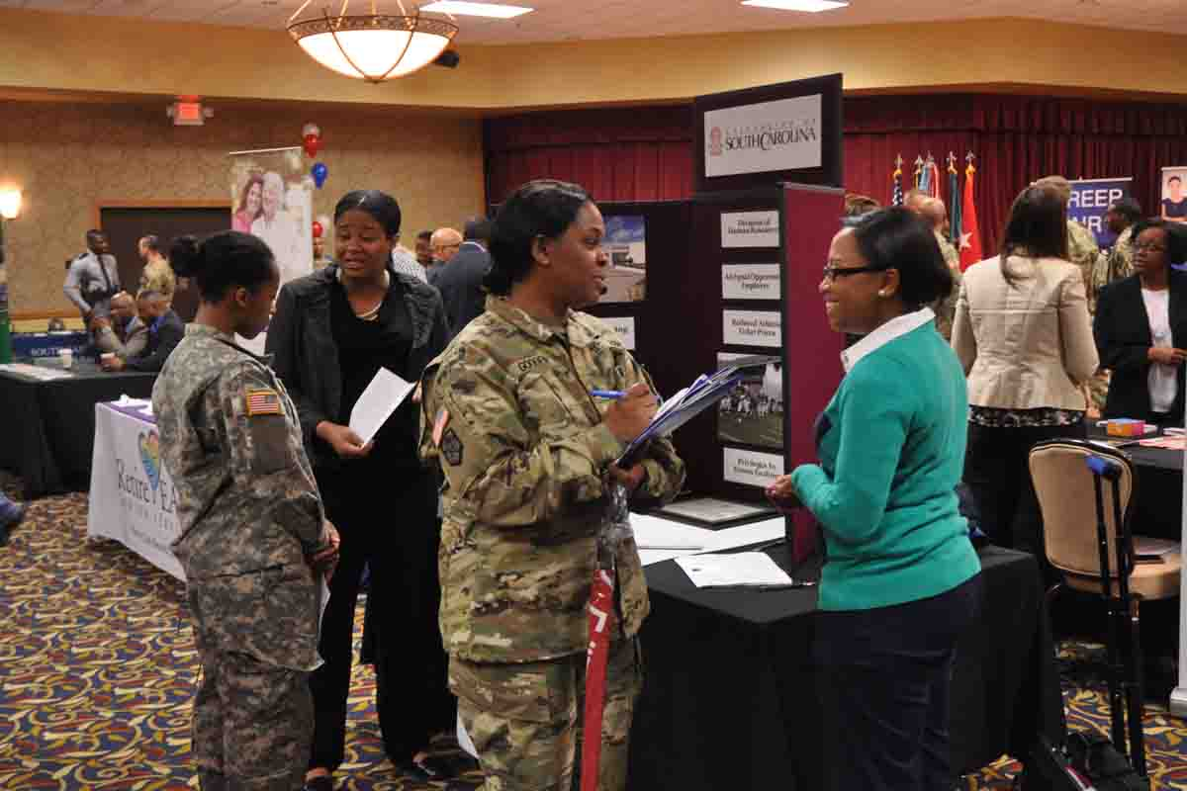
Enrollment
Determine eligibility
Identify and assess needs and barriers
Develop individualized employment plan
Create measurable goals

Slide 17
Stabilization and Referrals
Begin addressing barriers, recognizing traumas
Make connections to partner organizations for housing, addiction treatment, mental health, etc.
Co-enroll with Worksource and DVOPs
HVRP specializes in person-centered case management and warm hand offs to our partners!

Slide 18
Supportive Services
Vocational training funds and career guidance
Resume development
Interview skill-building, online & in-person
Interview or work clothing, tools, equipment
Phone/phone minutes
Haircuts/hygiene items
Transportation/car insurance

Slide 19
OED & HVRP Co-enrollment Benefits
Benefits to HVRP Participants
Supportive case mgmt. by an inter-disciplinary team
Collaborative process
Access to increased information/OED-specific grants & programs
Partner Benefits
Training funds can be combined across agencies
Memorandums of understanding/policy agreements
Shared networking opportunities
Community economic development

Slide 20
Job Search and Employment
Job leads/networking
Application assistance
Direct communication with employers
12 months of follow up (retention) after obtaining employment

Slide 21
Statistics for Program Year 2020-2021
Combined statistics for Veteran Connections and other HVRPs in Oregon:
Enrolled Veterans – 476
Placed to employment – 179
Average wage - $16.04
Placement Rate – 54.86%

Slide 22
Contacts
Michael McCoy
michaelm@goodwill-oregon.org
458.234.7068
Holly Holtan-Archer
hollyh@goodwill-oregon.org
541.832.4012

