Slide 1
Mike Grella Chief Infrastructure Officer, Active Infrastructure Founder, Grella Partnership Strategies October 2023
Economic Development 4.0 - Next Generation Site Selection

Slide 2
Economic Development 4.0: Site Selection Trends & Challenges
Lack of grid capacity, constraints on new infrastructure equipment
Not enough shovel ready “megasites” to keep up with demand
Legal, regulatory, zoning, and environmental issues
Community opposition to power & water intensive Projects
Continued adoption of industry 4.0 tech disrupting workforces (and we’re not ready)
Technical & semiskilled talent shortage
DATA CENTER
^

Slide 3
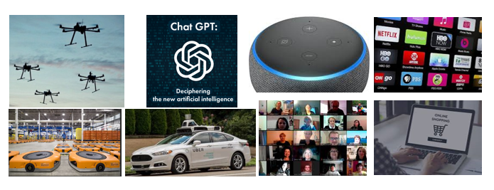
Economic Development 4.0:
Technology Drivers for Data Center Growth
US Hyperscale Data Center Construction Spending Will Exceed $100 Billion Over the Next Five Years (Bloomberg 9/20/23)

Slide 4
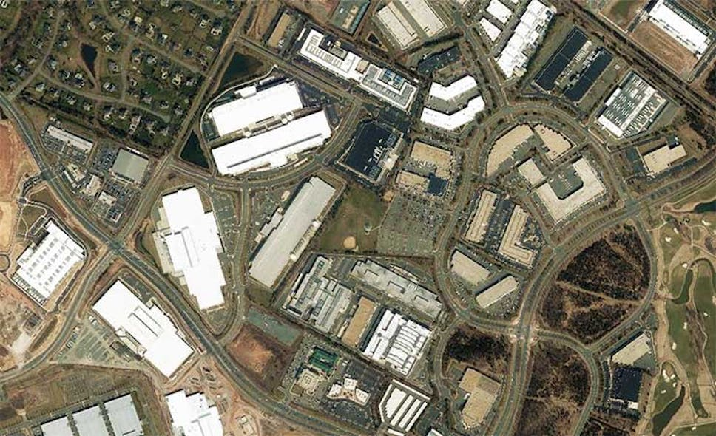
Economic Development 4.0: Site Selection Trends
AI, Machine Learning, Deep Learning data center workloads run at much higher power densities than traditional data center servers (can be 3x greater) putting additional pressure on utilities to meet current and future anticipated demand.
Advanced manufacturing, automotive, EV battery, chip fabrication plants competing with data centers competing for power is limiting primary market growth leading to deployments in outlying areas, secondary markets and submarkets, particularly for data centers. “Where is the best place to operate in 15 years?”
Long lead time (2-4 years) on electrical equipment has become a major impediment to new construction.
Elected official opposition encountered more frequently: aesthetics, traffic, noise, odor, lack of jobs (for data centers), environmental impacts, excessive power & water consumption. Social media magnifying NIMBY and BANANA.
Fully entitled data center land in primary markets: $1-4M/acre.

Slide 5
Economic Development 4.0: Community Considerations in Data Center Attraction
Pros:
Significant property tax increment
Low impact on traffic, noise (generally), light, pollution, odor
Well compensated jobs
Extremely resilient jobs & industry (you can’t just turn off the switch!)
Catalyst for tech ecosystem attracting other data centers and technology intensive business & talent
Cons:
Fewer jobs than other industrial uses
Energy & water intensive (can mitigate through low water designs)
Environmental impact depending upon fuel mix (can mitigate through renewable PPAs)

Slide 6
Economic Development 4.0: Community Considerations in Advanced Manufacturing Megaproject Attraction
Pros:
Significant property tax increment
Significant job creation
Well compensated jobs
Generally, highly resilient jobs
Attracts OEMs, creating ecosystem to support operations
Cons:
Potential for nuisances: traffic, noise, light, pollution
Competition for existing industrial businesses constraining labor pool, increasing wages
Pressure on housing market supply, schools, and other government resources
Energy & water intensive (can mitigate through low water designs)
Without diversification, can be disproportionately impacted in downturns

Slide 7
Economic Development 4.0: Best Practices for Attracting Data Centers & Large Industrial Projects
Workforce, talent attraction, education means the world.
Adoption of industry specific tax incentives & zoning regulations (as-of-right zoning).
Identify “dream team” of in-house and third-party experts to address entitlement, environmental impact, infrastructure, construction, and operational issues that will support future negotiations with large industrial developers & operators.
Collaborate with impacted stakeholders to address site/regional gaps & shortcomings. Focus on long lead time items, e.g., power, water, fiber.
Conduct mock RFP & site visit simulating prospect. Speed & responsiveness > Perfection
Have a plan to market and attract developers & users to your top sites.
DO NOT COLD CALL. DO NOT WAIT FOR THE PHONE TO RING.

Slide 8
Economic Development 4.0: Best Practices for Attracting Data Centers & Large Industrial Projects
Think long-term, how will you compete & win 3, 5, 10 years into the future.
Infrastructure ready sites: Geotech, wetlands, cultural resources, fiber, water, wastewater, power (generation, transmission, distribution, fuel mix, utility PPAs)
Influence comprehensive plan drafting & amendment for future megaprojects
Adequate supply of attainable housing
Public amenities, green spaces
Integrate multilingual classroom/lab/work experience & curriculum
Take greater ownership of sustainability & climate change in policymaking
Be a contrarian. Do not mortgage the future with incentives! Quantify project externalities before giving up tax revenues. Who’s paying for new roads, teachers, substations, etc.?

Slide 9
Economic Development 4.0: Environmental, Social & Governance (ESG), An Overview
ESG is a general term used in capital markets and used by investors to evaluate corporate behavior and to determine the future financial performance of companies. — Financial Times
ESG criteria are a set of standards for a company’s operations that socially conscious investors use to screen potential investments.
Environmental criteria consider how a company performs as a steward of nature.
Social criteria examine how it manages relationships with employees, suppliers, customers, and the communities where it operates.
Governance deals with a company’s leadership, executive pay, audits, internal controls, and shareholder rights. –Investopedia
"To prosper over time, every company must not only deliver financial performance, but also show how it makes a positive contribution to society.“
-BlackRock CEO, Larry Fink.

Slide 10
Economic Development 4.0 – The Criticality of Corporate ESG Policy
TALENT ATTRACTION: Candidates are choosing employers based upon corporate culture, values, and commitment to social, & economic justice.
PUBLIC SECTOR CONTRACT REQUIREMENTS: tens of billions of dollars of government contracts require disclosures or commitments related to DEI & sustainability.
VENDOR CONTRACT REQUIREMENTS: Many Fortune 500 companies have requirements for suppliers/vendors tied to sustainability and diversity.
CAPITAL MARKET ACCESS: private equity, banks, public pension & sovereign wealth funds investment & divestment decisions are analyzed in light of ESG considerations.
GOVERNMENT REGULATORY SCRUTINY
STRENGTHEN BRAND, CUSTOMER LOYALTY, CORPORATE REPUTATION

Slide 11
ESG Regulatory Impact on Corporate Decision Making
September 2023: California legislature passes SB253: will require businesses in California that earn over a billion dollars a year in revenue to publicly declare their greenhouse gas emissions.
The law will make California the first location in the U.S. to require corporate carbon accounting.
SEC chief says new California law could 'change baseline' for coming SEC climate rule for carbon emissions reporting.
Most tech companies supportive of new law, to be determined whether new law impacts site selection for new manufacturing facilities.

Slide 12
Economic Development 4.0: Corporate ESG Goals Will Impact Site Selection
Sustainability
Morgan Stanley reducing greenhouse gas emissions in lending portfolio to reach net-zero emissions by 2050. 2050
BlackRock committed to supporting the goal of net zero greenhouse gas emissions by 2050 or sooner.
Blackstone: launching a program to reduce carbon emissions by 15% across all new investments where it controls energy usage.
Goldman Sachs: Committed to reach a carbon-emission level of net-zero by the year 2030.
KKR: Launched $1.3B fund for companies whose focus is on delivering UN Global Climate Goals.
Diversity / Equity / Inclusion
Amazon commits to doubling the number of U.S. Black Directors & VPs and increase hiring of U.S. Black management employees by at least 30% year-over-year from 2020 hiring.
Google commits to improving Black representation at senior levels and a goal to improve leadership representation of underrepresented groups by 30 percent by 2025.
Microsoft: Commitred to $150M of diversity & inclusion investment, doubling Black and African American managers, senior contributors & leaders in the US by 2025.
Facebook: five-year goal to increase leaders who are people of color by 30%.
POSITION & MARKET YOUR COMMUNITY AS ESG FRIENDLY!

Slide 13
Economic Development Organizations are embracing ESG
Montgomery, Alabama conducted a SWOT analysis of region’s strengths, weaknesses, opportunities, and threats with regard to quality of life, health, education, poverty, access to capital public safety with a focus on equity.
Northeast, Ohio launched the first ESG site selection tool in the country providing key data on racial equity, climate change and access to talent for specific sites and neighborhoods.
Louisville, Kentucky “Inclusive. Competitive. Connected”. The City boasts a perfect score on the Human Rights Campaign’s Municipal Equality Index.

