Slide 1
BREAKOUT B
“The Ag Supply Chain as an Economic Development Target"

Slide 2
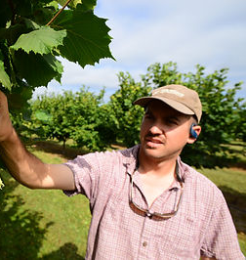
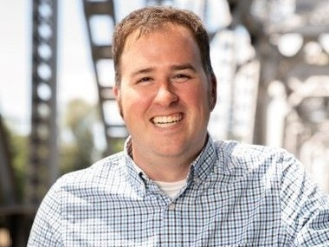
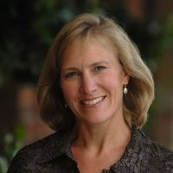
SPEAKERS
Dylan Branch
Alex Paraskevas
Erik Andersson
Theresa Haskins
SEDCOR
SEDCOR
PGE
Riddel Farms

Slide 3
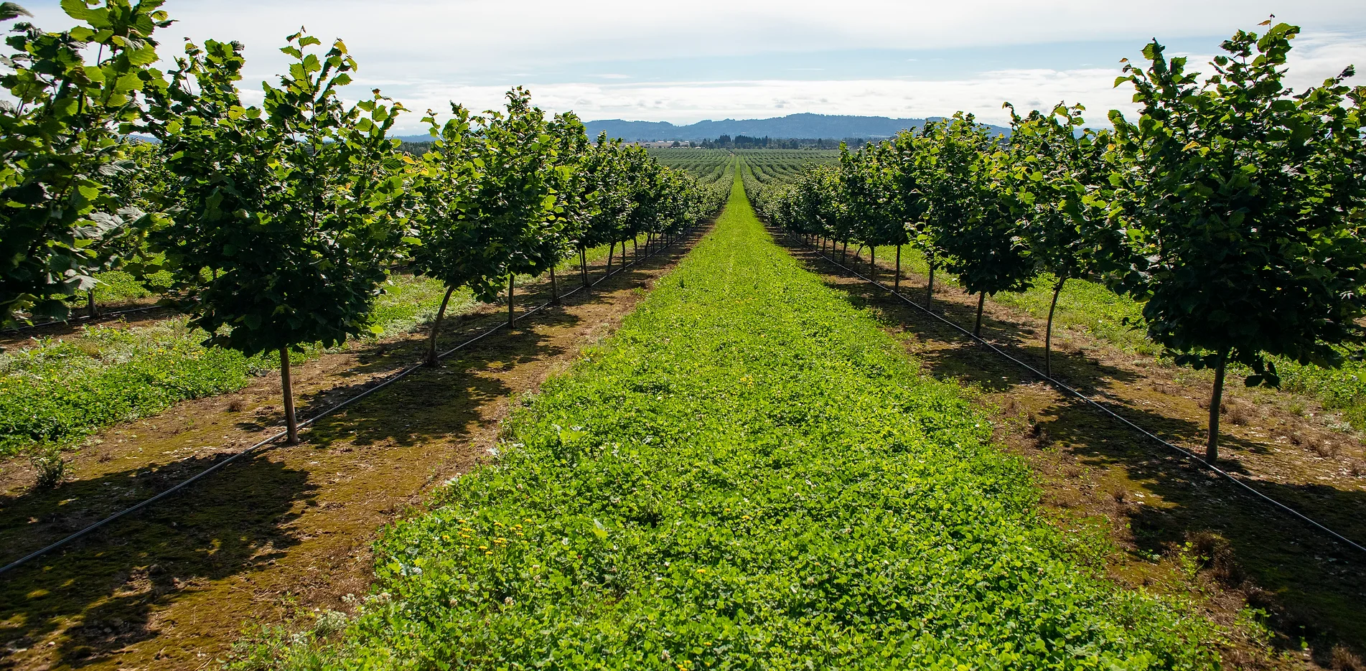
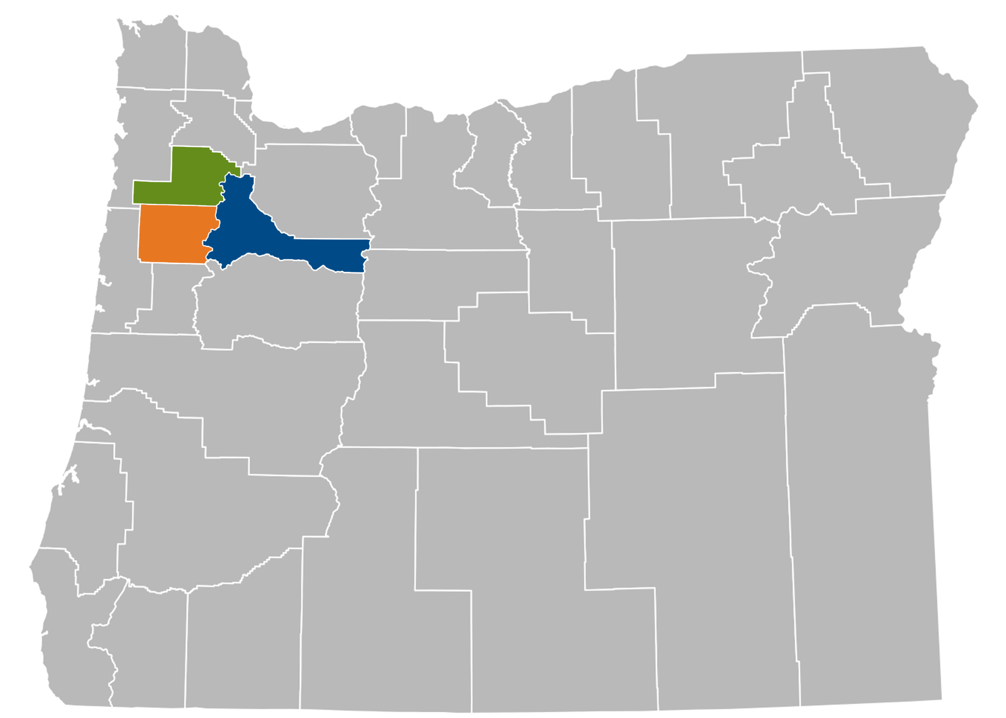
The Ag Supply Chain as an Economic Development Target: Agriculture, Food & Beverage Are Traded Sectors Too
October 9, 2023
Eugene, Oregon
Helping our region’s most vital and innovative businesses thrive.

Slide 4
The Ag Supply Chain as an Economic Development Target: Agriculture, Food & Beverage Are Traded Sectors Too
Moderator: Theresa Haskins, Portland General Electric
Panelists: Erik Andersson, SEDCOR
Dylan Branch, Riddell Farms, Inc.
Alex Paraskevas, SEDCOR
Helping our region’s most vital and innovative businesses thrive.

Slide 5
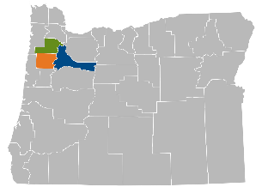

Slide 6
Helping our region’s most vital and innovative businesses thrive.

Slide 7
Thank You
Helping our region’s most vital and innovative businesses thrive.

Slide 8
Thank You!
SPONSORS

