Slide 1
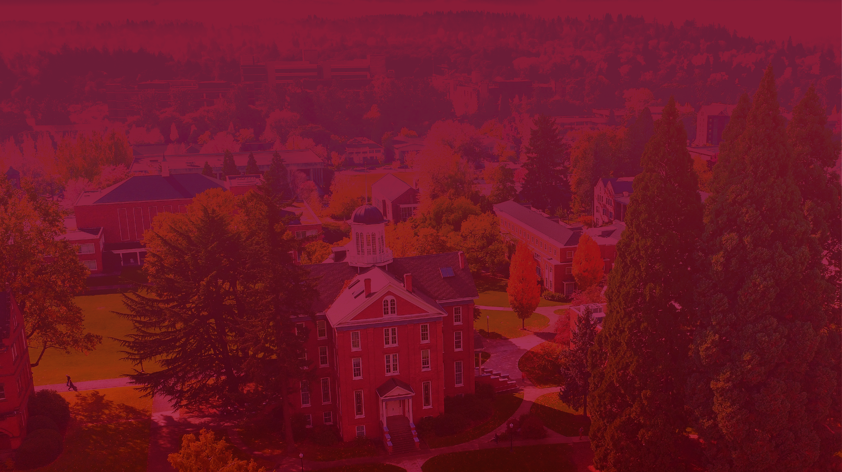

Slide 2
Exploring the Impact of AI on Economic Development
Jameson Watts, PhD
Dean, School of Computing and Information Sciences
Willamette University

Slide 3
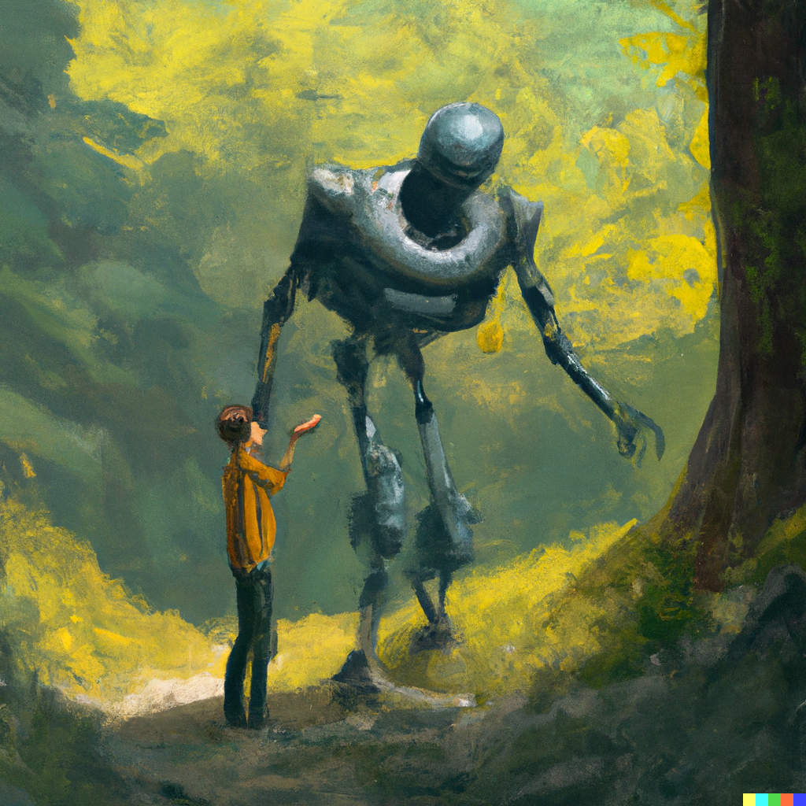
DALL-E Prompt: Humans and Robots Playing in an Oregon Forest.
Notes:
When I was a freshman in high school, I was part of the last class that ever learned to type on an actual typewriter.
Well, a lot has changed in the 30 years since then.
For instance, I no longer use a typewriter.
My kids are learning to type in 3rd grade
And these days, ChatGPT does most of the typing for me.
Not only that, Open AI’s Dall-e application created all the images for this presentation
The world continues to change.
And productive coexistence with technology is not guaranteed.
Our jobs—and I mean quite literally our jobs---depend on thoughtful use of this new class of tools for economic development

Slide 4
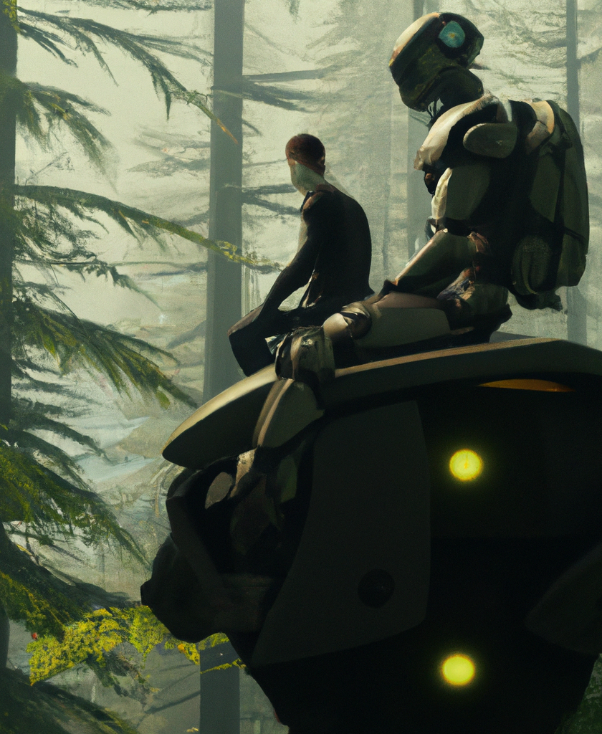
Agenda
Applications of AI for Oregon
Skills for an AI-assisted future
Discussion

Slide 5
Applications of AI for Oregon

Slide 6
A (very) brief history of AI
1990s
2000s
2010s
Rise of Machine Learning
Deep Learning Dominance
Now
Generative AI
Rule-based AI
Data + Power
Notes:
Believe it or not, I wrote my very first AI app in 1999 for an elective course on machine learning. I used the Perl programming language to implement a shallow neural network for handwriting recognition
1990s - Expert Systems and Rule-Based AI:
Expert Systems: These were computer systems that emulated the decision-making abilities of a human expert. They relied on a set of manually crafted rules.
Backpropagation: Although the concept existed before the 1990s, it began to gain traction during this period, leading to the growth of neural networks.
Reinforcement Learning: This concept began to gain popularity, particularly Q-learning, which provided a foundation for many contemporary AI systems.
2000s - The Rise of Machine Learning:
Support Vector Machines (SVM) and Random Forests: These became popular machine learning models for classification tasks.
Natural Language Processing (NLP): Statistical methods, such as Latent Dirichlet Allocation (LDA) for topic modeling, started to dominate the NLP scene.
Deep Learning Begins: Pre-training strategies for deep architectures, including early work on Deep Belief Networks by Geoffrey Hinton and his team, sowed the seeds for the deep learning revolution.
Datasets and Competitions: Platforms like Kaggle began hosting machine learning competitions, encouraging the development and sharing of advanced models.
2010s - The Deep Learning Revolution:
Deep Neural Networks: The success of deep learning models in the ImageNet competition, particularly Convolutional Neural Networks (CNNs), propelled deep learning to the forefront.
Transfer Learning: Models like BERT, GPT, and their derivatives revolutionized NLP, allowing for pre-trained models to be fine-tuned on specific tasks.
Generative Adversarial Networks (GANs): Introduced by Ian Goodfellow and his team, these became a powerful tool for generating synthetic data.
Reinforcement Learning Advances: Techniques like Deep Q Networks (DQNs) and algorithms like AlphaGo by DeepMind showcased the potential of combining deep learning and reinforcement learning.
Explainable AI (XAI): As deep learning models became more prevalent, there was a push to understand and interpret their decision-making processes.
Edge AI: With the improvement in hardware, AI began moving from centralized data centers to edge devices, such as smartphones and IoT devices.
2020s - Ethics, Generalization, and Integration:
Ethics in AI: Concerns over fairness, accountability, transparency, and biases in AI have led to a surge in research focused on ethical AI.
Few-shot and Zero-shot Learning: Techniques aiming to train models on limited data started becoming prominent.
AI in Real-world Applications: Integration of AI in sectors like healthcare, finance, automotive (self-driving cars), and more.
Language Models: The rise of large-scale models, like GPT-3 and GPT-4 by OpenAI, showcased the capability of AI in generating human-like text.

Slide 7
A (very) brief history of AI
Follow
Learn
Predict
Generate
Data + Power
Notes:
1990s - Expert Systems and Rule-Based AI:
Expert Systems: These were computer systems that emulated the decision-making abilities of a human expert. They relied on a set of manually crafted rules.
Backpropagation: Although the concept existed before the 1990s, it began to gain traction during this period, leading to the growth of neural networks.
Reinforcement Learning: This concept began to gain popularity, particularly Q-learning, which provided a foundation for many contemporary AI systems.
2000s - The Rise of Machine Learning:
Support Vector Machines (SVM) and Random Forests: These became popular machine learning models for classification tasks.
Natural Language Processing (NLP): Statistical methods, such as Latent Dirichlet Allocation (LDA) for topic modeling, started to dominate the NLP scene.
Deep Learning Begins: Pre-training strategies for deep architectures, including early work on Deep Belief Networks by Geoffrey Hinton and his team, sowed the seeds for the deep learning revolution.
Datasets and Competitions: Platforms like Kaggle began hosting machine learning competitions, encouraging the development and sharing of advanced models.
2010s - The Deep Learning Revolution:
Deep Neural Networks: The success of deep learning models in the ImageNet competition, particularly Convolutional Neural Networks (CNNs), propelled deep learning to the forefront.
Transfer Learning: Models like BERT, GPT, and their derivatives revolutionized NLP, allowing for pre-trained models to be fine-tuned on specific tasks.
Generative Adversarial Networks (GANs): Introduced by Ian Goodfellow and his team, these became a powerful tool for generating synthetic data.
Reinforcement Learning Advances: Techniques like Deep Q Networks (DQNs) and algorithms like AlphaGo by DeepMind showcased the potential of combining deep learning and reinforcement learning.
Explainable AI (XAI): As deep learning models became more prevalent, there was a push to understand and interpret their decision-making processes.
Edge AI: With the improvement in hardware, AI began moving from centralized data centers to edge devices, such as smartphones and IoT devices.
2020s - Ethics, Generalization, and Integration:
Ethics in AI: Concerns over fairness, accountability, transparency, and biases in AI have led to a surge in research focused on ethical AI.
Few-shot and Zero-shot Learning: Techniques aiming to train models on limited data started becoming prominent.
AI in Real-world Applications: Integration of AI in sectors like healthcare, finance, automotive (self-driving cars), and more.
Language Models: The rise of large-scale models, like GPT-3 and GPT-4 by OpenAI, showcased the capability of AI in generating human-like text.

Slide 8
Forestry
&
Agriculture
Energy
&
Storage
Retail
&
Apparel

Slide 9
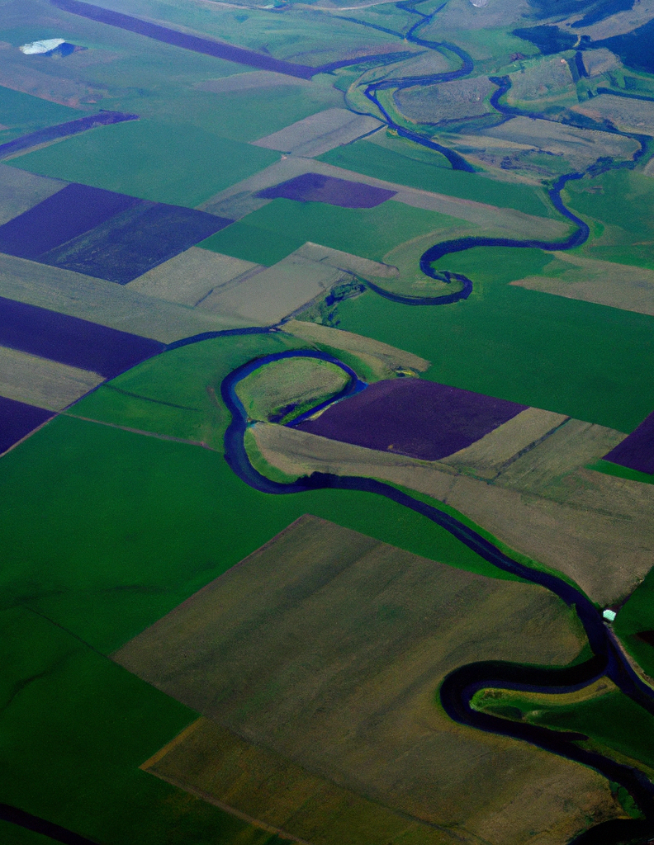
Forestry and Agriculture
Follow a set of predetermined rules to notify farmers of water use
Learn how soil, climate and chemicals yield the best crops
Predict how much water southern Oregon will have next year
Generate a plan for logging that minimizes future fire danger

Slide 10
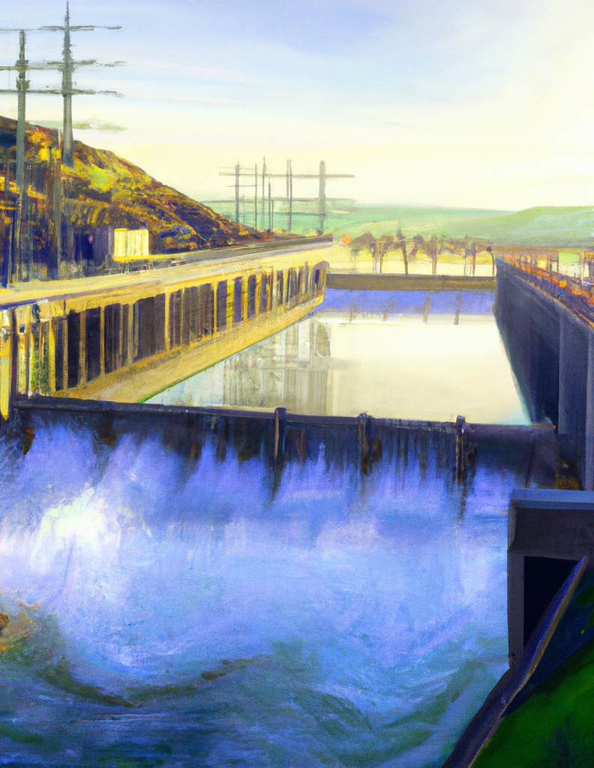
Energy and Storage
Follow known energy usage patterns to interact with smart thermostats
Learn what types of incentives and messaging lead to conservation
Predict how energy usage will change with demand for electric cars
Generate a map of the best locations for offshore wind power

Slide 11
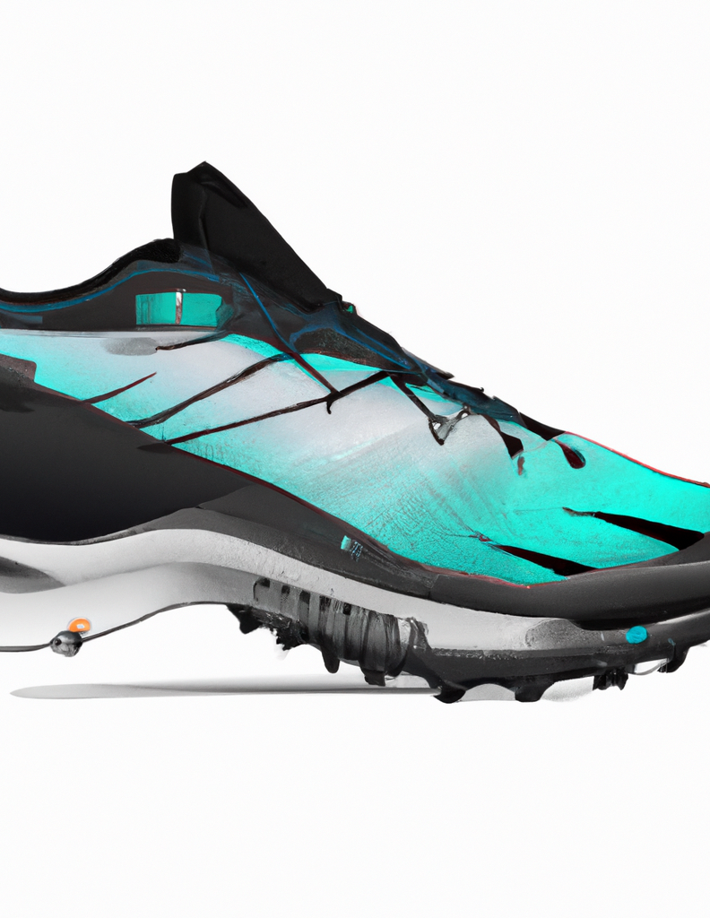
Retail and Apparel
Follow a routine that alerts users when their helmet is impacted
Learn how different activities and usage patterns affect shoe longevity
Predict level of exertion from sensors embedded in your ski boots
Generate a staffing schedule based on video footage of customer traffic

Slide 12
Skills for an AI-assisted Future
Notes:
So we’ve just talked about some of the ways that AI can be used to push Oregon forward. Let’s now take a moment to examine the jobs that will be eliminated and those that could be created as this new technology gains widespread adoption.

Slide 13
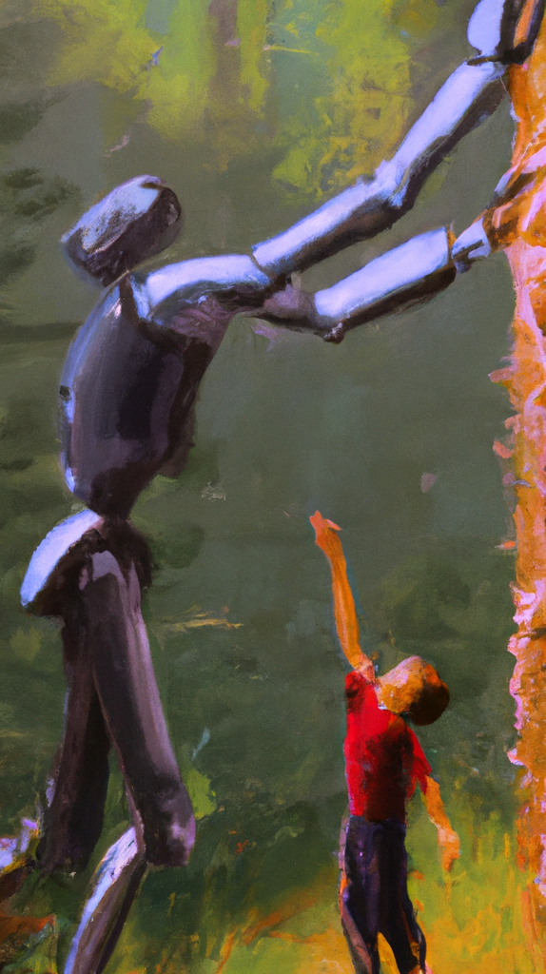
Both manual laborers and knowledge workers at risk
Manufacturing: Jobs in assembly lines, quality checks, and some aspects of plant operations can be automated using AI and robotics.
Agriculture: Planting, harvesting, and sorting can be automated. Drones equipped with AI can monitor crop health, optimize irrigation, and predict diseases.
Customer Service: First-level support in call centers or chat support, are already being replaced by AI-driven chatbots and voice assistants.
Retail: Tasks like inventory management, billing, and even some sales roles might be impacted with the advancement of AI and robotics.
Banking and Finance: Jobs that involve routine data analysis, credit checks, and even some investment strategies can be automated with AI algorithms.
Notes:
So what’s left?

Slide 14
So what are we left with?
Labor
Serve
Provision
Number of Jobs
Analyze
Direct
Create
Amount of Training Required

Slide 15
Rising income inequality
Humans
Labor
Serve
Provision
Number of Jobs
Analyze
Direct
Create
Amount of Training Required

Slide 16
An optimistic future...
Jobs
Deep contextual knowledge
Strong social skills
Premium on creativity
Economy
Experience, health, and energy
Large social safety net
Subsidized training risk

Slide 17
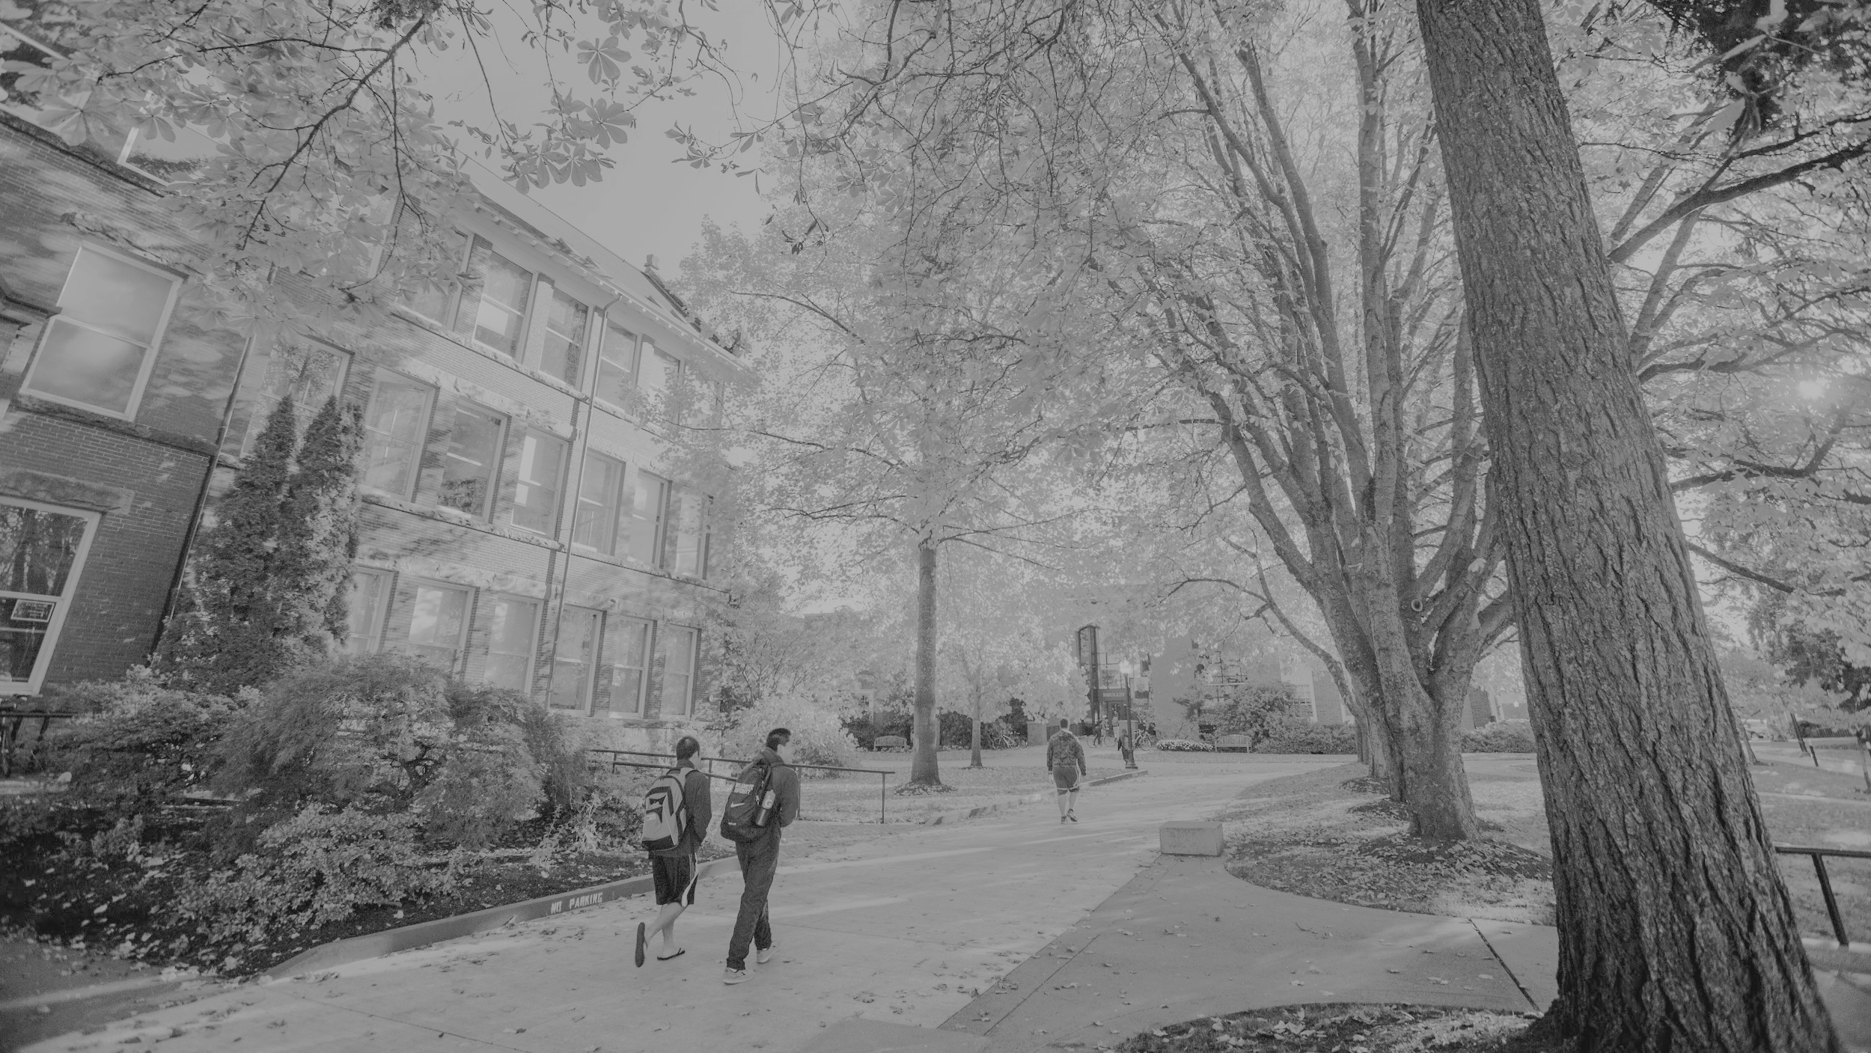
Takeaways
AI is transitioning from prediction (2010s) to generation (2020s)
AI is being adopted in nearly every sector of Oregon’s economy
We can avoid rising income inequality if we invest in education
Notes:
To mitigate potential negative impacts, it's crucial for stakeholders, including policymakers, educational institutions, and businesses in Oregon, to invest in upskilling, reskilling, and education to ensure the workforce is prepared for the changes AI might bring.

Slide 18
Discussion

