Slide 1
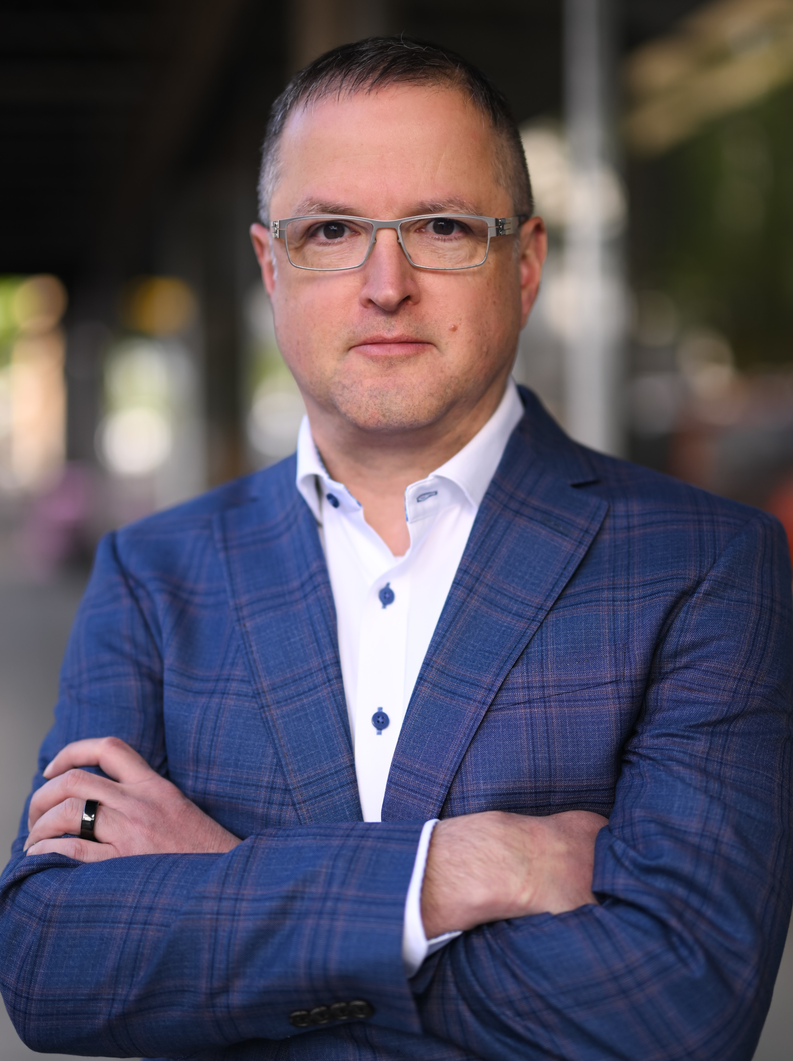
KEYNOTE LUNCHEON
CHRIS OXLEY
Former VP of Government Affairs and
GM of Venues for the Portland Trailblazers

Slide 2
HELLO!
ECONOMIC
DEVELOPMENT
ASSOCIATION
OF
OREGON
CHRIS
OXLEY

Slide 3
Opening Days and nights
Notes:
Opening Day Tradition - Senior Leadership
Works in 4 Professional Sports
Thousands of Music Events
Why - Incredibly Gratifying

Slide 4
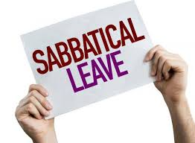
Notes:
Where am I now

Slide 5
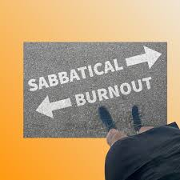
SABBATICATION

Slide 6
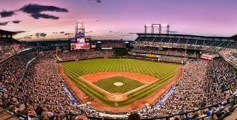
Notes:
Stated at Coors Field
Opening Day of the Inaugural Season
1 of 50K people
Walked out with a new career
Early lessons that I only later comprehended:
- Live Event Experience is Irreplaceable
- Venues build spirit and cohesion in their communities
- Incredible catalyst for development
More on this later. . .

Slide 7
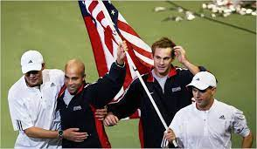
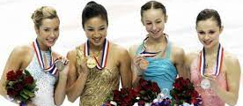
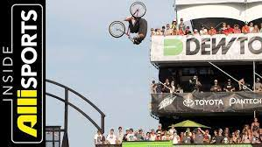
Notes:
Moved to Portland in 1999 to join the TB team and then Rose Garden
Led incredible efforts to bring some of the most compelling events in Oregon hisotry.

Slide 8
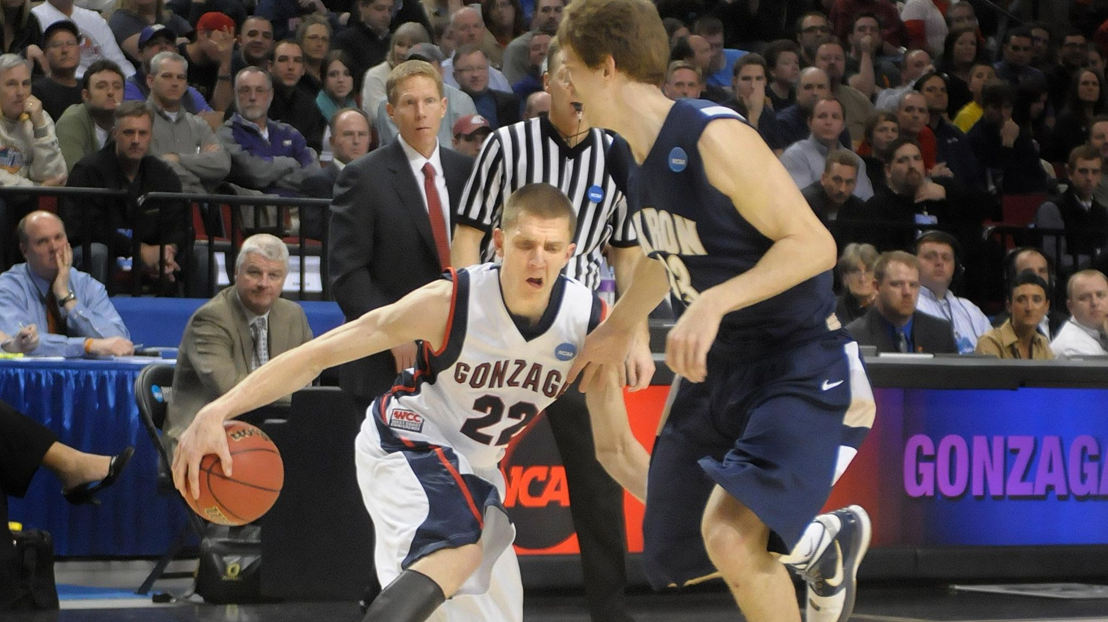
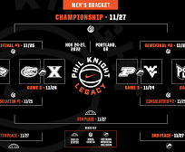
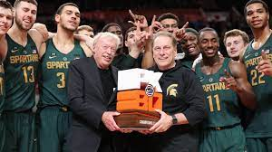
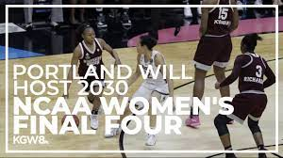
Notes:
Demise of Sports Action and Immediately pounced on the first bid proposal to bring NCAA Championships back to Oregon.
Co-owned and produced PK-80
Greatest and most successful pre-conf basketball event in history
Legacy
On the team that recruited 2030 Women's Final 4
A moment 18 years in the making

Slide 9
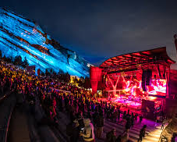
IT’S BETTER LIVE!
Event Venues
Sports
Celebration
Music
Arts
Notes:
Not just a Sports Job:
Venues are community assets
Places of Incredible Celebration
Arenas, Stadium, Theaters, Performing Arts Centers, Convention Centers, Ballrooms
All in the same business - We are a platform for people to have moments they will remember for the rest of their lives.
Kid's Graduation. . .
That special sports moment. . .
Stop for a second - do you remember your first concert?
Show of hands

Slide 10
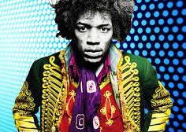
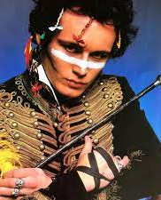
JIMI HENDRIX
ADAM ANT
Notes:
You'd think someone in my position would have had this epic first show.
That's how I like to think of myself.
But no. . . I got this guy.
Anyone know?

Slide 11
Economic Impact of Sports Events and Tourism in the United States
$39.7B in direct spending
$91.8B in total economic impact
$12.9B in total tax revenues
635,000 in total jobs generated
*Sports ETA 2021 State of the Industry Report
Notes:
A bit on sports impact
I believe economic impact was required for any presentation this week. . . so here you go
Big numbers
Don't really have much context
Seems Important
If I asked my youngest. . . Goober

Slide 12
Oregon’s Athletic, Outdoor, Team and Recreation Ecosystem
51,000 jobs
9% of jobs in Greater Portland
$29B per year in Economic Output
Greater Portland Sector has 3,100 small businesses with 20 employees or fewer.
$976M in Tax Revenue
*Oregon: State of Sport Economic Impact Report
Notes:
I do like these numbers though!
Oregon EcoSystem
Larger than either the professional services or accommodation/food services sectors.
Undervalued and Underappreciated

Slide 13
Intersection of sports and government
Taxation
Labor Law
Consumer Protection
Homelessness
Behavioral Health
Unions
Land Use
Strength of business
Environment
Notes:
Big part of my job - Inersection

Slide 14
Intersection of sports and government
Transportation
Sports Betting
PLACEMAKING
Notes:
Focus on 3 areas I though important for this group

Slide 15
transportation
Guest Experience
Carbon Emissions
Statewide Economic Competitiveness
Notes:
Why is transportation important to sports teams
Few Reasons
I'll explain why. . .

Slide 16
Guest experience
CONGESTION
FREEWAY ACCESS
PARKING
VEHICLE FLOW
TRANSIT SAFETY
EGRESS TIMES
Notes:
We are a discretionary and consumer experience business
The live event experience does not just start at the doors to the arena.
It starts with the anticipation leading up to that big night!
Go thru List
Hands down some of the worst scores in consumer sentiment come from transportation to and from a Venue
Have to get this right in order to provide a seamless experience

Slide 17
Carbon emissions
28% From Transportation
75% From Vehicle Transport
73%
Percentage of Total Carbon Footprint
Notes:
AS a sector - 28% of all carbon emissions come from Transportation
75% of those emissions come from Vehicle Transport
Greatest Accomplishments - Lead Gold for EB
First sports facility in the US to do it
Proud to lead on environmental goals
CLICK
73% OF OUR TOTAL EMISSIONS CAME FROM GUESTS MOVING BACK AND FORTH TO THE ARENA.
Trail Blazers as an org had goals too, but so much outside our control.

Slide 18
Statewide Economic Competitiveness
“Congestion in the Portland metro area is having a major impact on the economic vitality of all regions. It not only creates challenges for commuters and businesses in the metro area, it also makes it difficult for producers across the state to move their goods into and through Portland in a predictable, reliable, and timely fashion."
One Oregon: a Vision for Oregon’s Transportation System - 2016
Notes:
Bare with me, but I have to read this.
Click
One of you wrote these. . .
That was 2016!
Keep in mind at this point:
Rose Quarter was estimated at $400m
Now approaching $2billion
- Sports teams count on Oregon's Success
- Thriving Economy
- Strong Business Sector to consume our products
We have to show more urgency on these issues.
Unprecedented $$ at the federal level

Slide 19
Sports betting to professional teams
Fan engagement
Sponsorship
Licensing

Slide 20
The Lottery transferred $909 million to Oregon’s Economic Development Fund.
Lottery revenue is distributed as follows:
1. 53% Public Schools
2. 25.5% Job Creation
3. 7.5% State Parks
4. 7.5% Natural Habitats
5. 4% Outdoor Schools
6. 1.5% Veteran Services
7. 1% Problem Gambling Support
2022 Oregon Lottery Annual Financial Report
Notes:
A Lot of Good Work of the Oregon Lottery
Click
Extremely Important Investments
But the needs of the state are so much greater

Slide 21
2022 Oregon State Lottery Revenues
Total Lottery Revenues
$1.7B
Sports Betting Revenue
$32M
1.9%
Notes:
Lets look at the Revenues
Keep that $1.7B front of mind

Slide 22
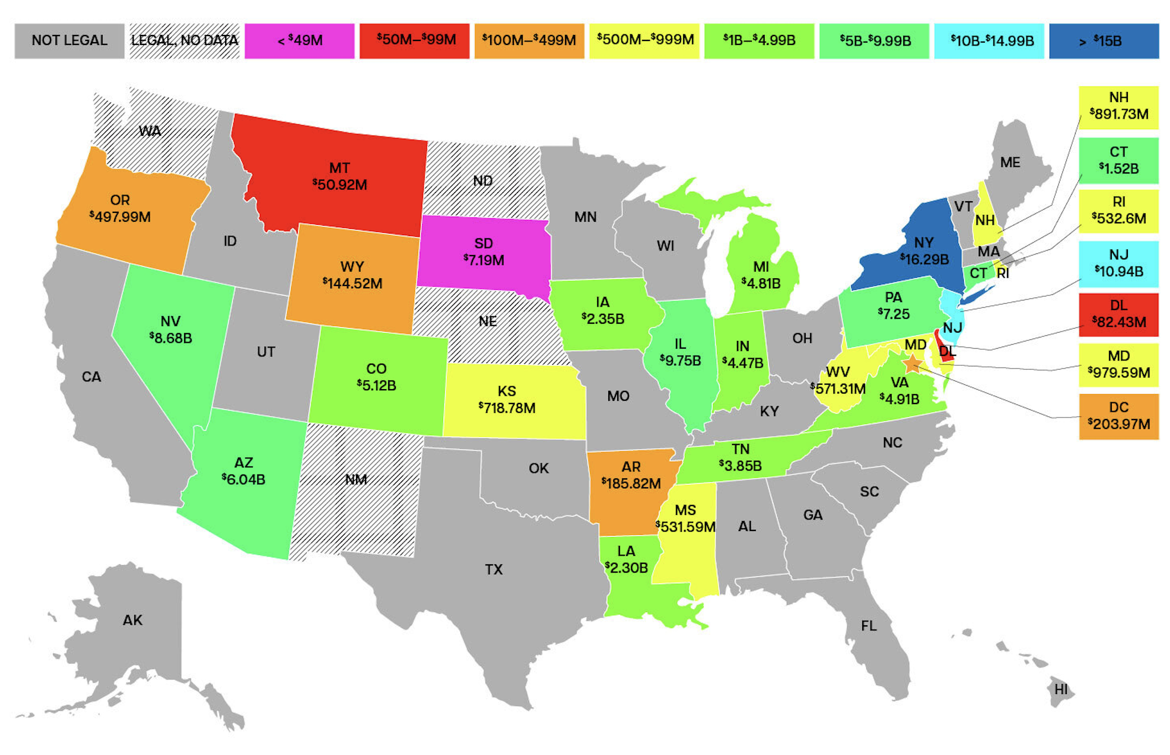
2018 – 2023
https://www.gamingtoday.com/revenue/
Notes:
CT is generating in Sports Betting Revenue almost what the entire lottery see in revenue
Iowa
NH
RI
WV
No Professional Sports Teams and still outpacing Oregon
My argument is this:
- Oregon is tax revenue on the table
- Oregon Lottery monopoly is not working for Oregon
- The current approach is bad for exiting sports teams
- Woefully under pacing other teams on the Sports Betting related revenues.

Slide 23
Year one Tax and License Model
Year One Growth - 6X
$32M = $190M
Tax Revenue
$16M = $30M
Notes:
Recent consultant study
Open market tax and license model
Click through
Just Year 1
- We've chosen to be a sports betting state, but we are also choosing to just not do it well.
- We've also got to choose to do more than a few things at a time.

Slide 24
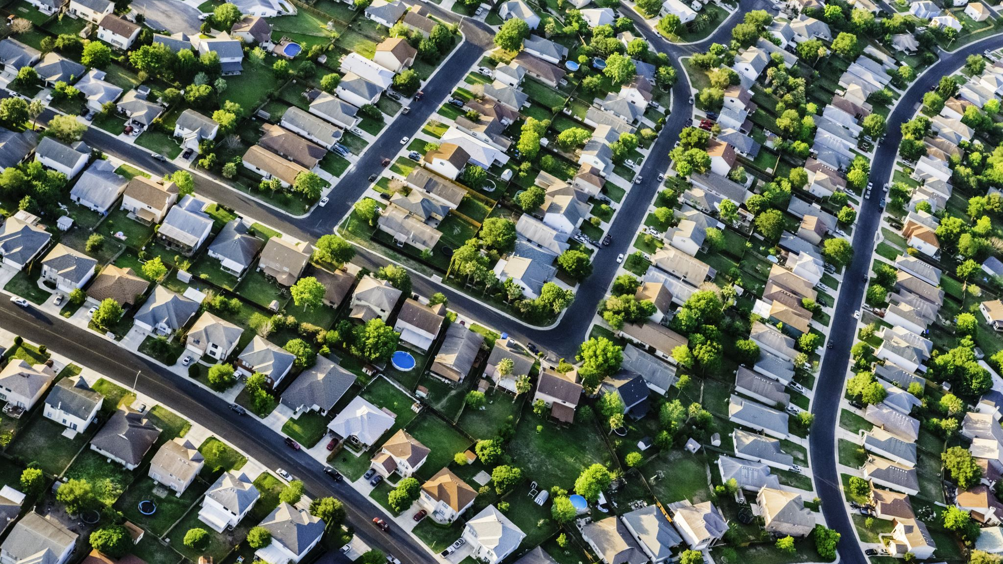
Portland exodus cost Multnomah County $1 billion
Oregonians' overall tax burden is tied to people leaving the state and leaving Portland.
Oregon population decline is cause for concern, say economists
Those who've moved away from Portland in recent years for greener pastures — with affordable housing or lower crime rates — have left a large dent financially.
Notes:
We've all seen the headlines. . .
Placemaking plays a unique role in helping solve these issue
Improved livability is one of the key means for reversing these trends
Most things Portland was known for washed away during Covid. . .
Revitalized interest in music, sports and sports tourism as one of the only catalysts to expedite our recovery.
Those of us on the inside are finally feeling apprecaited
But how do new venues come together?

Slide 25
Placemaking
New venues are frequently located in low-income areas of cities for several reasons:
Inexpensive Land
Empty space
Revitalization
A Stadium or Arena possesses a unique ability to bring new life and development to an area.
Notes:
Placemaking is a major talking point even in good times
Particularly valuable when we are talking about the revitalization of entire metropolitan regions
New venues can be an incredible catalyst for communities
But it must be done responsibly

Slide 26
Story of 2 ballpark developments
Dodger stadium (Chavez Ravine)
Coors field
Designated Slums (30’s)
Eminent Domain
Sacrificed Public Housing Development
1000 Families Displaced
Modern Day LA Downtown
Blighted LODO
Economic Transformation
Downtown Vibrancy
$195M Impact in First Year
All-Star Game Brings $100M
Notes:
Here's the story of 2 ballparks
Neither being the worst of the best, but with different story lines.
Familiar with the story of Chavez Ravine?

Slide 27
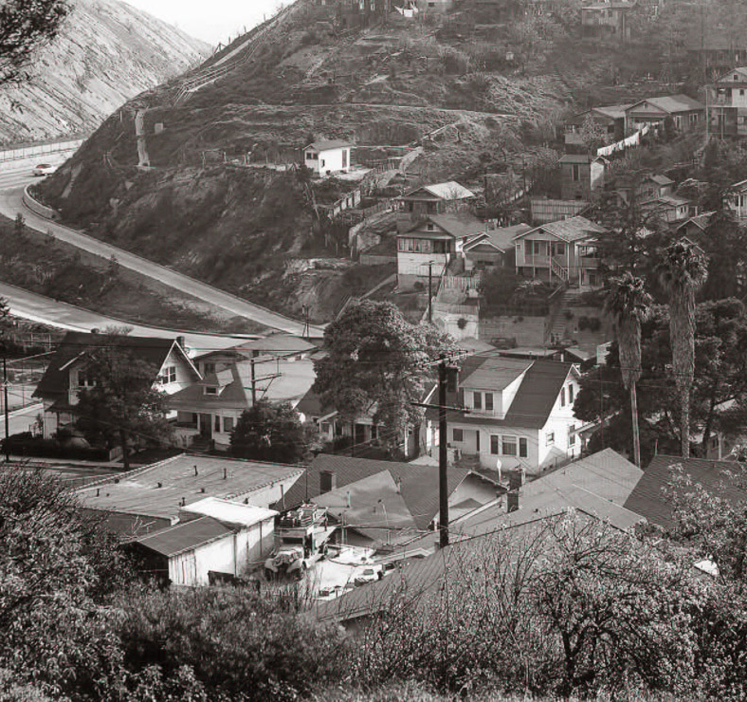
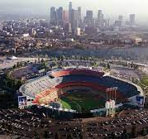

Slide 28
Notes:
In the 50's this is what happened to Aurora Vargas.
Carried out of her home by police as the bulldozers stood by
To her neighborhood, to her home and family.
A generational impact
There any many checks and balances to make sure this practice did not continue, but we must maintain a balance of development and community impact so these stories.

Slide 29
Trends in arena and stadium development
Old School (1960 – 1990)
New School (2000 – 2023)
Create Construction Jobs
Generate New Spending by Fans
Drives Tourism
Attracts New Businesses
Multiplier Effect to Local Economy
Community Benefit Agreements
Living Wage Jobs
Hiring Benchmarks – Where It’s Needed Most
Housing and Social Infrastructure
Environmental Standards and Practices
Notes:
Old School Justification for public investment in public multi-purpose venues
Click
All relevant, but economists have argued this for decades.
The CBA establishes core principles that for public investment, or public subsidies, surrounding communities should see community benefits returned to them.

Slide 30
Value proposition
TANGIBLES
INTANGIBLES
Post-Covid Impact of Live Events
Enhanced Livability
Catalytic Development
Anchor for Public Transportation
Halo Effect on Property Values
Make Cities Bigger
Deepen the Relationship Between Teams and Their Cities
National and International Brand Awareness
Provide Diverse Gathering Platforms
Dodgers – 43% Latino
Notes:
But lets look beyond just the deal points from a negotiation.
There is a more significant value proposition.

Slide 31
Notes:
Set aside the economic impact report and focus on what’s really important.
I've talked about some of my memories. . . here's a few more that you may have.

Slide 32
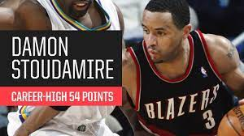
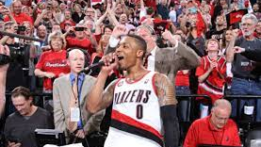
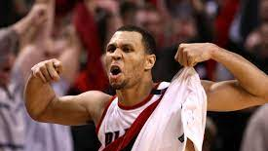
Notes:
Big Shots. . .
Historic in their own right, but not possible without venues that house them.
But this isn't just about sports

Slide 33
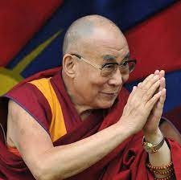
Notes:
Meeting the Dali Lama goes down as one of my greatest moments
Click
10,000 other people that got to experience his holiness
Does anyone remember this?
I've been a part of 3 or 4 Presidential Visits
And some wanna be presidential visits

Slide 34
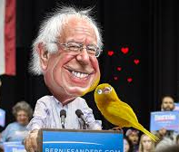
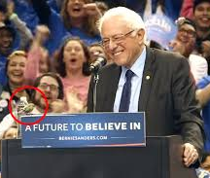
Notes:
An incredible moment on in Portland. . .
At the height of Portlandia. . . a bird lands on his podium
An incredible embarrassment for the guy responsible for the venue
Does anyone remember this?
I chose to recall the moment looking like this
Click

Slide 35
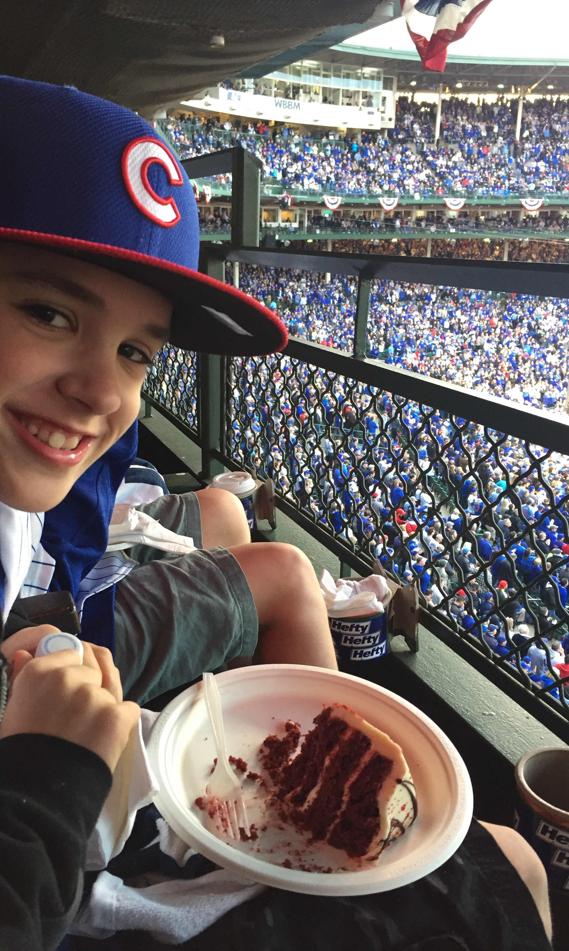
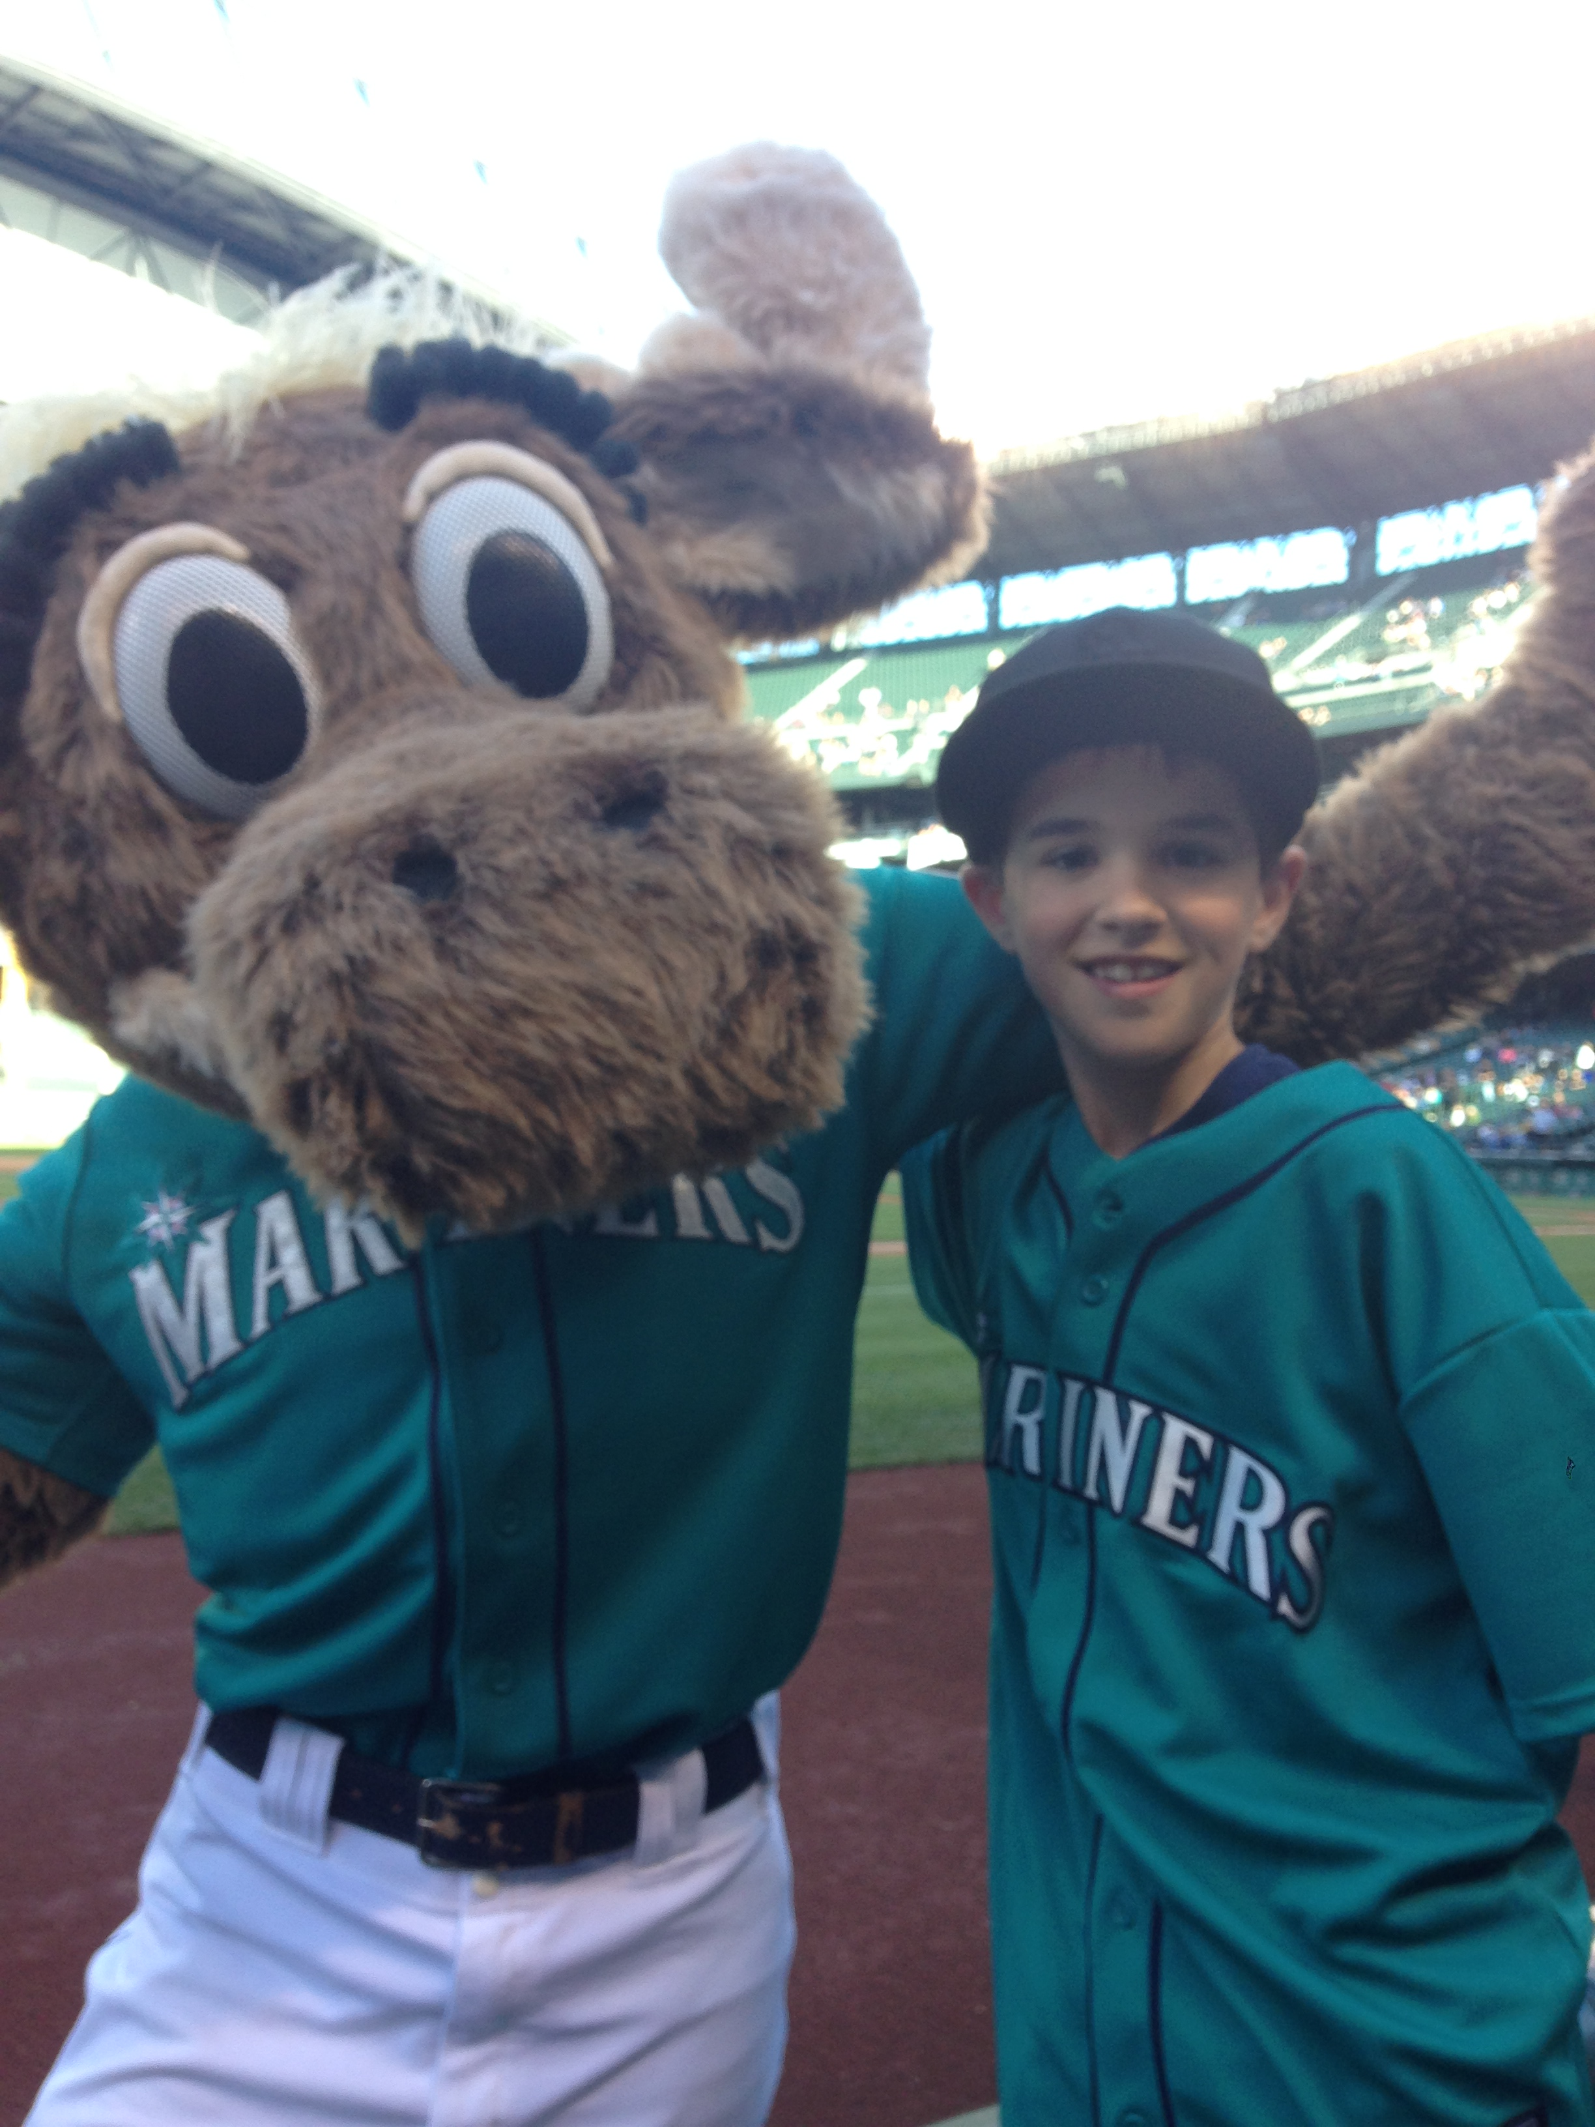
Notes:
Some of my most impactful moments have been seeing the live event business through the eyes of my children.
I am sure you have all shared those moments as well
It made me proud to do the work that I do

Slide 36
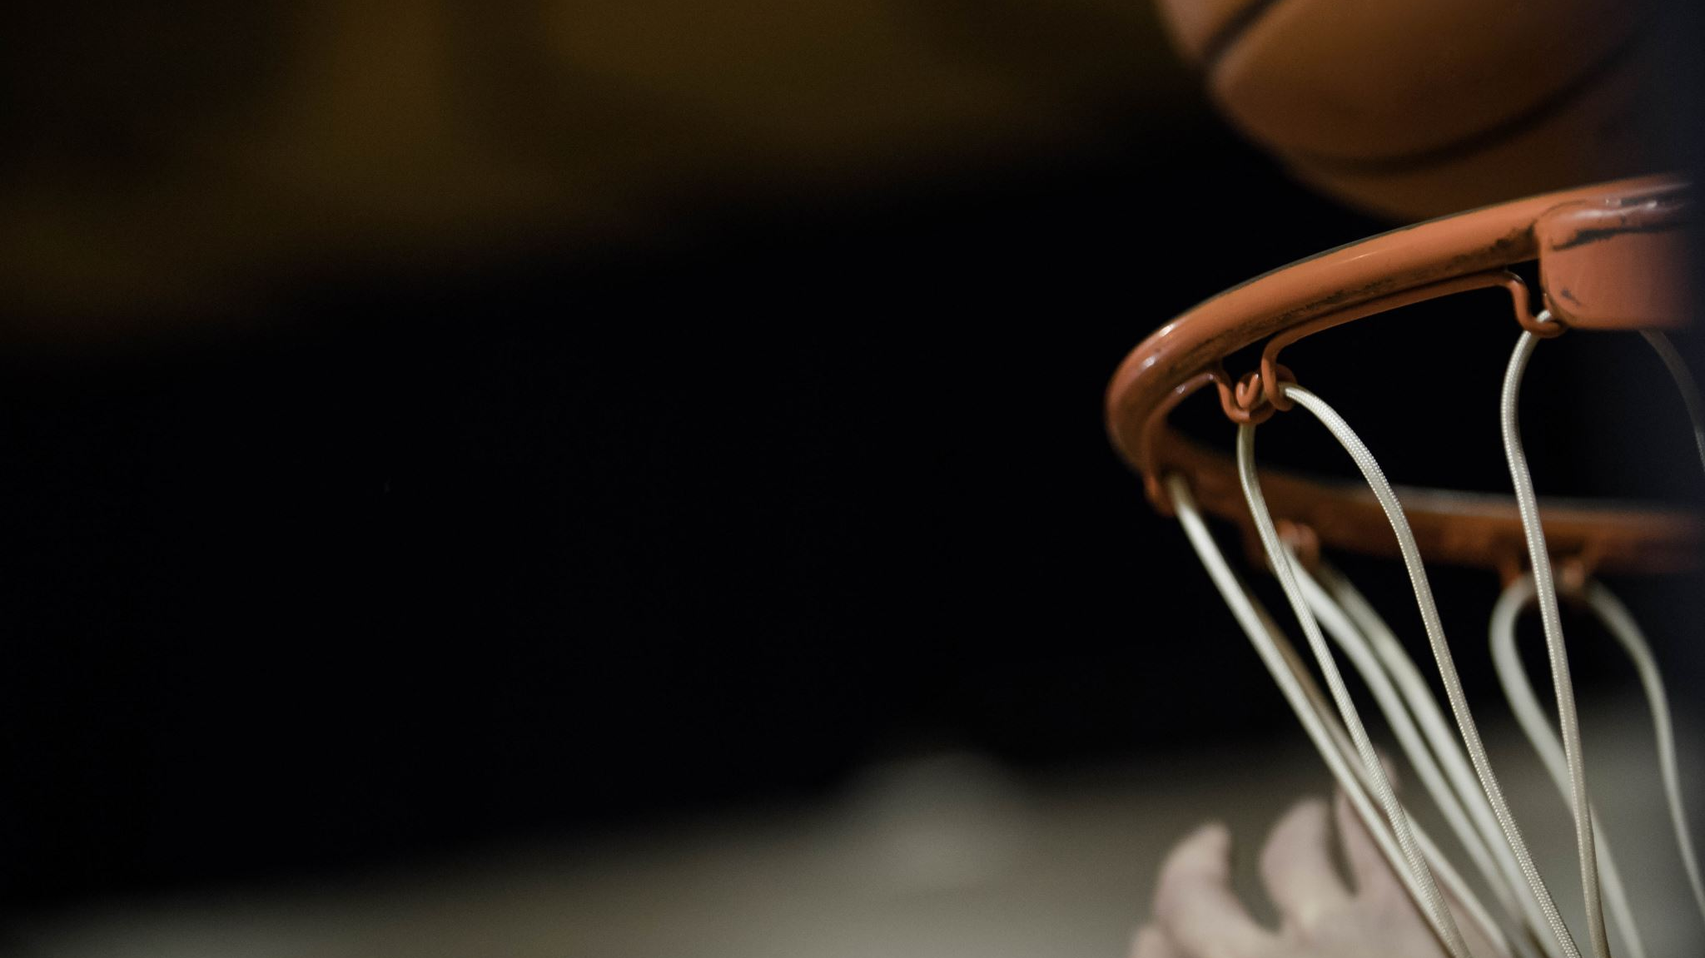
the Big set up
2003 – 2 years after 9.11
NBA Playoffs
National TV
Game 3 – Trail Blazers v Dallas Mavericks
Blazers Down 0-2 Back at Home
Packed House of 20,000
Notes:
One of the most galvanizing moments in sports
I can feel you non-sports folks averting your eyes. . .
Stay with me.
Trail Blazer fans are some of the best in sports

Slide 38
Maurice Cheeks Moment
"I didn’t know I would do that."
”I did not want her to be standing in the middle of all those people and not know the words. So I just kind of reacted.”
“I don’t even know why.”
Notes:
Navigated with Ease
Quickly became a national story
Coach Cheeks said after some time had past. . .

Slide 39
Take this with you!
Toxic insecurity
Toxic ambiguity
Lack Empathy
Conceal or Compensate for Self-Doubt
Extremely Risk Averse
Unproductive
Fog of Poor Communication
Crisis of Accountability
Unprepared for Ambiguous Situations
Unclear on Role
Notes:
Could have left you with that heart warming moment, but not my style.
I would usually bring all of this brand stuff, but today I leave you with words. . .
There are learning from the discussion today
2 Toxins being inflicted on our society
Click
Insecurity - Personalize
Ambiguity - Mo Cheeks
One Person to Resolve that issue
Sense of Urgency

Slide 40
My personal lesson
Be Confident
You were given the job because you have talent and experience. Trust your instincts.
Be Decisive
Don’t take too much counsel of your fears. Be thoughtful, but not paralyzed by indecision.
Be Passionate
Show your employees you care about them and about the mission.
The Wisdom of the Bullfrog. Admiral William H. McRaven

Slide 41
"Life is not easy for any of us. But what of that? We must have perseverance and above all confidence in ourselves. We must believe that we are gifted for something and that this thing must be attained."
-MARIE CURIE
Notes:
French Scientist Marie Curie
I bid you Adieu

Slide 42
PM BREAKOUT SESSIONS
BREAKOUT A: "TIF COMMITTEE: Guided Roundtable Discussion"
BREAKOUT B: "OREGON'S SEMICONDUCTOR INDUSTRY:
what happened in 2023 and what's next"

