Slide 1
Creating a Marketing Plan
April 18, 2018

Slide 2
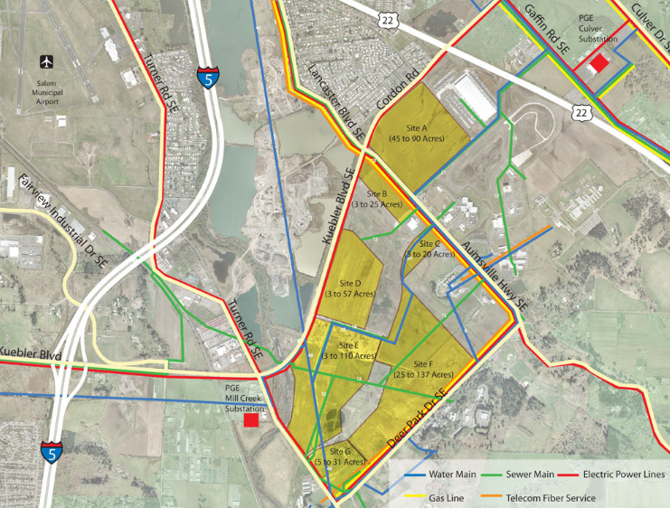
Product
What do you have to sell?
Land
Building space
Talent
Transportation access
Natural resources
Lifestyle amenities

Slide 3
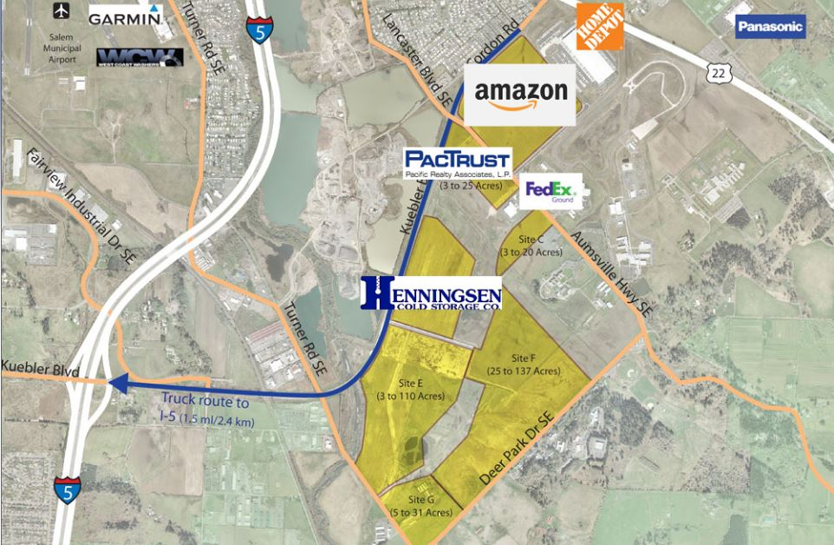
CUSTOMER
Who needs what you have to sell?
Distribution centers
Food processors
Other manufacturing

Slide 4
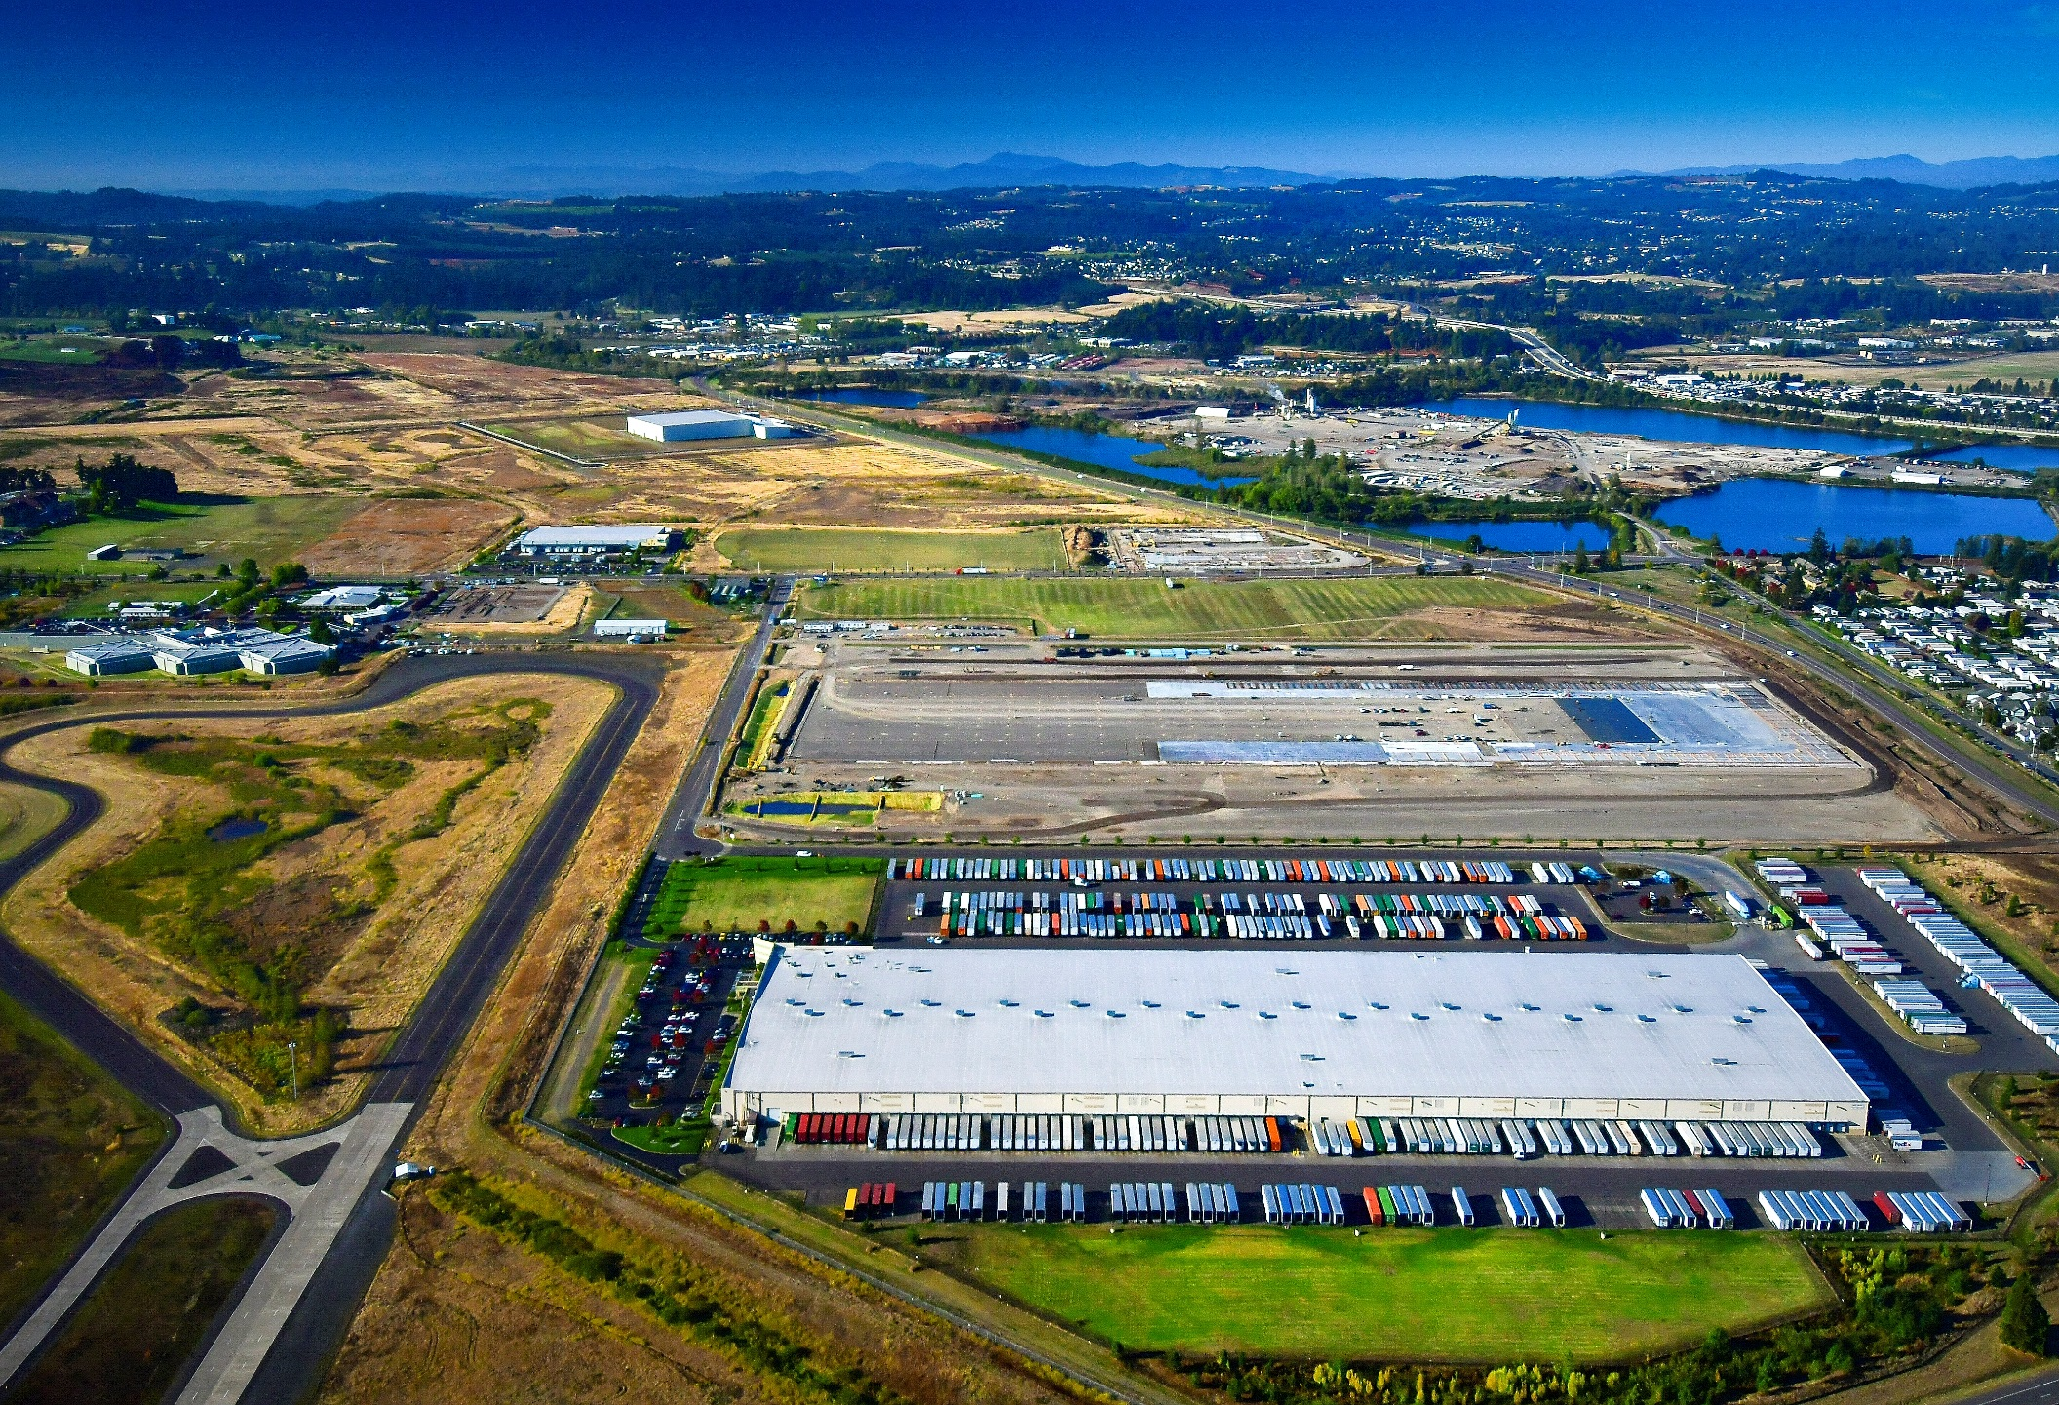
VALUE PROPOSITION
Why do they need what you’re selling?
Transportation access
Large parcels
Fast project delivery
Workforce
Cost affordability

Slide 5
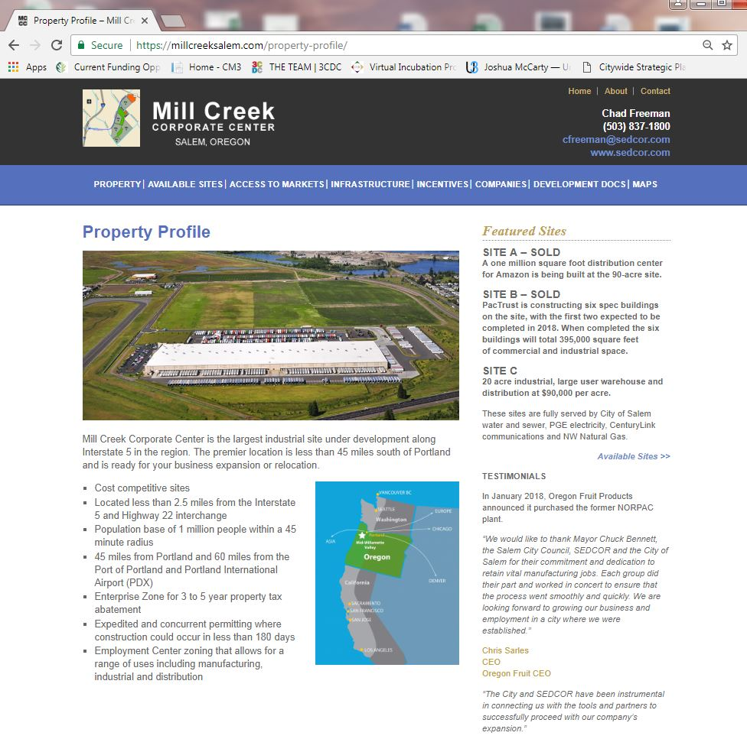
MESSAGING
How do you share your product and value proposition with customers?
Partnerships
Tools
Working your network
Collateral
Testimonials

Slide 6

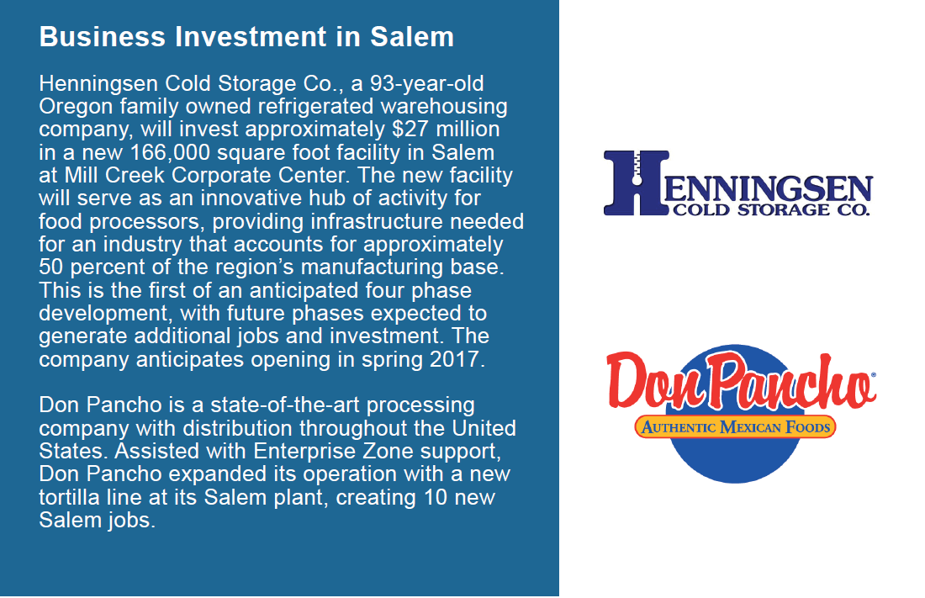
METRICS
How are you measuring your marketing performance?
Contacts made
Acres developed
Jobs created
Growth in AV
Project delivery speed

Slide 7
QUESTIONS?

