Slide 2
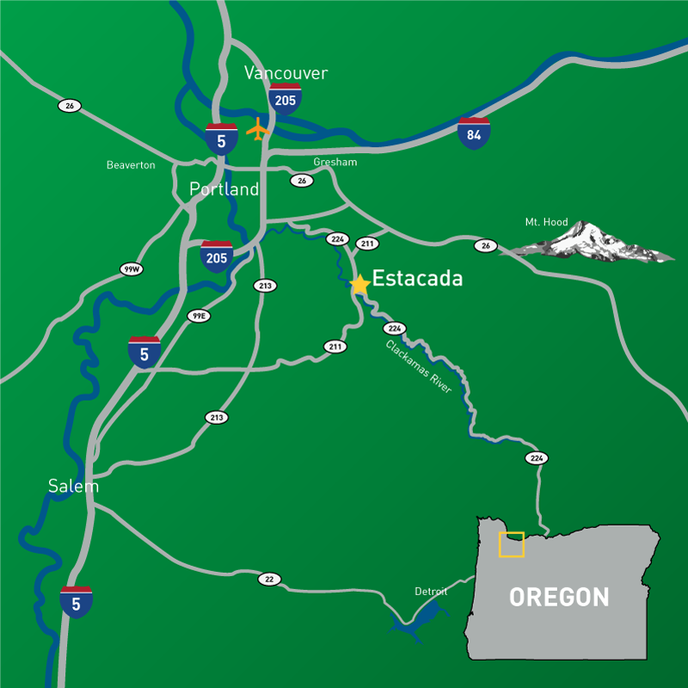
Extatada?
Es – tuh – cay – duh
Pop. 3250
Founded 1905, during era of dam construction on Clackamas River
Logging/Lumber Heritage
Bright future

Slide 3
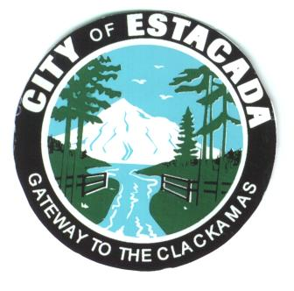
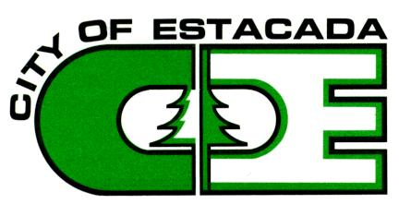
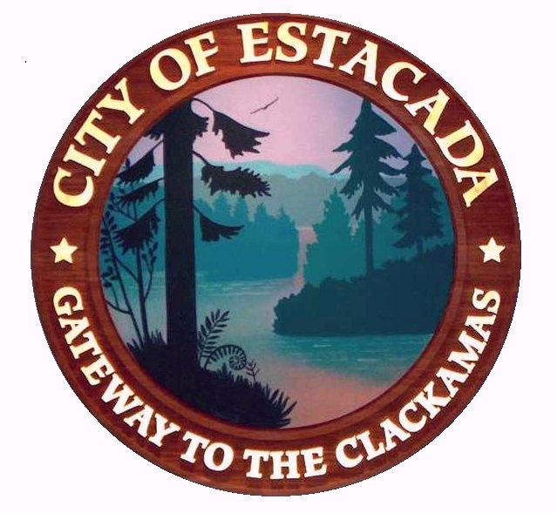

Slide 6
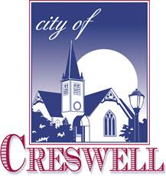
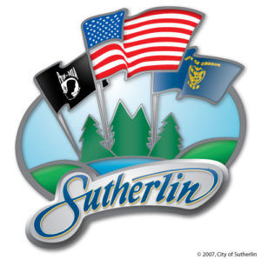
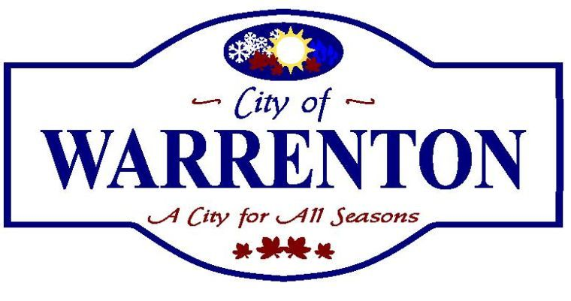

Slide 7
Timeline
Council Goal Setting - January 2015
Community “Summit” – February
Branding Committee Formed – March

Slide 8
Branding Committee
Downtown/Main Street
City Council & Staff
Forest Service
School District
Local Business Owners
Chamber of Commerce
Arts Community

Slide 9
Timeline
Council Goal Setting - January 2015
Community “Summit” – February
Branding Committee Formed – March
RFP Issued – April
Hired Consultant – Late April
Survey residents and visitors – Summer
3 concepts presented & refined – October-Dec
Logo/Brand/Messaging Selected – December
Implementation/Embrace – 2016 +

Slide 10
Reception
Mostly positive
Some negative
The logo makes it seem like we’re the “un” city
Many also feel the word “Estacada” is crossed out by the river.
“There was just a select group of people on the community. There wasn’t enough community input.”
City councilor _____________initially joined the branding committee, but left because he disagreed with its direction.
“New Estacada logo draws mixed reviews”, Estacada News, March 3, 2016

Slide 11
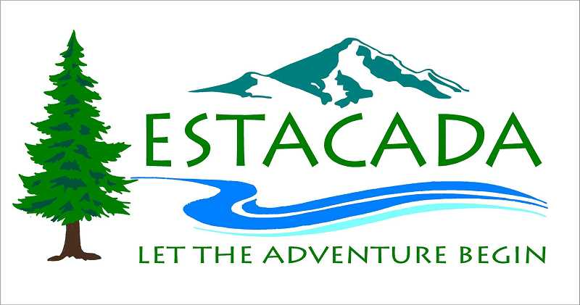

Slide 12
Implementation
Styleguide
Brand implementation Grant
Messaging
New City Website
Tourism-focused videos & photography
Used for social media campaign
Will appear on Comcast this summer
Promotional Brochure (digital & print)

Slide 13
Messaging Sample
Escape to Estacada. Go from the roar of traffic to the rhythm of the river. Grab two fat tires or one big paddle. Cycle, paddle, float, ramble or climb. Immerse yourself in trees, sky, and water; summer’s greens and winter’s whites. Or wander through town to discover our history in murals, explore galleries and stop for a local craft beer. Events and festivals, celebrations, concerts and shows await. It’s an untamed, choose-your-own-adventure place with acres and acres of forest and miles and miles of river right here. A bit quirky, definitely different, and certainly unforgettable.

Slide 14
Budget
Source | Amount
City of Estacada | $13,800
Estacada Community Foundation | $1,000
Ford Family Foundation | $5,000
TOTAL | $19,800

Slide 15
VIDEOS WEBSITE

Slide 16
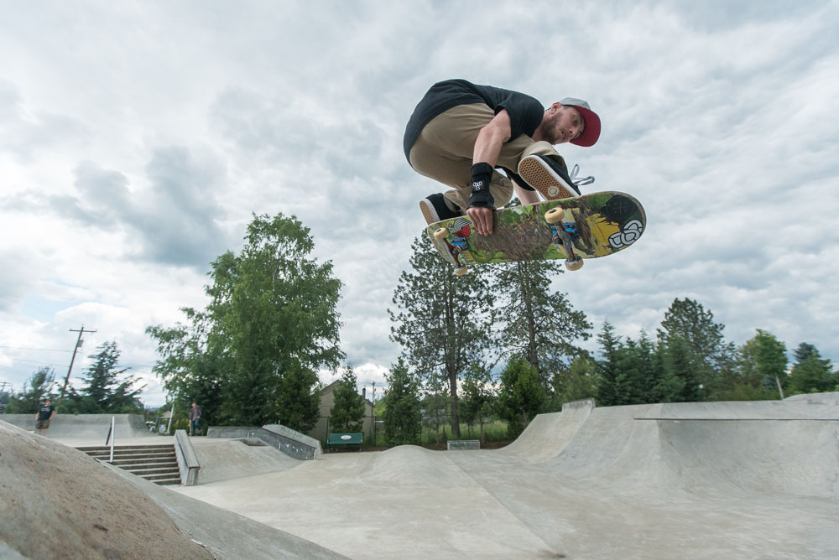

Slide 18
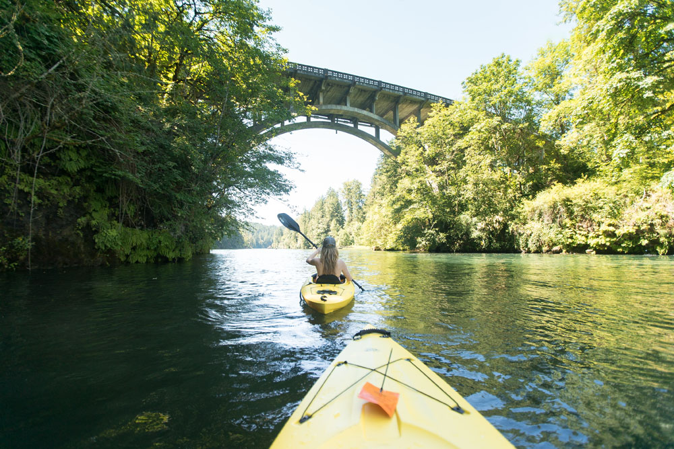

Slide 19
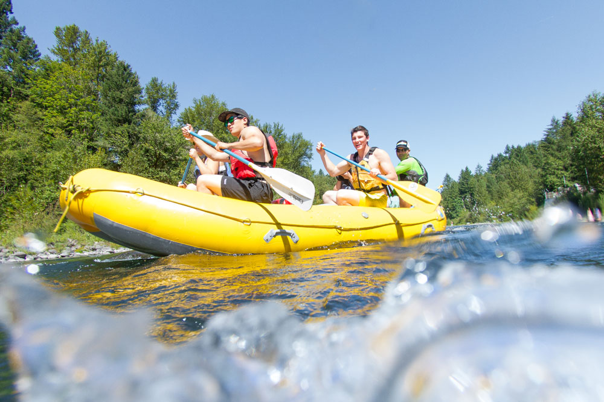

Slide 20
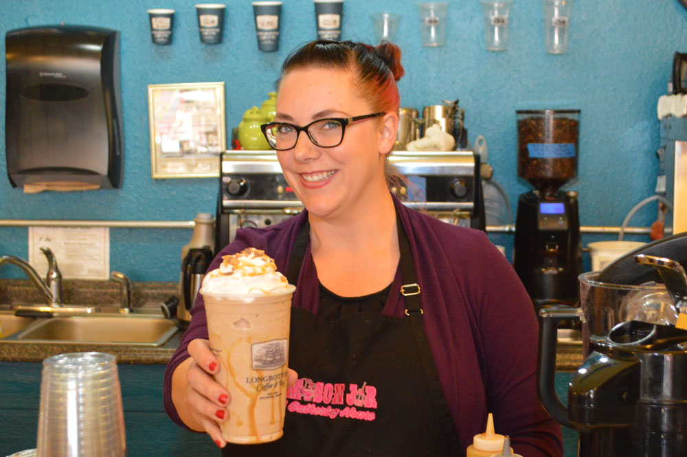

Slide 21
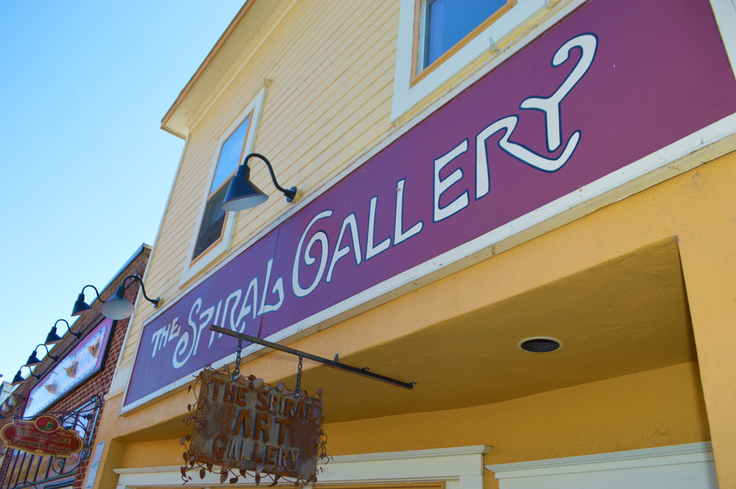

Slide 22
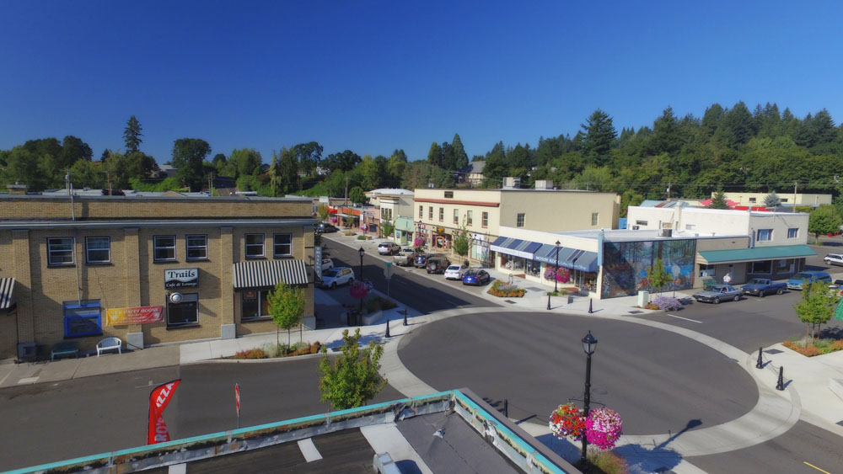

Slide 24
Takeaways (especially for small cities)
Strategic Doing > Strategic Planning
Find partners and share costs
Representative Democracy
Haters gonna hate
Comprehensive Approach
A logo is only one piece
Be “that guy” – follow and enforce the styleguide
Resist the temptation to go DIY…
Hire a professional

Slide 25
