Slide 1

Marketing for Small Communities

Slide 2
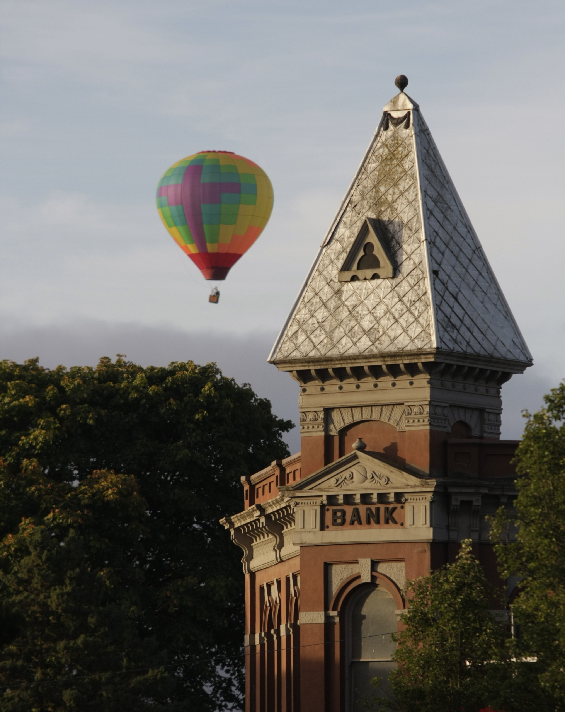
What’s your Message?
What are you doing and WHY?
What’s the big picture?
Who are you, and who do you want to be?
Be real, but aspirational
Develop your elevator pitches
Notes:
Attitude sets the tone – you are what you say you are

Slide 3
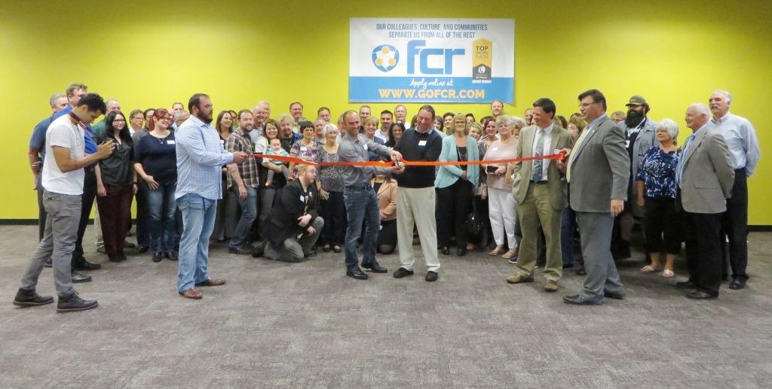
What’s your Plan?
Word of mouth
Social media
Local news
Ribbon cuttings
Local ambassadors

Slide 4
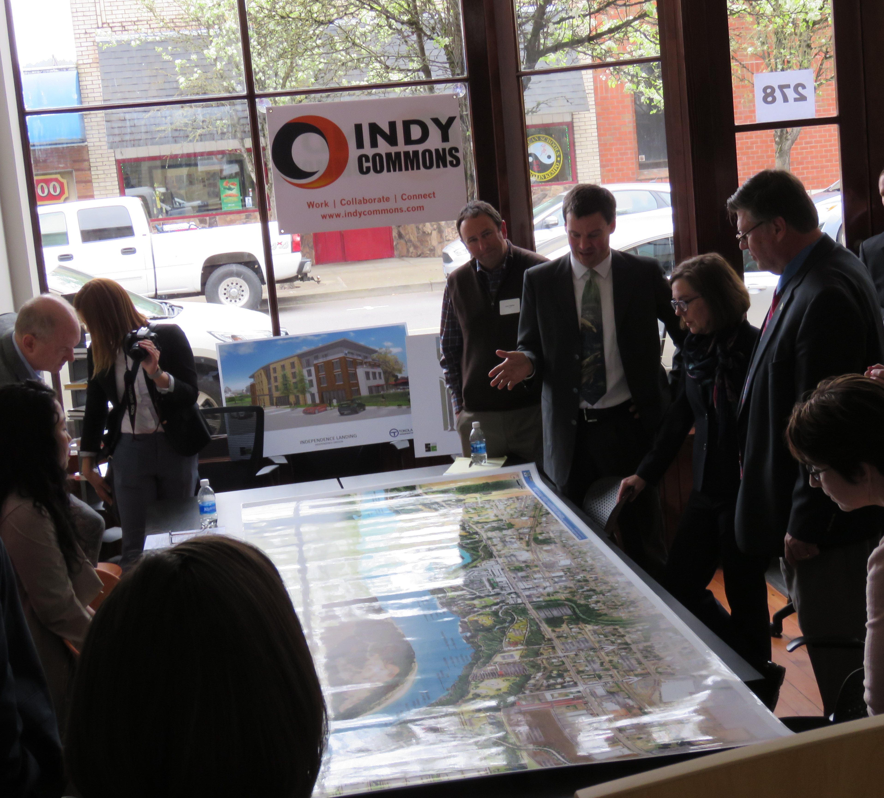
Keep your Eye on the Big Picture
Don’t forget to say WHY you are doing this
Opportunity to link to your brand/identity
This is the part that hooks people and media

Slide 5

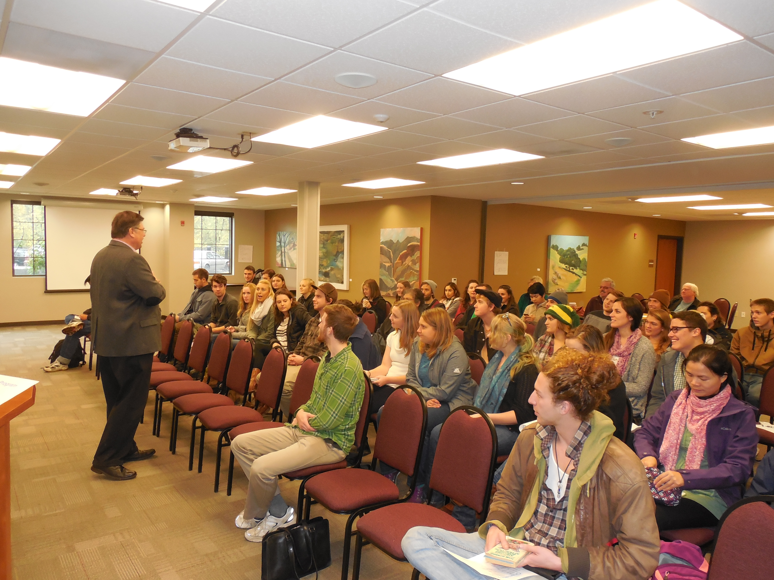
Get Creative

Slide 6
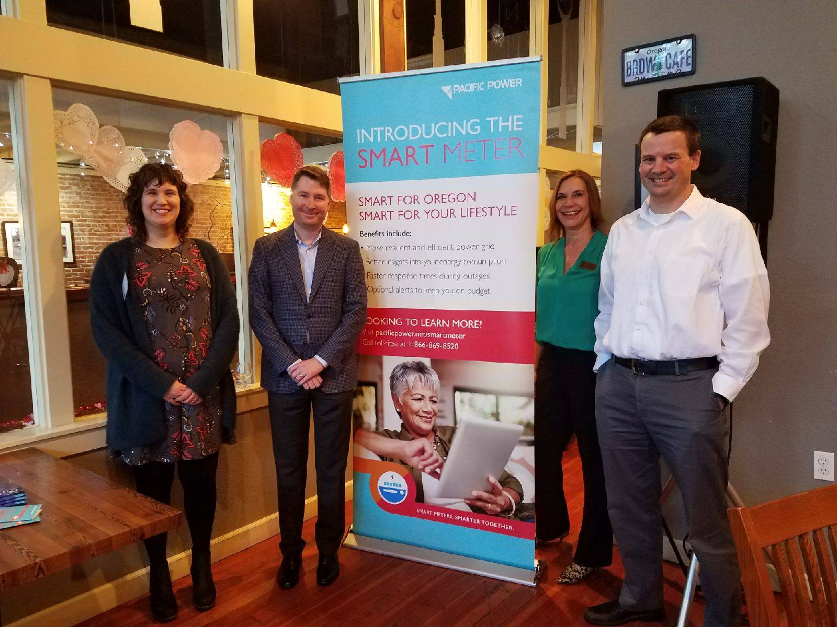
Find Partners to Work with
Notes:
commercial grade mesh network

Slide 7
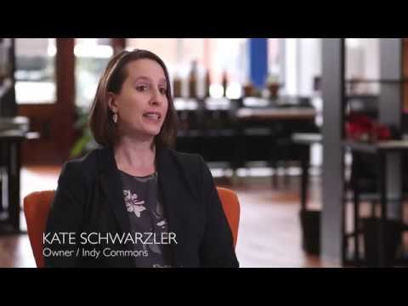

Slide 8
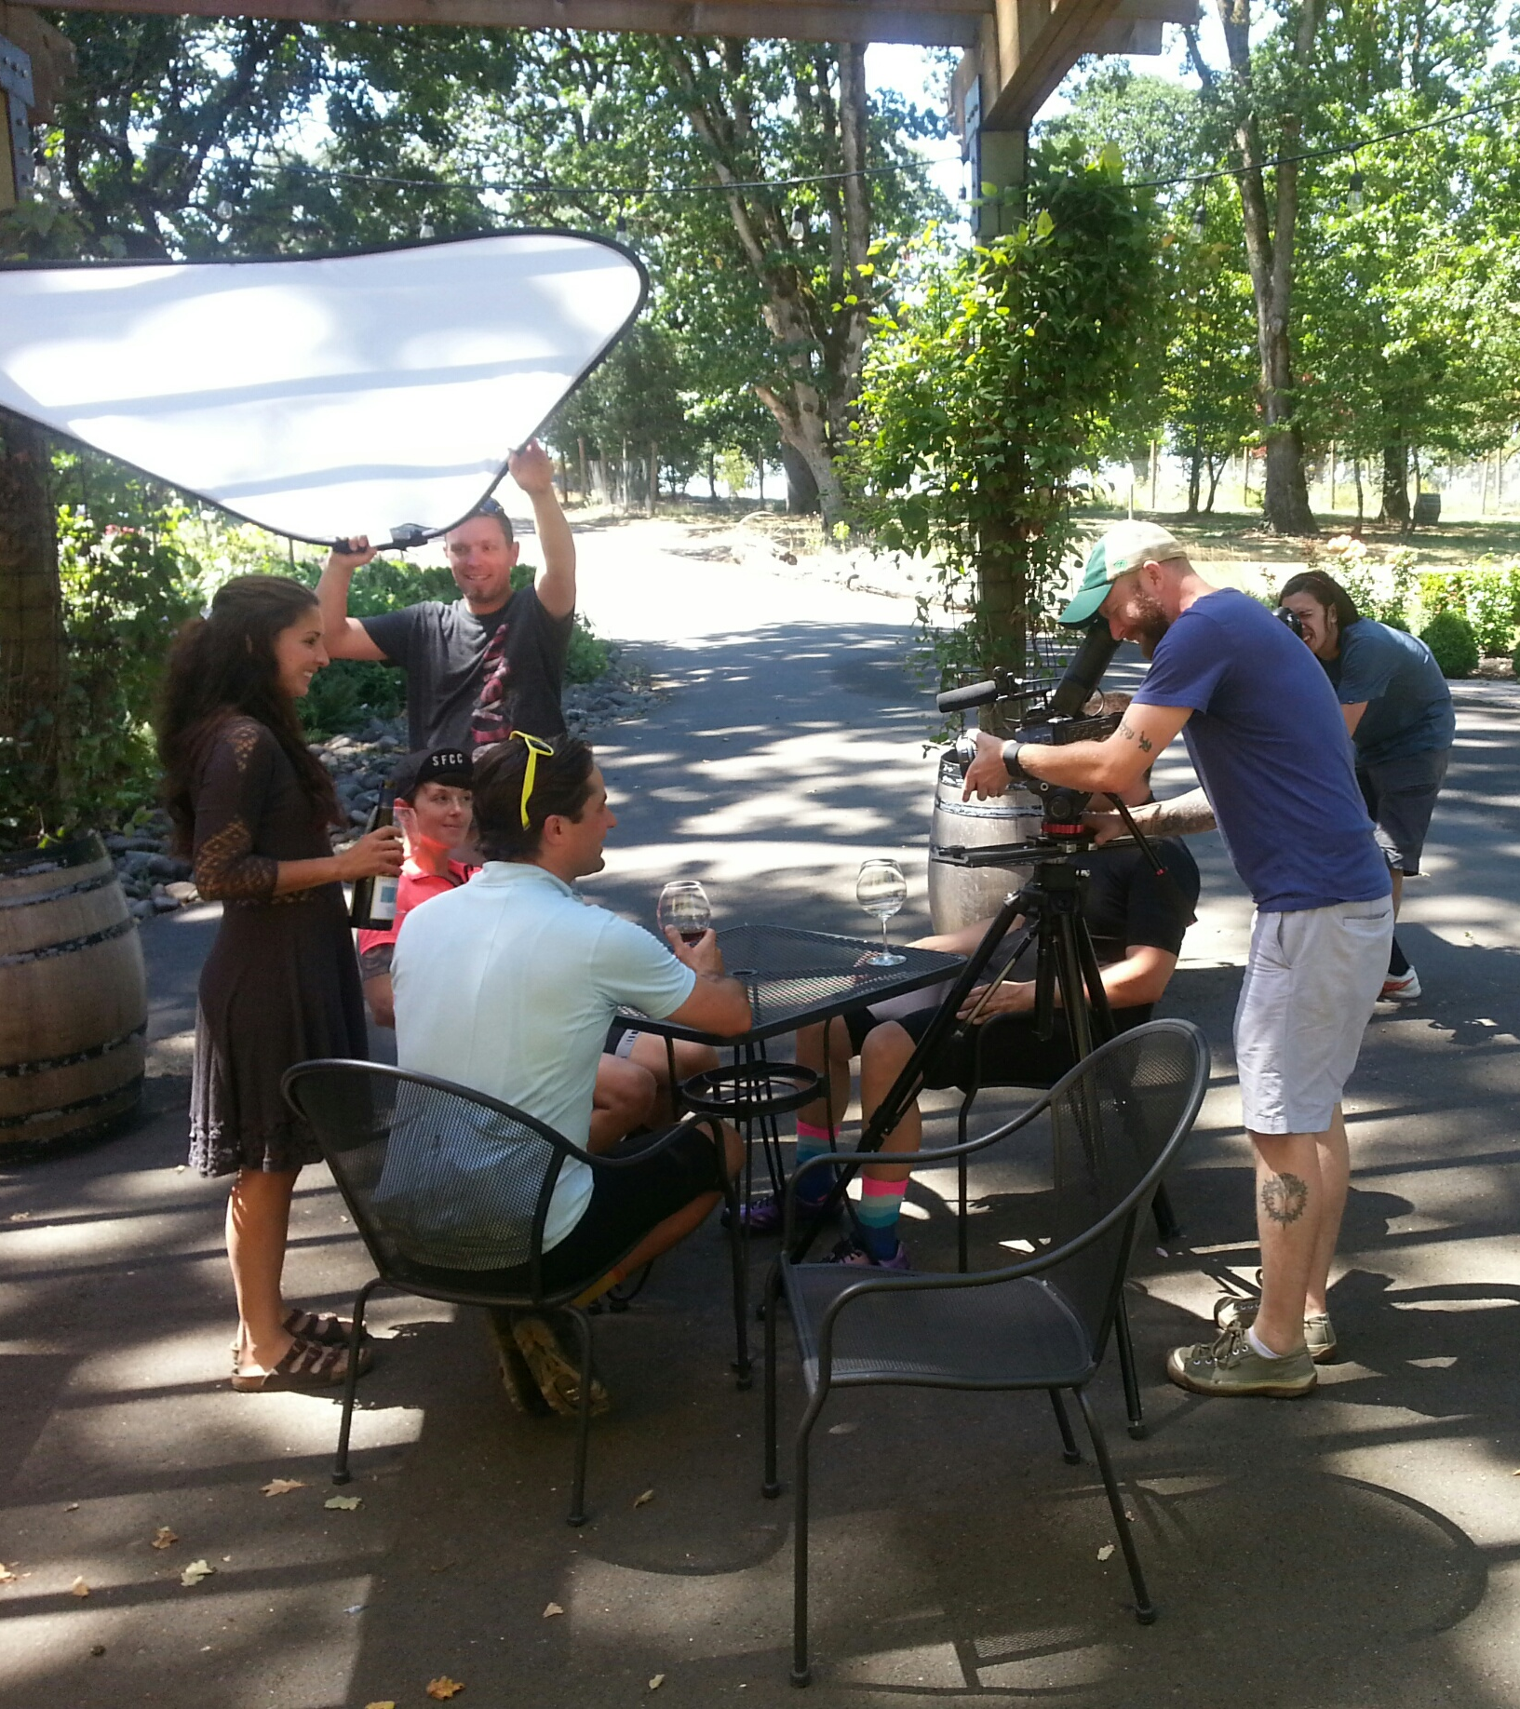
Polk Rural Tourism Studio
Initial planning group of ~35
Final Steering Committee of 12
Members representing anyone related to tourism – wineries, lodging, government, cycling, restaurant, PR, chamber, etc.
Lots of familiar faces and lots of new ones
Placed a heavy emphasis on outreach – it was critical to get lots of people to the sessions.
Not creating new destinations, connecting existing ones for greater impact

Slide 9
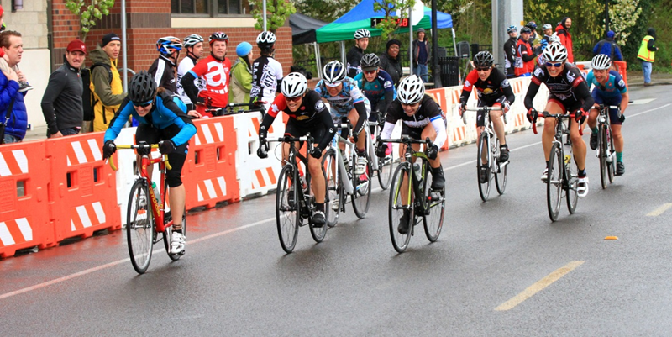
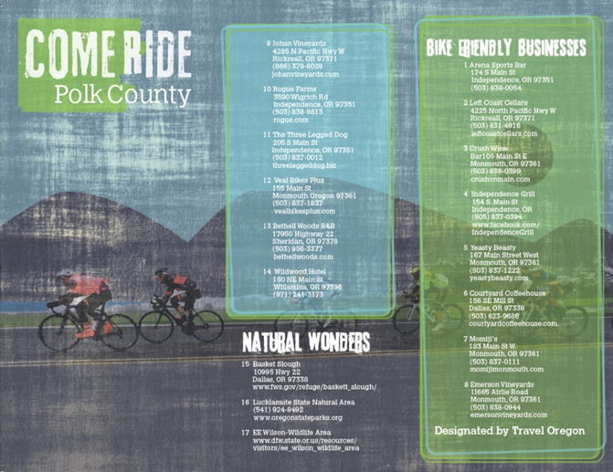
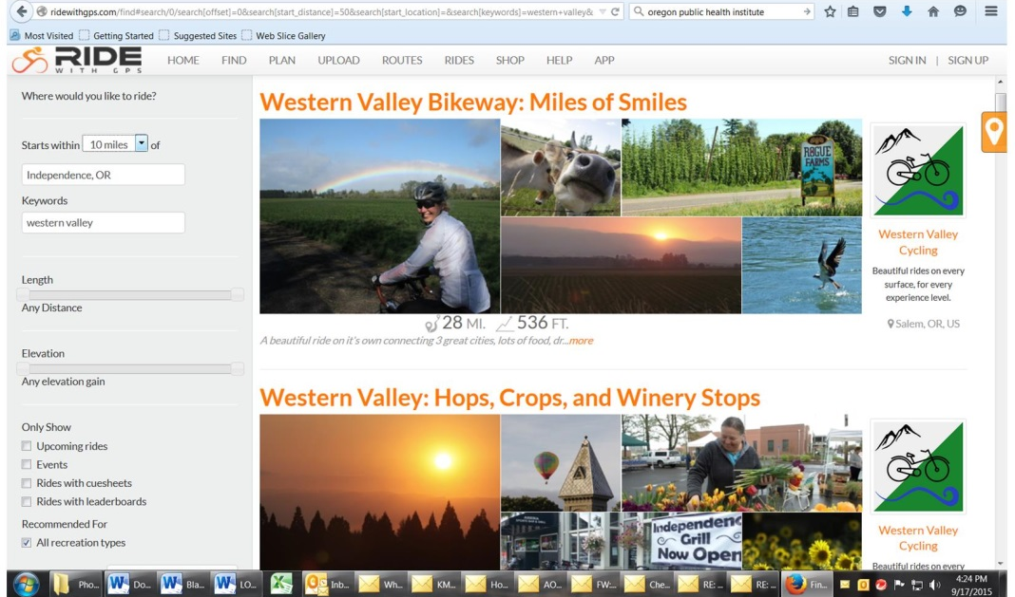

Slide 10
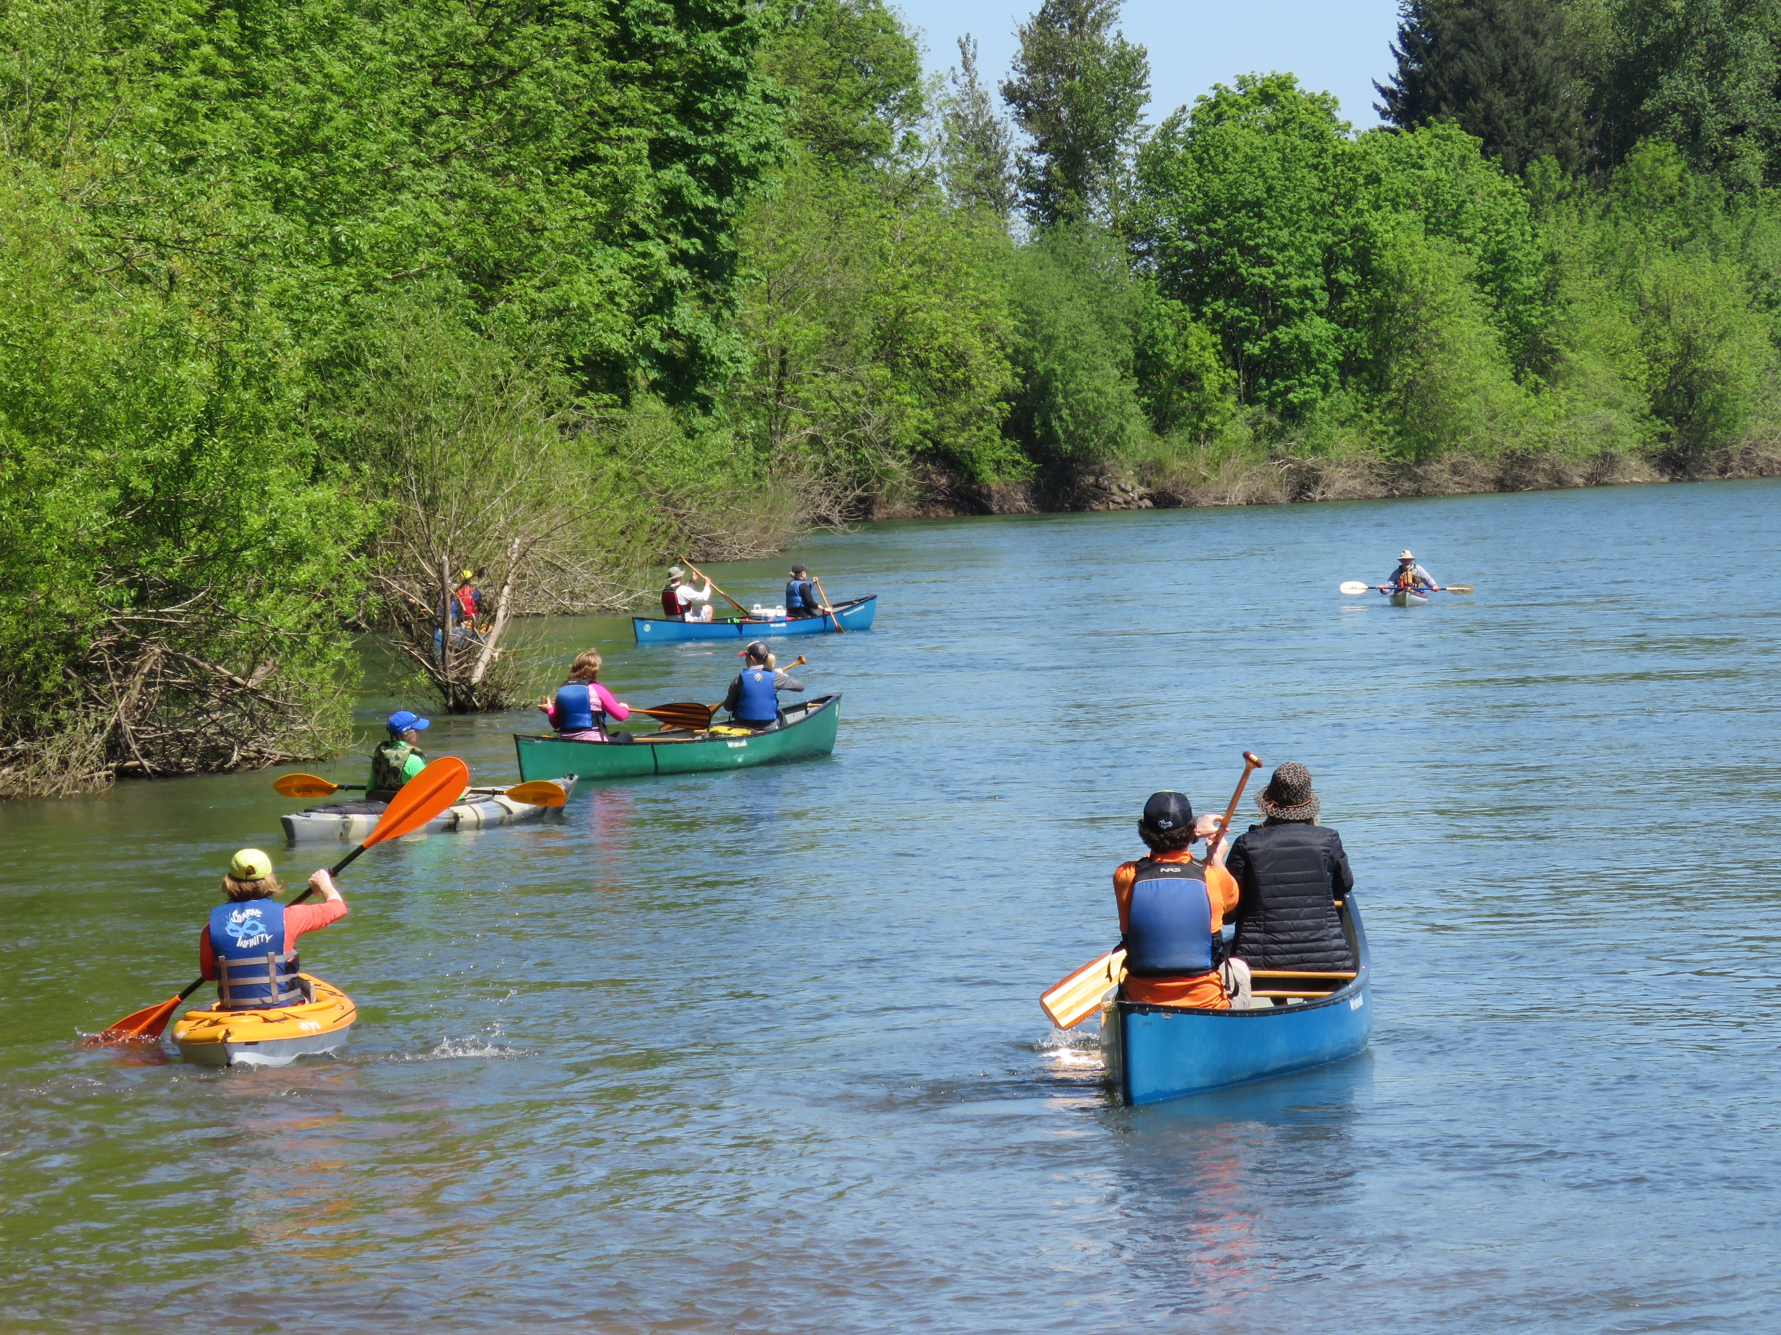
Notes:
commercial grade mesh network

Slide 11
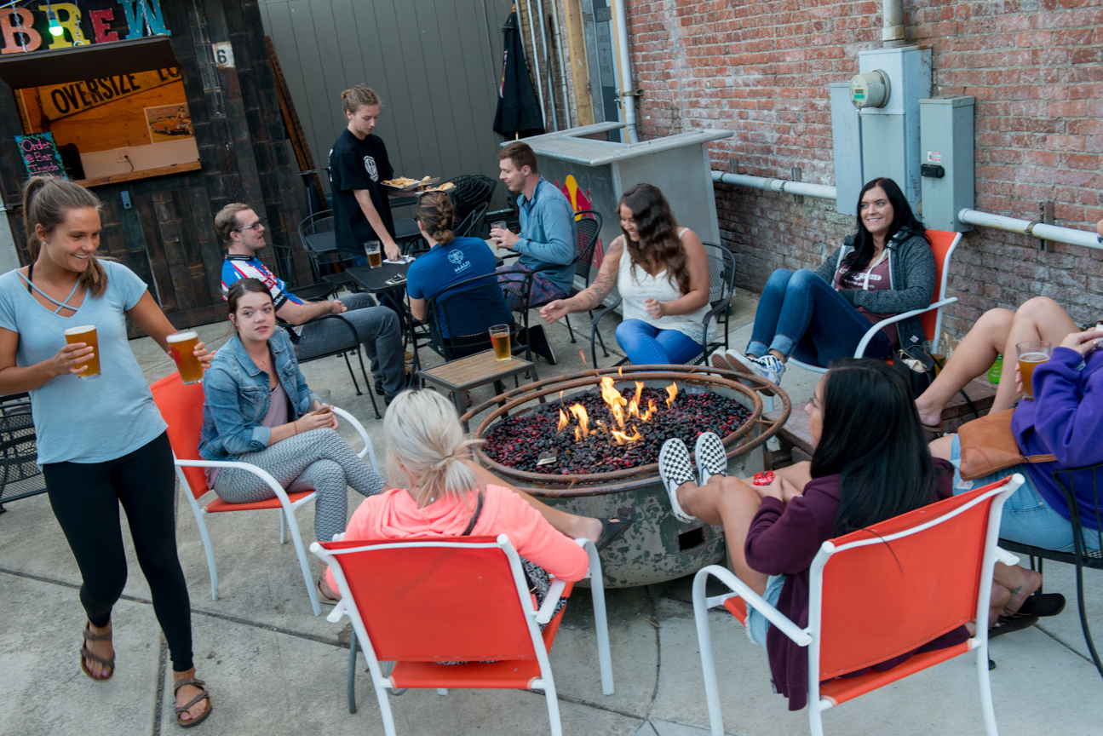
The real value is in the new connections
Create a core of energized people
Even those not actively participating can and will be called on when needed.
Don’t expect an immediate impact
You can do this yourself. Just start a conversation.
Notes:
This isn’t rocket science. The secret sauce is consistent effort

Slide 12
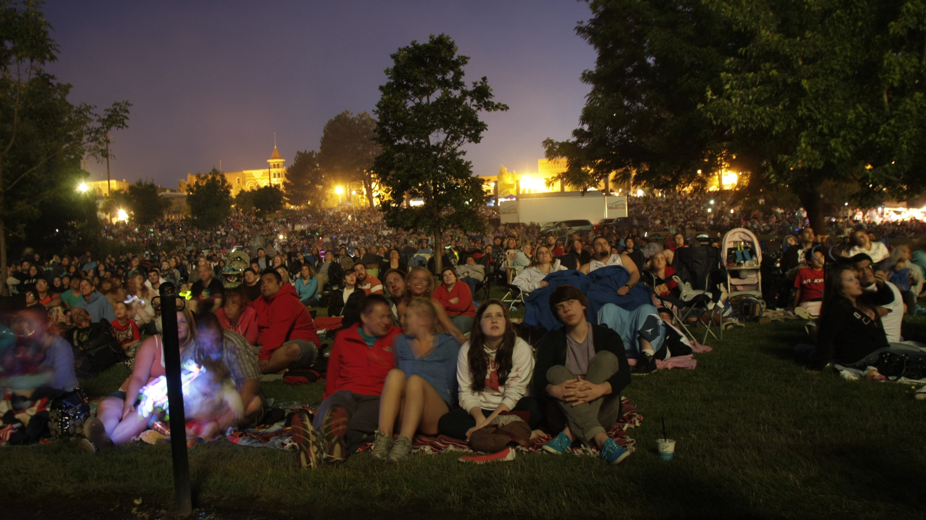
Leverage Local Events

Slide 13
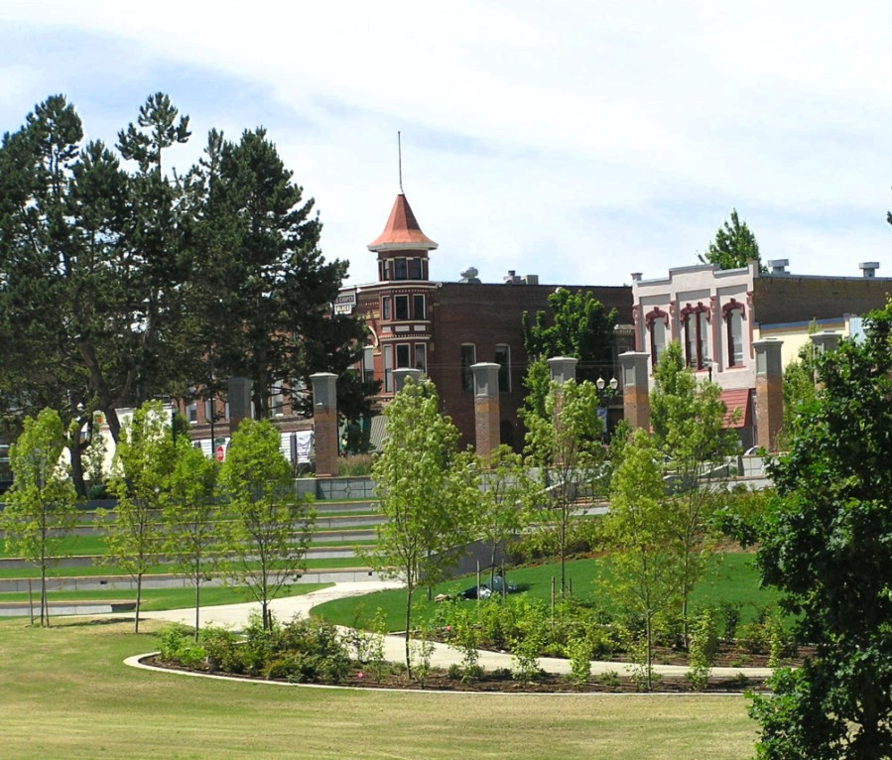
Takeaways
This isn’t rocket science
It does require consistent effort
Developing your message is critical
Work with your assets
Have fun with it!

Slide 14
Shawn Irvine
Economic Development Director
City of Independence
503-837-1191
sirvine@ci.independence.or.us

